Slide 1
MCB 5472
Psi BLAST, Perl: Arrays, Loops, Hashes
J. Peter Gogarten
Office: BPB 404
phone: 860 486-4061,
Email: gogarten@uconn.edu

Slide 2
Blast: find High Scoring Pairs between query and database of target sequences
Join neighboring HSPs into single gapped alignment (formerly known as gapped blast)
Report all HSPs (joined or not) between query and target sequence
Note: if your target is a single genome, all HSPs (joined or not) will be reported as a single match
Position Specific Iterated Blast: Find matches between PSSM and target
RPS (Reverse PSI) blast: find matches between query and database of PSSMs

Slide 3
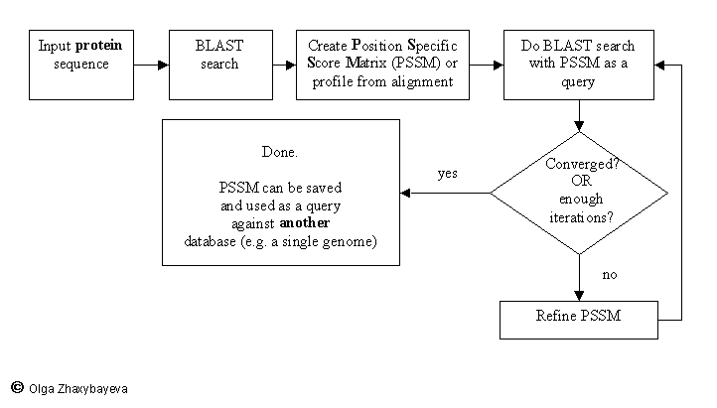
PSI BLAST scheme

Slide 4
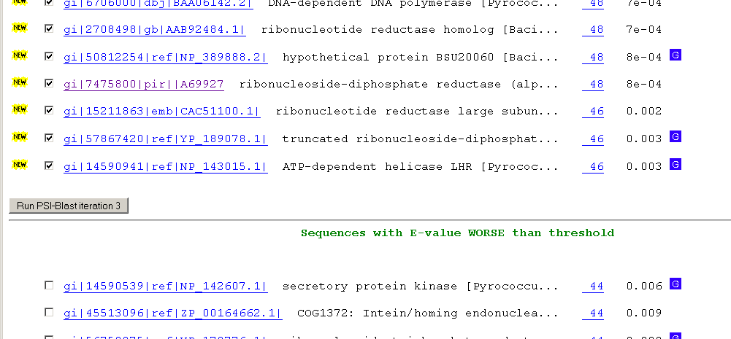
Psi-Blast Results
Query: 55670331 (intein)
link to sequence here, check BLink ☺

Slide 5
PSI BLAST and E-values!
Psi-Blast is for finding matches among divergent sequences (position-specific information) WARNING: For the nth iteration of a PSI BLAST search, the E-value gives the number of matches to the profile NOT to the initial query sequence! The danger is that the profile was corrupted in an earlier iteration.

Slide 6
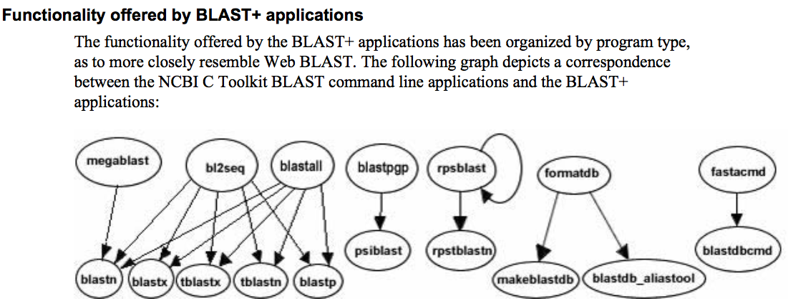
The NCBI has released a new version of blast. The command line version is blast+ .
The new version is faster and allows for more flexibility, but at present we still have problems with running it on the cluster.
The new commands are equivalent to the blastall commmands:

Slide 7
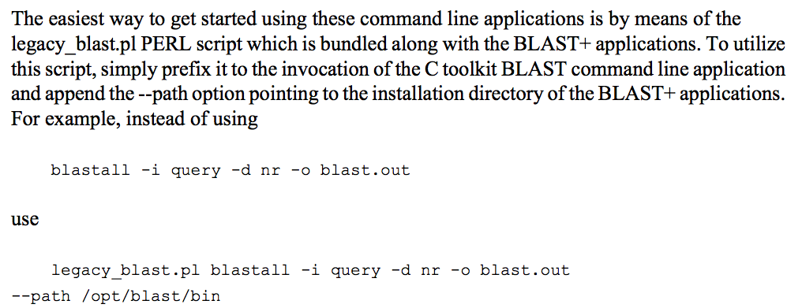
The legacy_blast.pl script that is part of blast+ translates blastall commands into the blast+ syntax. E.g.:
$ ./legacy_blast.pl megablast -i query.fsa -d nt -o mb.out --print_only
/opt/ncbi/blast/bin/blastn -query query.fsa -db "nt" -out mb.out $
From the blast+ manual:

Slide 8
PSI Blast from the command line
Often you want to run a PSIBLAST search with two different databanks - one to create the PSSM, the other to get sequences: To create the PSSM:
blastpgp -d nr -i subI -j 5 -C subI.ckp -a 2 -o subI.out -h 0.00001 -F f
blastpgp -d swissprot -i gamma -j 5 -C gamma.ckp -a 2 -o gamma.out -h 0.00001 -F f
Runs a 4 iterations of a PSIblast
the -h option tells the program to use matches with E <10^-5 for the next iteration, (the default is 10⁻³ )
-C creates a checkpoint (called subI.ckp),
-o writes the output to subI.out,
-i option specifies input as using subI as input (a fasta formated aa sequence).
The nr databank used is stored in /common/data/
-a 2 use two processors
(It might help to use the node with more memory (017)
(command is ssh node017)

Slide 9
To use the PSSM:
blastpgp -d /Users/jpgogarten/genomes/msb8.faa -i subI -a 2 -R subI.ckp -o subI.out3 -F f
blastpgp -d /Users/jpgogarten/genomes/msb8.faa -i gamma -a 2 -R gamma.ckp -o gamma.out3 -F f
Runs another iteration of the same blast search, but uses the databank /Users/jpgogarten/genomes/msb8.faa
-R tells the program where to resume
-d specifies a different databank
-i input file - same sequence as before
-o output_filename
-a 2 use two processors

Slide 10
PSI Blast and finding gene families within genomes
use PSSM to search genome at the nucleotide level:
Use protein sequences encoded in genome as target:
blastpgp -d target_genome.faa -i query.name -a 2 -R query.ckp -o query.out3 -F f
B) Use nucleotide sequence and tblastn. This is an advantage if you are also interested in pseudogenes, and/or if you don’t trust the genome annotation:
blastall -i query.name -d target_genome_nucl.ffn -p psitblastn -R query.ckp

Slide 11
Assignment 1: blastall
Histogram script replaced: working verison in scripts and linked in assignments #2
Do example on data in blasttest
Go through output –m9 and –m8
Go through extract_lines.pl
Open in Excel, save columns -> make histograms in R
Open workbook2 in 2004 Excel -> check %identity and # of identical residues

Slide 12
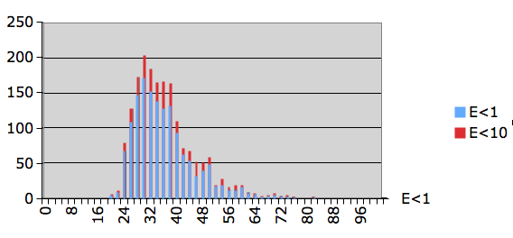
Histogram of percent identity for significant and insignificant hits

Slide 13
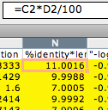
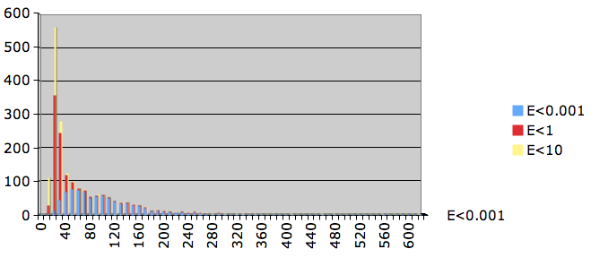
Number of identical residues for significant and insignificant hits

Slide 14
3) Write a short Perl script that calculates the circumference of a circle given a radius provided by the user.
The best way to find which module to use is google. You can search core modules at http://perldoc.perl.org/search.html?

Slide 15
Old Assignment for Monday
5)
For the following array declaration @myArray = ('A', 'B', 'C', 'D', 'E');
what is the value of the following expressions: $#myArray length(@myArray) $myArray[1] $n=@myArray reverse (@myArray)
Go through array-scalar example

Slide 17
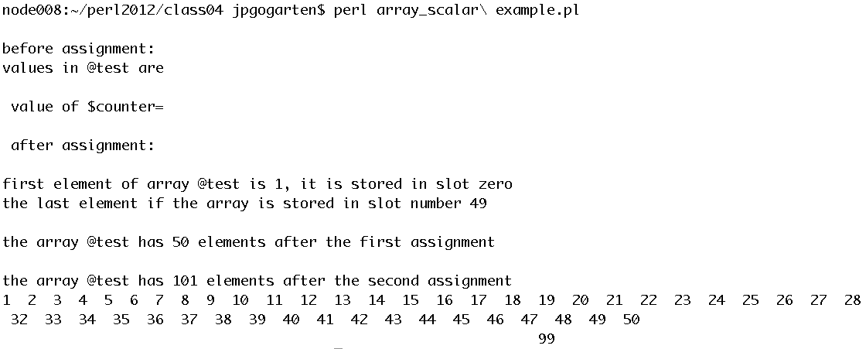

Slide 18
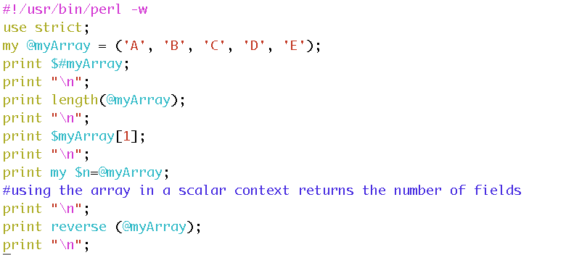
node008:~/perl2012/class04 jpgogarten$ perl myArrayEx.pl
4
1
B
5
EDCBA

Slide 19
Old Assignment for Monday
Write a 2 sentence outline for your student project
Read chapter P5 and P12 conditional statements and on “for, foreach, and while” loops. http://korflab.ucdavis.edu/Unix_and_Perl/unix_and_perl_v2.3.3.pdf
Background: @a=(0..50); # This assigns numbers from 0 to 50 to an array, # so that $a[0] =0; $a[1] =1; $a[50] =50
3) Write perl scripts that add all numbers from 1 to 50. Try to do this using at least two different control structures.
4) Create a program that reads in a sequence stored in a file handed to the program on the command line and determines GC content of a sequence. Use class3.pl as a starting point.

Slide 20
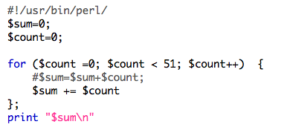
Control structures: Sum 1..50
while ( ) { }
for ( , , ) { }

Slide 21
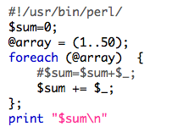
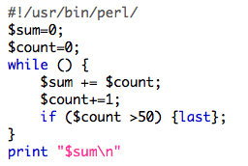
Control structures: Sum 1..50
foreach ( ) { };
Infinite loop with last:
while () {
if( ) {last};
};

Slide 22
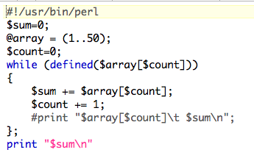
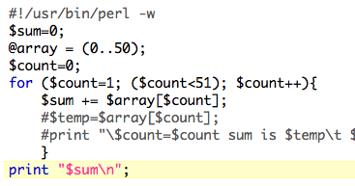
Control structures: Sum 1..50
while (defined ( )) { };
for ( , , ) { }
Counting elements of an array
Could have started at 0

Slide 23
6)
Create a program that reads in a sequence stored in a file handed to the program on the command line and determines GC content of a sequence.
Details in class3.pl. See the challenge!

Slide 24
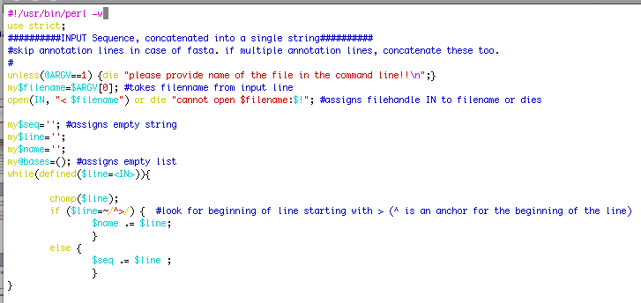
%GC counter, part A: read in seqs

Slide 25
%GC counter, part B: move seqs to array

Slide 26
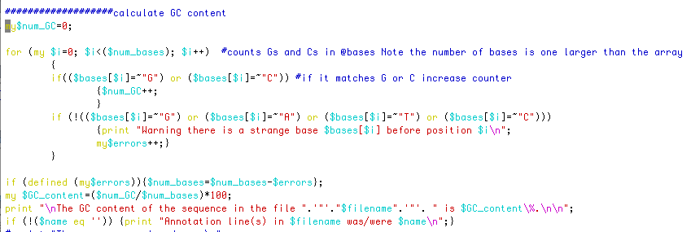
%GC counter, part B: calculate %GC

Slide 27
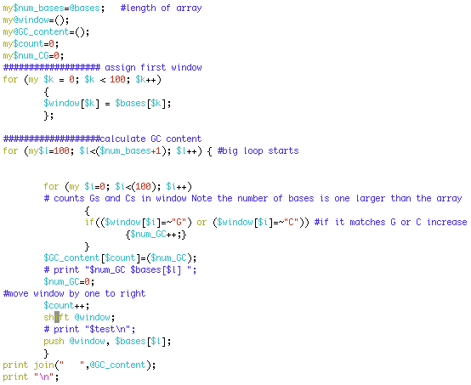
Challenge: GC counter in rolling window

Slide 28
For Next Monday
Write a script that reads in a sequence and prints out the reverse complement.
Modify your script to that it can handle a sequence that goes over several lines.
Background: $comp =~ tr/ATGC/TACG/; #translates every A in $comp into a T; every T into an A; every G into a C and every C into a G
Read P 14 on hashes, write the program suggested in the chapter (P14.1-P14.3).

Slide 29
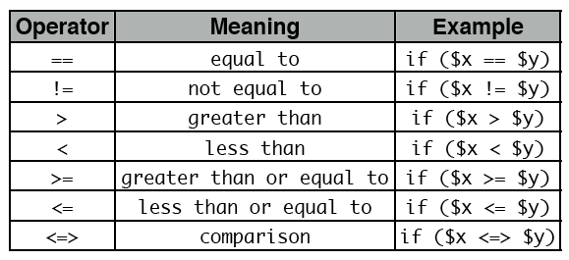
For Monday
Do the following statements evaluate to true or false? (Check P5)
1
0 && 1
0||1
45
45-45
45/45
45==45
45<=>45
45<=50 from http://korflab.ucdavis.edu/Unix_and_Perl/unix_and_perl_v2.3.3.pdf
55>=50
50<=>70
45!=45
45!=50

Slide 30
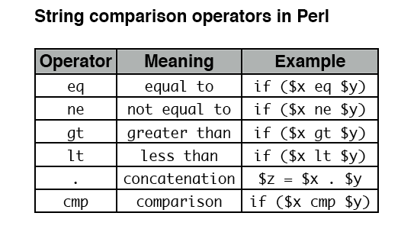
from http://korflab.ucdavis.edu/Unix_and_Perl/unix_and_perl_v2.3.3.pdf

Slide 31
Most of the smaller assignments should be solvable within half an hour. Using the notes, the text book and the internet try to solve one problem for not more than one hour. Then ask me, or Kristen, or Erica for help.
In total, the assignments for one week might take a few hours, but if it goes beyond 5 hours total, ask for help, or hand in the latest version of your attempt to solve the assignment. Sometimes, a little help can go a long way. The main reason for the assignments is to make you actually write code and to learn form the mistakes you make.

Slide 32
Hashes are tables that relate keys and values.
(in the array the number of the field could be considered the key: @a=(1..51) => $a[0]=1, $a[50]=51 )
In a %ash the entry for the key is the address where the value is stored.
E.g., you could have a hash where the students age is stored as value and the student ID is the key.
But you also could use the students name as key and the ID or age or …. as value. This works very economically, especially if the table is sparse. my (%studentID, %student_first_name, %studentGPA);$studentID{gogarten}=9999;
$student_first_name{gogarten}=‘Johann Peter’;
$studentGPA{gogarten}=“nd”;
In many instances you need to make sure that the key you want to use has not yet been assigned. If (exists ($studentID{gogarten}) {};
Go through class 4.pl
http://gogarten.uconn.edu/mcb5472_2012/class4.pl
http://gogarten.uconn.edu/mcb5472_2012/gi_list.txt

