Slide 1
Bioinformatics Resources at UCONN
Vijender Singh
vijender.singh@uconn.edu
cbcsupport.uconn.edu
Institute for Systems Genomics:
Computational Biology Core
bioinformatics.uconn.edu

Slide 2
High-performance computing (HPC)
HPC/Cluster Introduction
HPC/Cluster architecture
HPC/Cluster resources for bioinformatics
Getting an account and Connecting to cluster
Batch jobs vs interactive jobs
Cluster etiquette. Troubleshooting/getting help
Institute for Systems Genomics:
Computational Biology Core
bioinformatics.uconn.edu

Slide 3
Computational Biology Core
https://bioinformatics.uconn.edu/
Institute for Systems Genomics:
Computational Biology Core
bioinformatics.uconn.edu

Slide 4
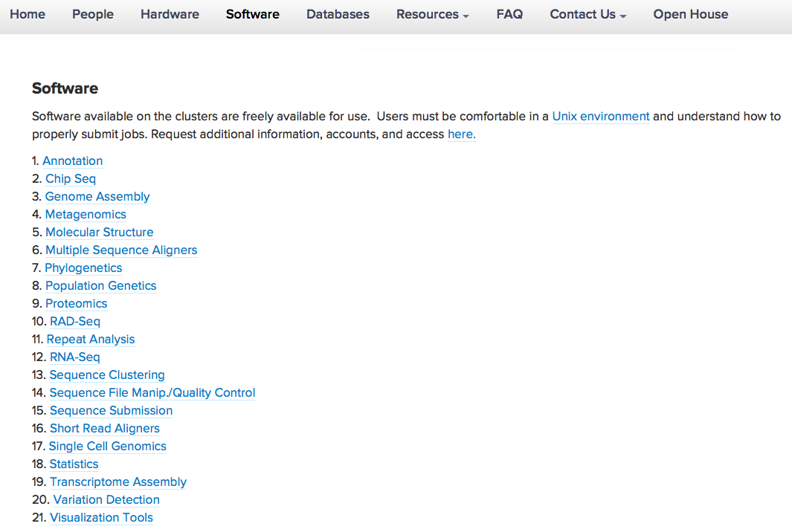
CBC: Software
Two Clusters (Free Accounts)
BBC and HPC1 with core Bioinformatics Applications
300 Applications Supported on BBC
Open Source
Variety of Genetics, Genomics, and Proteomics Analysis

Slide 5
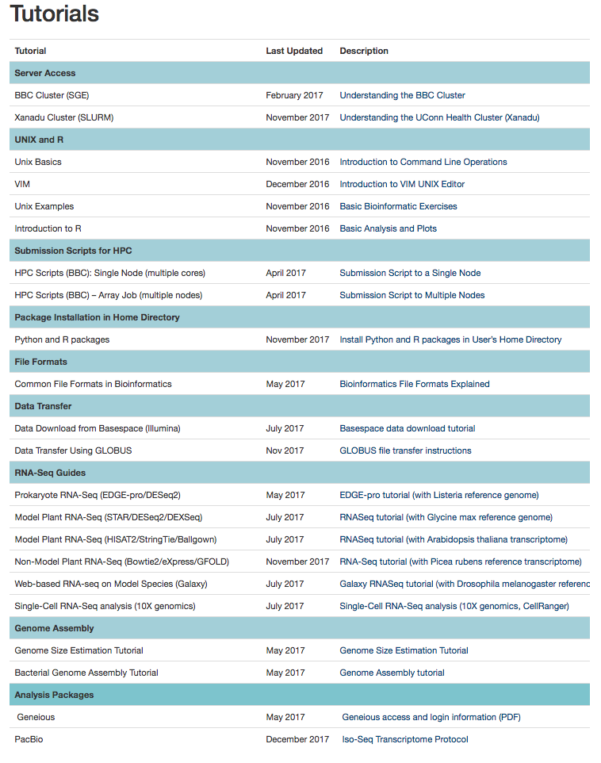
CBC: Tutorials
Custom Guides:
Interacting with the Cluster
Analysis and Viz with R!
RNA-Seq
Genome Assembly
More on the way!

Slide 6
High-performance computing (HPC)

Slide 7
High-performance computing (HPC)
Development of models begins at small scale.
Working on your laptop is convenient, simple.
Actual analysis, however is slow.
“Scaling up” typically means a small server or fast multi-core desktop.
Speed exists, but for very large models, not significant.
Single machines don’t scale up forever.
Institute for Systems Genomics:
Computational Biology Core
bioinformatics.uconn.edu

Slide 8
High-performance computing (HPC)
For the larger problems/models, a different approach is required
Institute for Systems Genomics:
Computational Biology Core
bioinformatics.uconn.edu

Slide 9
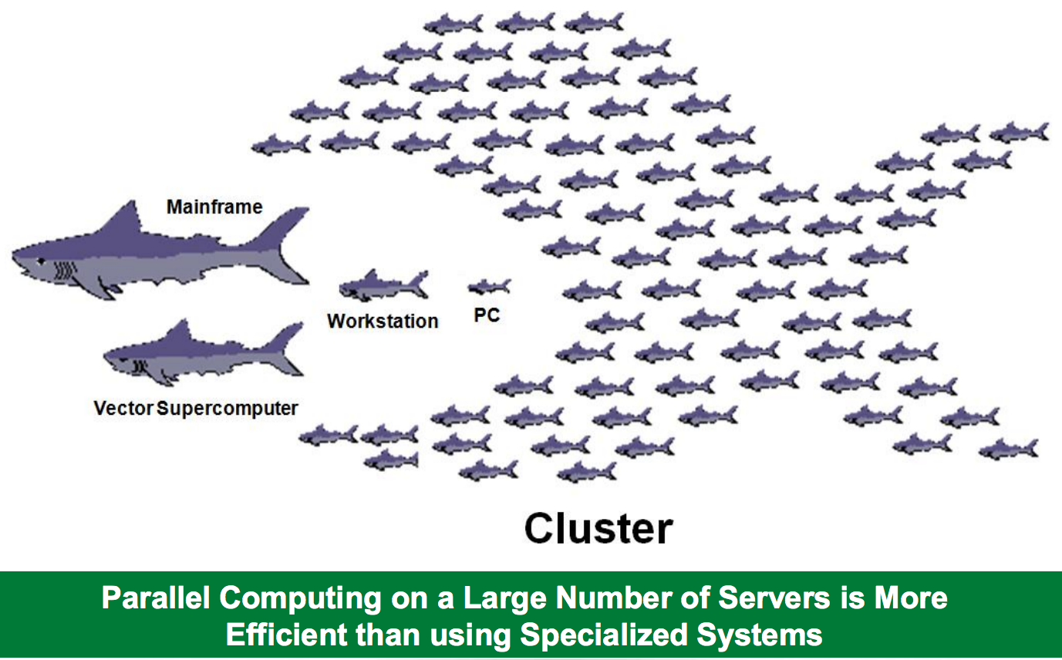
Institute for Systems Genomics:
Computational Biology Core
bioinformatics.uconn.edu

Slide 10
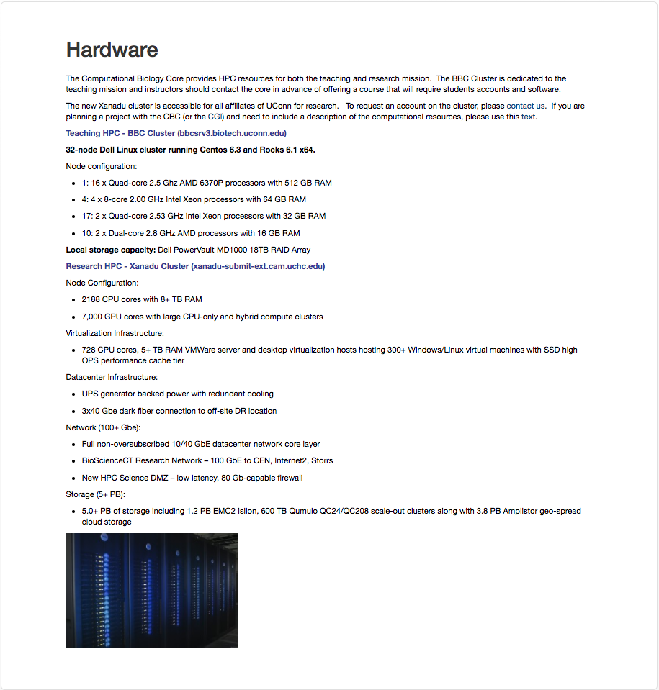
CBC: Hardware
Two Clusters (Free Accounts)
BBC – Research and Teaching
Xanadu – Research and Advance analytics
Institute for Systems Genomics:
Computational Biology Core
bioinformatics.uconn.edu

Slide 11
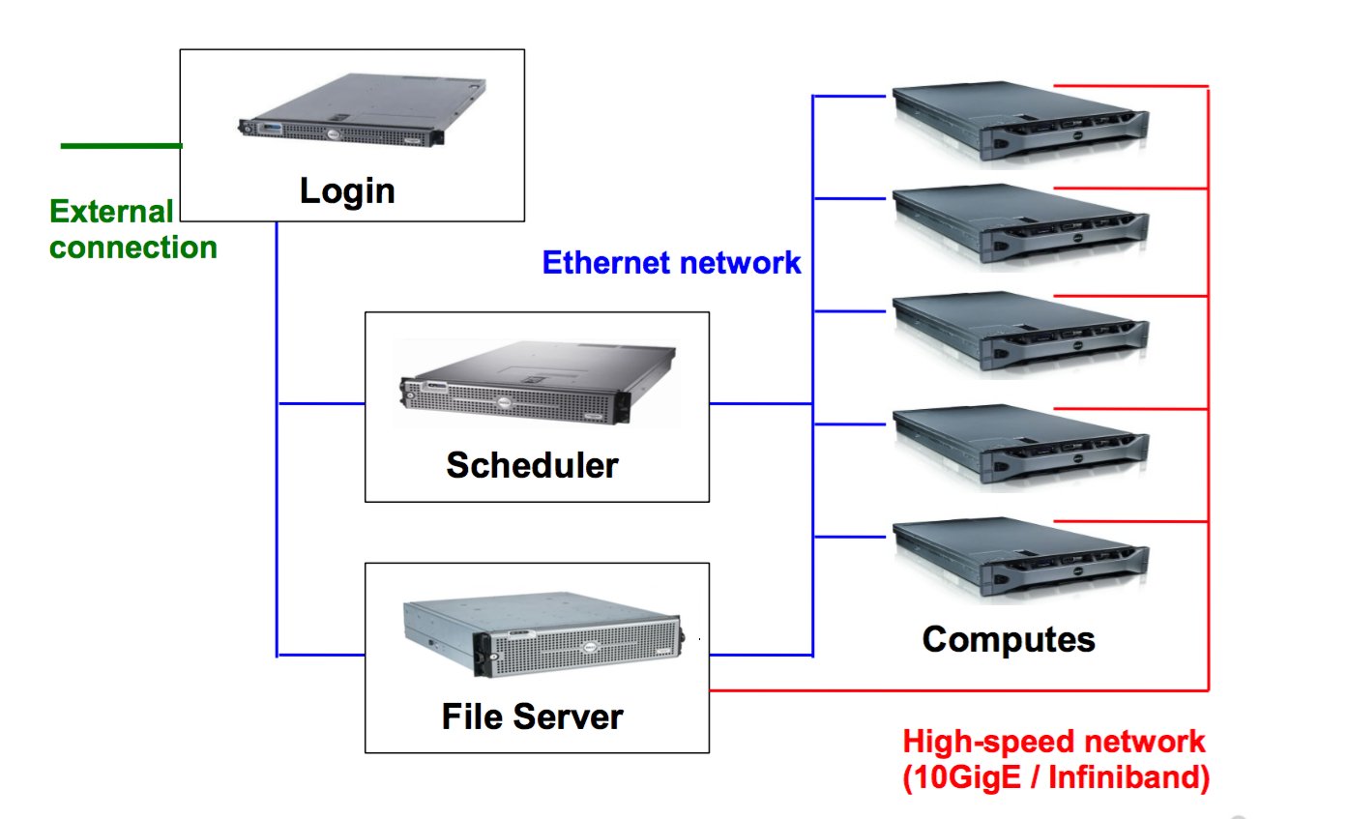
HPC architecture
Head Node/Submit Node /Login Node
SGE:
Sun Grid Engine
PBS:
Portable Batch System
SLURM:
Simple Linux Utility for
Resource Management
SGE
PBS
SLURM
Compute Nodes
/$HOME
/storage / System files etc
Institute for Systems Genomics:
Computational Biology Core
bioinformatics.uconn.edu

Slide 12
HPC architecture : BBC
Head Node: bbcsrv3.biotech.uconn.edu
SGE:
Sun Grid Engine
SGE
Compute Nodes
/$HOME (Only for very small files)
/tempdata3 (Ananlyse and store data here for short term )
Institute for Systems Genomics:
Computational Biology Core
bioinformatics.uconn.edu

Slide 13
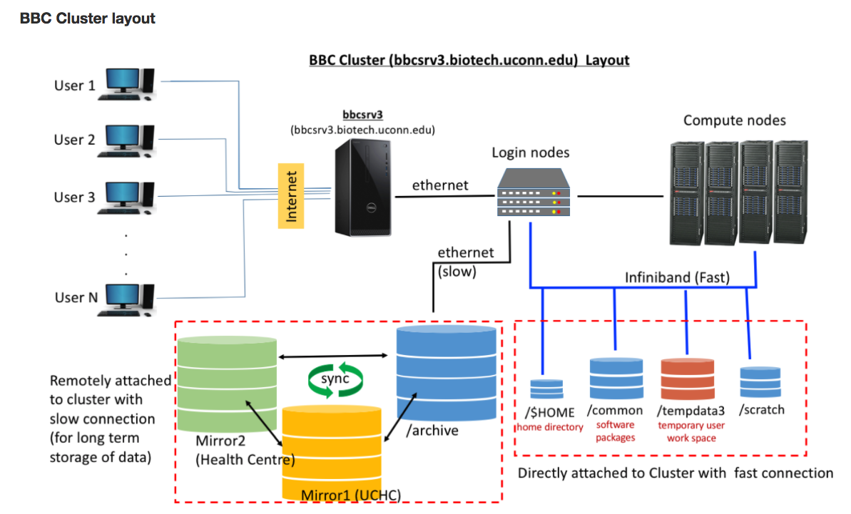
Institute for Systems Genomics:
Computational Biology Core
bioinformatics.uconn.edu

Slide 14
HPC architecture : BBC (Queue info )
Queue
course.q
all.q
highpri.q
lowpri.q
highmem.q
molfind.q
2 x Quad-core
2.53 GHz Intel Xeon processors
32 GB RAM
2 x Quad-core
2.53 GHz Intel Xeon processors
32 GB RAM
Head Node
4 x 8-core
2.00 GHz Intel Xeon processors
64 GB RAM
2 x Quad-core
2.53 GHz Intel Xeon processors
36 GB RAM
16 x Quad-core = 64 cores
2.5 Ghz AMD 6370P processors
512 GB RAM
2 x Dual-core
2.8 GHz AMD processors
16 GB RAM
Institute for Systems Genomics:
Computational Biology Core
bioinformatics.uconn.edu

Slide 15
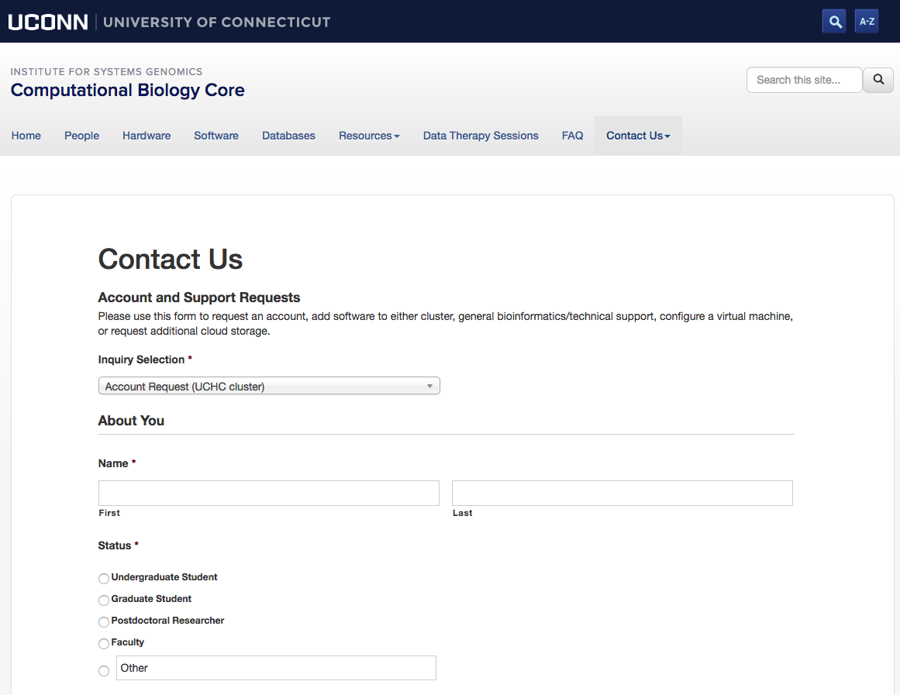
HPC at UCONN
BBC (Storrs): SGE - Research and Teaching
Xanadu (UCH): SLURM - Advanced research
Institute for Systems Genomics:
Computational Biology Core
bioinformatics.uconn.edu

Slide 16
Connecting to BBC
Mac : Terminal : ssh username@bbcsrv3.biotech.uconn.edu
Windows : Putty
Open Putty it will open window1.
Provide host name e.g. username@bbcsrv3.biotech.uconn.edu
Expand SSH tab and select X11 (shown in window2)
Enable X11 forwarding by selecting it. (window2)
Scroll up the left panel and select Session.(window1)
Name your session e.g. BBC_cluster and click save tab to save.
Your session name should appear in saved sessions.
Double click on your session name to connect to server with SSH session.
Institute for Systems Genomics:
Computational Biology Core
bioinformatics.uconn.edu

Slide 17
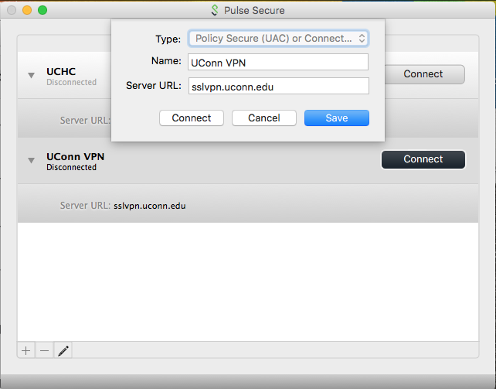
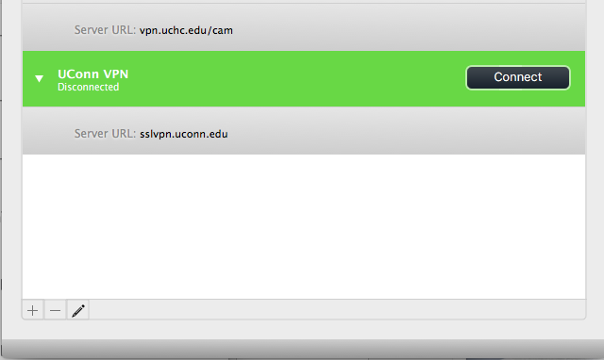
Connecting to BBC
Login: From outside the network (submit-ext node)
Use VPN (Open Pulse secure)
Open Pulse secure
Add new connection
Set Server URL to : sslvpn.uconn.edu
Save
Connect and login with NetID and Passwd
Institute for Systems Genomics:
Computational Biology Core
bioinformatics.uconn.edu

Slide 18
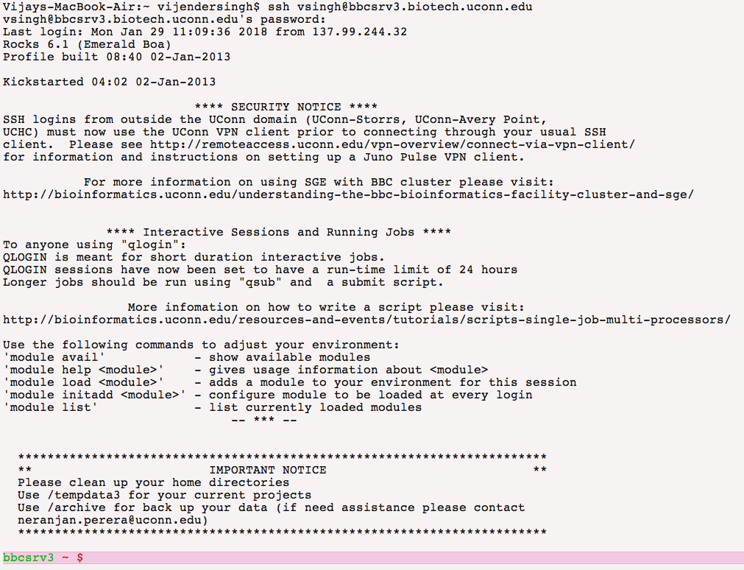
Connecting to BBC
Head Node: ssh <user_name>@bbcsrv3.biotech.uconn.edu
Login: (using terminal on mac)
Institute for Systems Genomics:
Computational Biology Core
bioinformatics.uconn.edu

Slide 19
Software/tool/packages on cluster
Environment Modules:
The Environment Modules package provides for the dynamic modification
of a user's environment via module files.
module avail : List modules that are available
module load modulefile : Loads the module to user environment
module list : List modules that are loaded
module unload modulefile : unloads module from user environment
module display modulefile : Displays information on module
swap [modulefile1] modulefile2 :Switch loaded modulefile1 with modulefile2.
Institute for Systems Genomics:
Computational Biology Core
bioinformatics.uconn.edu

Slide 20
BBC Resources
Institute for Systems Genomics:
Computational Biology Core
bioinformatics.uconn.edu

Slide 21
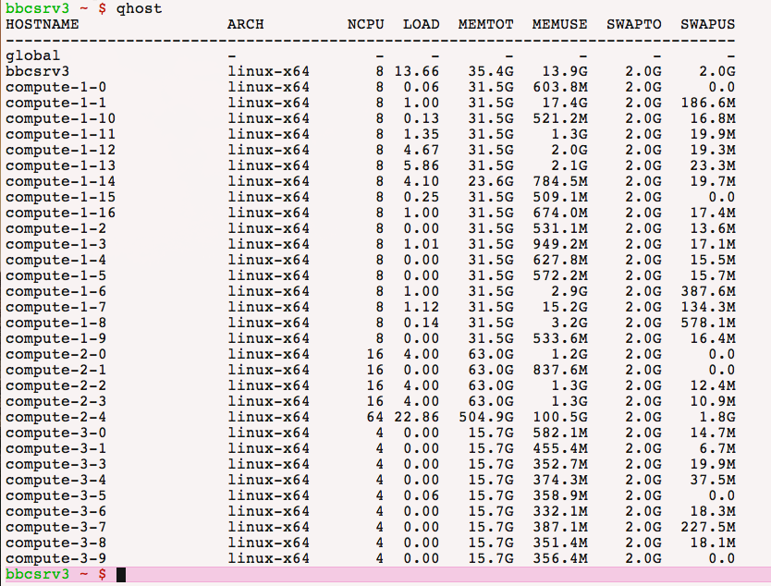
BBC Resources
Institute for Systems Genomics:
Computational Biology Core
bioinformatics.uconn.edu

Slide 22
BBC Resources
Head Node
Interactive session : Compute Node
Institute for Systems Genomics:
Computational Biology Core
bioinformatics.uconn.edu

Slide 23
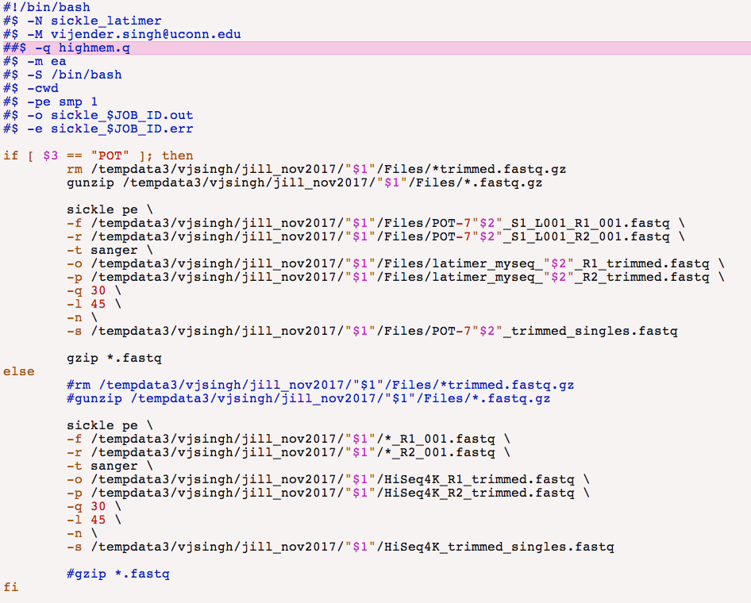
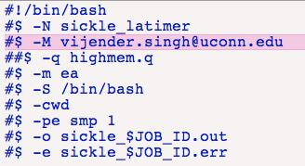
BBC Resources
Batch job/ Script job
Institute for Systems Genomics:
Computational Biology Core
bioinformatics.uconn.edu

Slide 24
BBC Etiquette
Never run anything on the head node of a cluster.
Keep track of what you are running and refrain from using all nodes at the same time.
Run and write your output files on scratch drive or /tempdata3. Then copy the file back to your home directory or /archive.
Institute for Systems Genomics:
Computational Biology Core
bioinformatics.uconn.edu

Slide 25
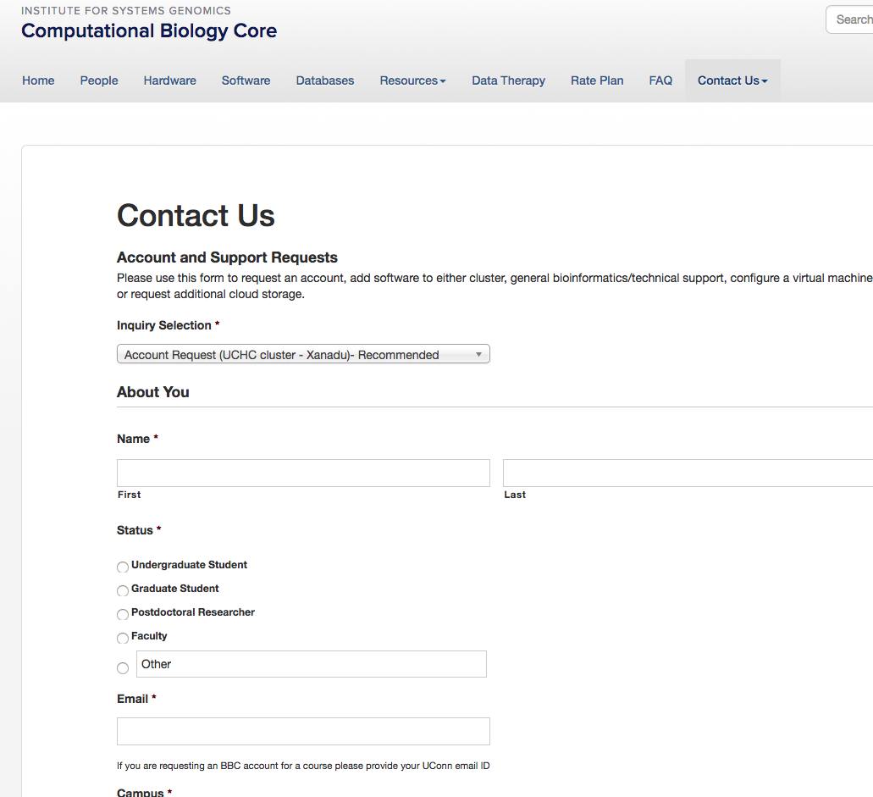
BBC Troubleshooting and getting help
Option 1
Option 3
Option 2
Email: cbcsupport.uconn.edu
Package info (version)
Command or script location
Error report
Associated datafile location
Institute for Systems Genomics:
Computational Biology Core
bioinformatics.uconn.edu

Slide 26
Questions ?

