Slide 1
dN/dS

Slide 2
Testing for selection using dN/dS ratio
dN/dS ratio (aka Ka/Ks or ω (omega) ratio) where
dN = number of non-synonymous substitutions /
number of all possible non-synonymous substitutions
dS = number of synonymous substitutions /
number of all possible synonymous substitutions
dN/dS >1 positive, Darwinian selection
dN/dS =1 neutral evolution - THIS IS THE USUAL NULL HYPOTHESIS
dN/dS <1 negative, purifying selection - THIS IS TRUE FOR MOST CODONS
Notes:
The synonymous and non-synonymous rates dN and dS are defined as the numbers of synonymous and nonsynonymous substitutions per site. The ratio of the two rates omega=dN/dS then measures selective pressure at the protein level. If selection level has no effect on fitness, nonsynonymous mutations will be fixed at the same rate as synonymous mutations so that dN=dS and omega=1. If nonsynonymous mutations are deleterious purifying selection will reduce their fixation rate so that dN<dS and omega<1. If nonsynonymous mutations are favored by Darwinian selection, they will be fixed at a higher rate than synonymous mutations resulting in dN>dS and omega>1.

Slide 3
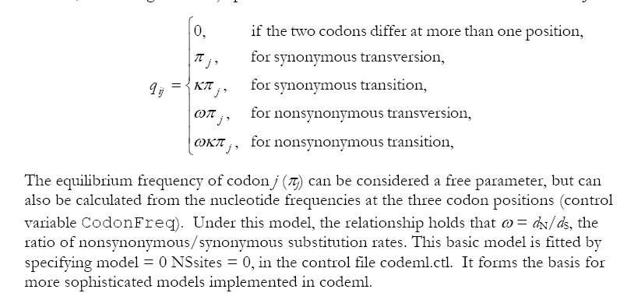
PAML (codeml) the basic model
Paml is available from the author at
http://abacus.gene.ucl.ac.uk/software/paml.html

Slide 4

sites versus branches
You can determine omega for the whole dataset; however, usually not all sites in a sequence are under selection all the time.
PAML (and other programs) allow to either determine omega for each site over the whole tree, ,
or determine omega for each branch for the whole sequence,
.
It would be great to do both, i.e., conclude codon 176 in the vacuolar ATPases was under positive selection during the evolution of modern humans – alas, a single site often does not provide much statistics.
PAML does provide a branch site model.

Slide 5
PAML – codeml – sites model (cont.)
the program is invoked by typing codeml followed by the name of a control file that tells the program what to do.
paml can be used to find the maximum likelihood tree, however, the program is rather slow. Phyml is a better choice to find the tree, which then can be used as a user tree.
An example for a codeml.ctl file is codeml.hv1.sites.ctl
This file directs codeml to run three different models:
one with an omega fixed at 1, a second where each site can be either have an omega between 0 and 1, or an omega of 1, and third a model that uses three omegas as described before for MrBayes.
The output is written into a file called Hv1.sites.codeml_out (as directed by the control file).
Point out log likelihoods and estimated parameter line (kappa and omegas)
Additional useful information is in the rst file generated by the codeml

Slide 6
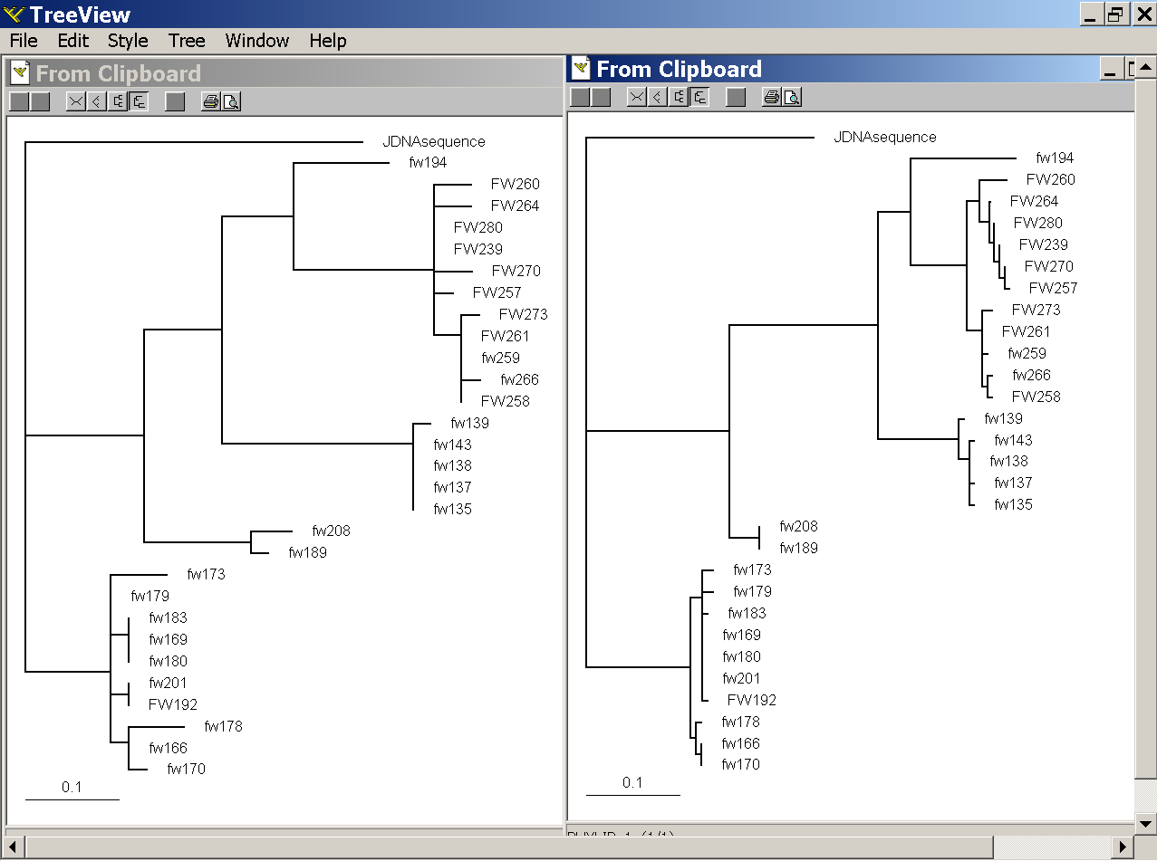
PAML – codeml – branch model
dS -tree
dN -tree

Slide 7
where to get help
read the manuals and help files
check out the discussion board at
https://www.ucl.ac.uk/discussions/viewforum.php?f=54
pal2nal: http://www.bork.embl.de/pal2nal/
else
there is a new program on the block called hy-phy
(=hypothesis testing using phylogenetics).
The easiest is probably to run the analyses on the authors datamonkey.

Slide 8
Illustration of a biased random walk
Image generated with Paul Lewis's MCRobot
Figure generated using MCRobot program (Paul Lewis, 2001)

Slide 9
sites model in MrBayes
The MrBayes block in a nexus file might look something like this:
begin mrbayes;
set autoclose=yes;
lset nst=2 rates=gamma nucmodel=codon omegavar=Ny98;
mcmcp samplefreq=500 printfreq=500;
mcmc ngen=500000;
sump burnin=50;
sumt burnin=50;
end;

Slide 10
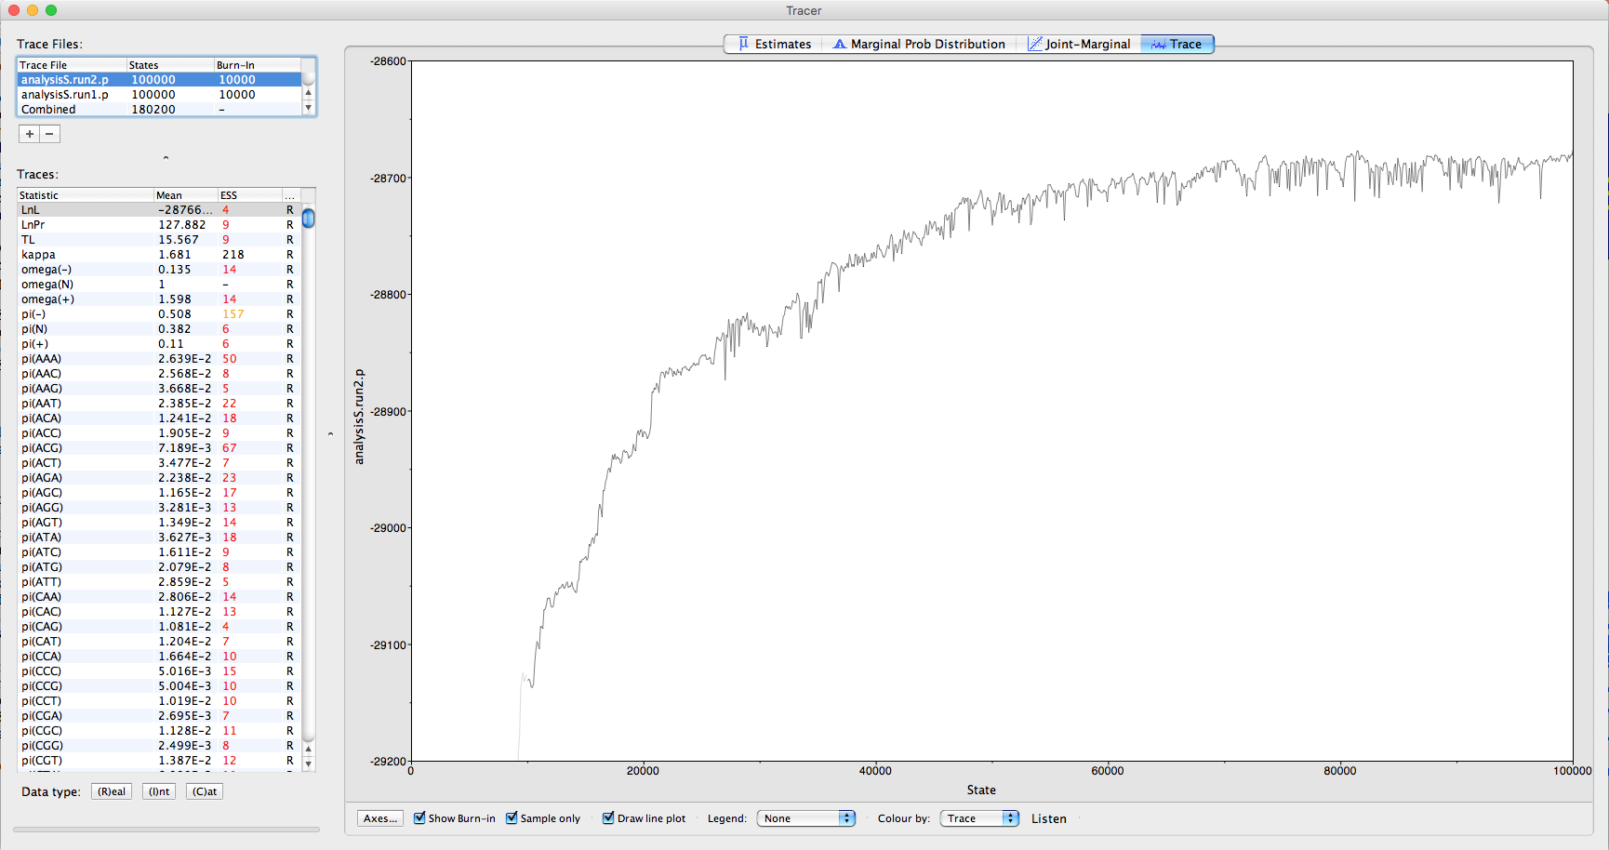

Slide 11
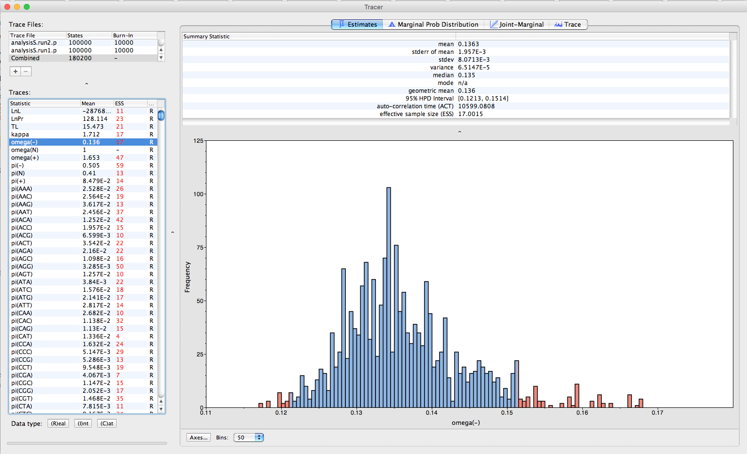

Slide 12
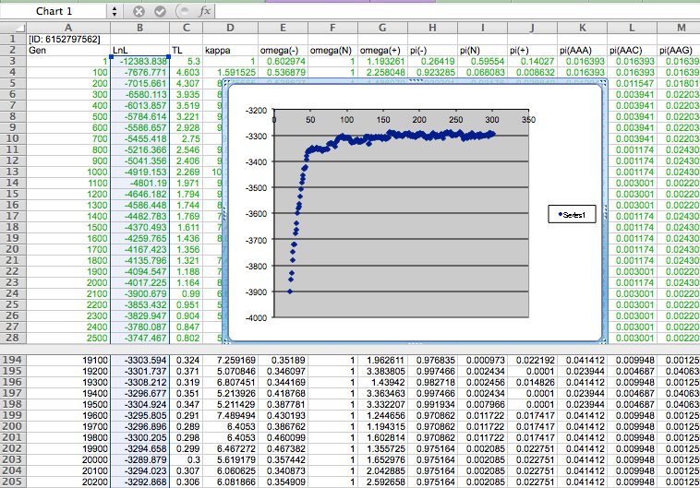

Slide 13
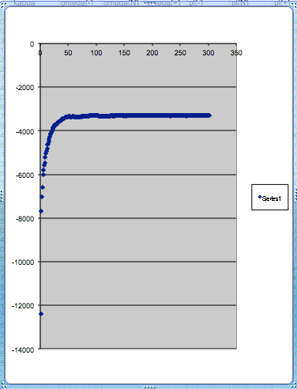
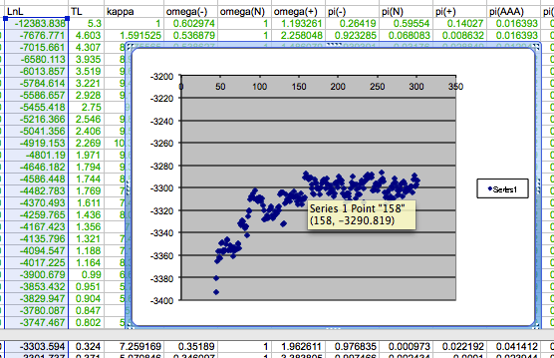
plot LogL to determine which samples to ignore
the same after rescaling the y-axis

Slide 14
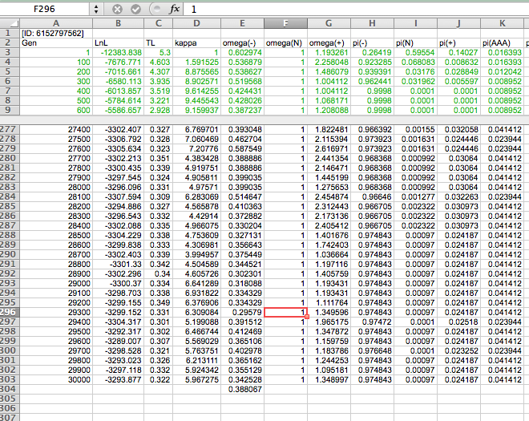

Slide 15
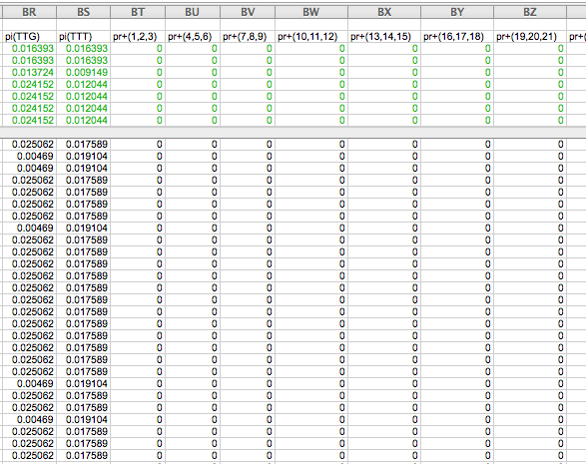

Slide 16
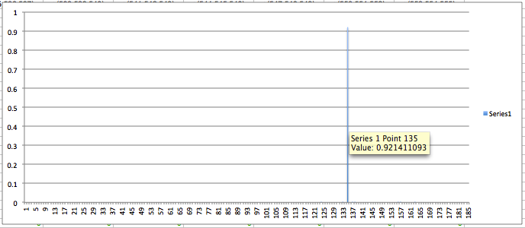
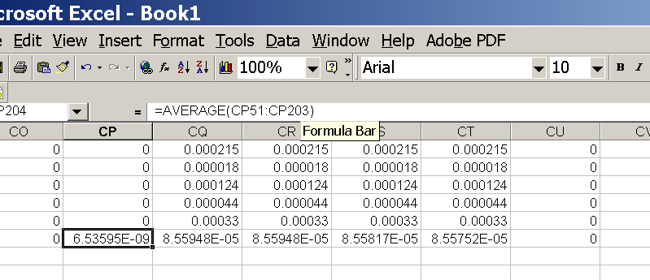
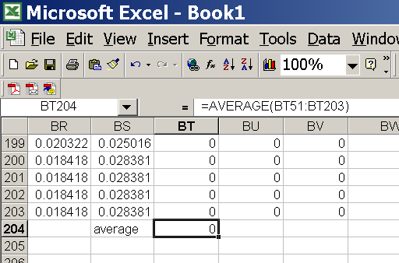
for each codon calculate the the average probability
copy paste formula
plot row
enter formula

Slide 17
LAGLIDAG motifs are at codon 232-243 and 442-451

Slide 18
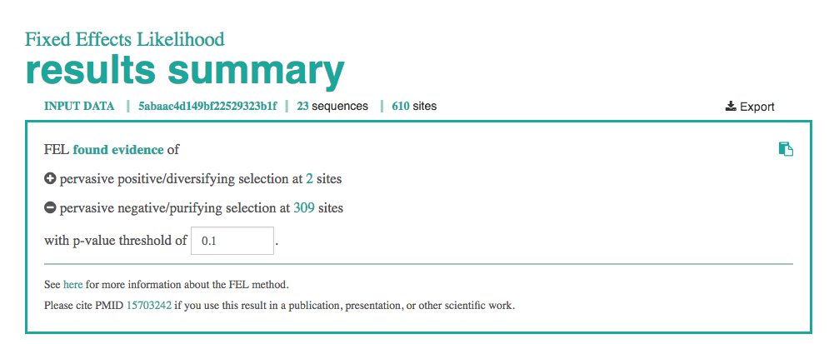
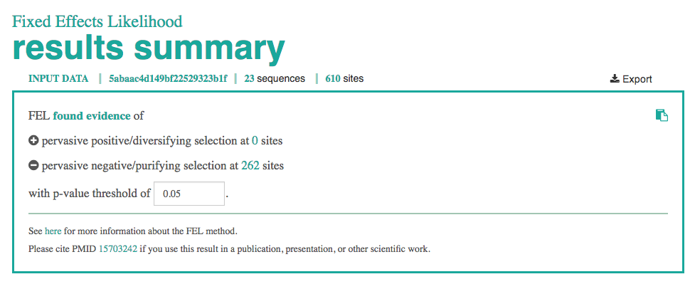
FEL Analysis using hyphy on the datamonkey

Slide 19
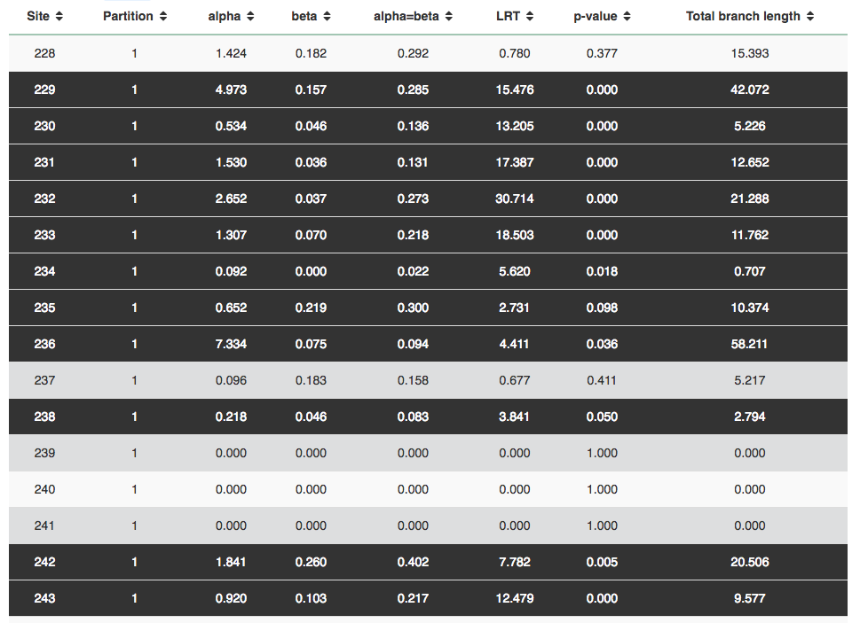
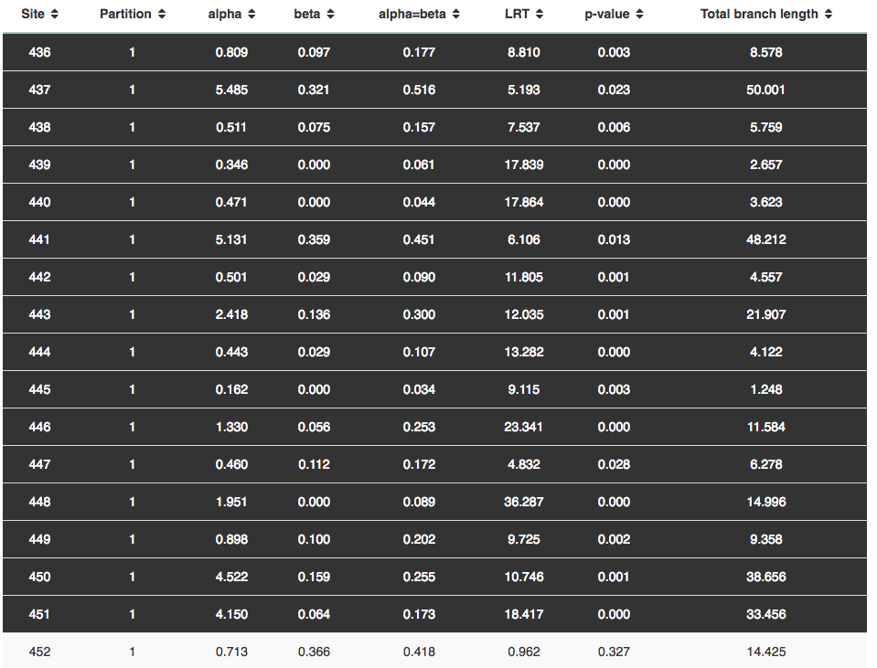
FEL Analysis using hyphy on the datamonkey

