Slide 1
MCB 5472
Selection and Horizontal Gene Transfer.

Slide 2
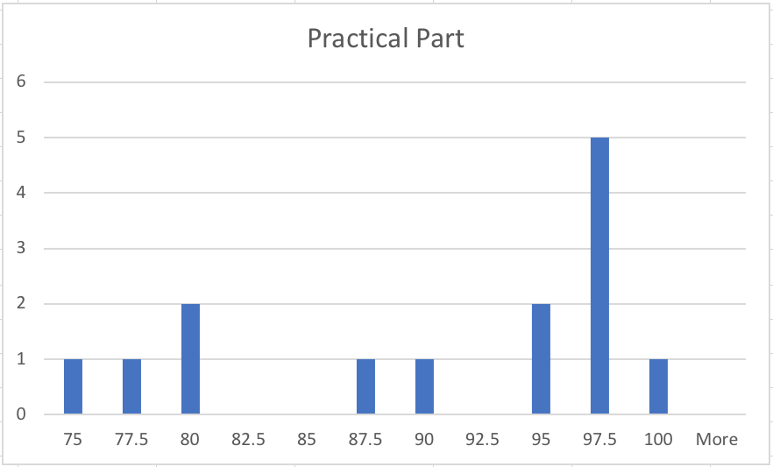
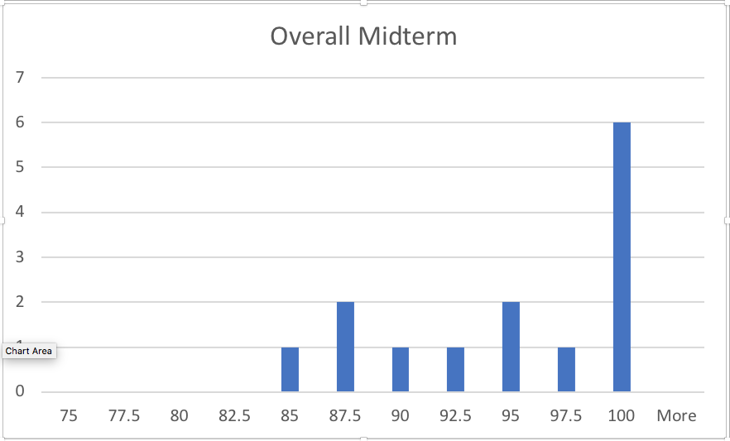

Slide 3
Gene Tranfer Agents:
Defective Phage
or
An Illustration of the Power of Sharing and Caring!

Slide 4
Purifying selection in E.coli ORFans
dN-dS < 0 for some ORFan E. coli clusters seems to suggest they are functional genes.
Gene groups | Number | dN-dS>0 | dN-dS<0 | dN-dS=0
E. coli ORFan clusters | 3773 | 944 (25%) | 1953 (52%) | 876 (23%)
Clusters of E.coli sequences found in Salmonella sp., Citrobacter sp. | 610 | 104 (17%) | 423(69%) | 83 (14%)
Clusters of E.coli sequences found in some Enterobacteriaceae only | 373 | 8 (2%) | 365 (98%) | 0 (0%)
Adapted after Yu, G. and Stoltzfus, A. Genome Biol Evol (2012) Vol. 4 1176-1187

Slide 5
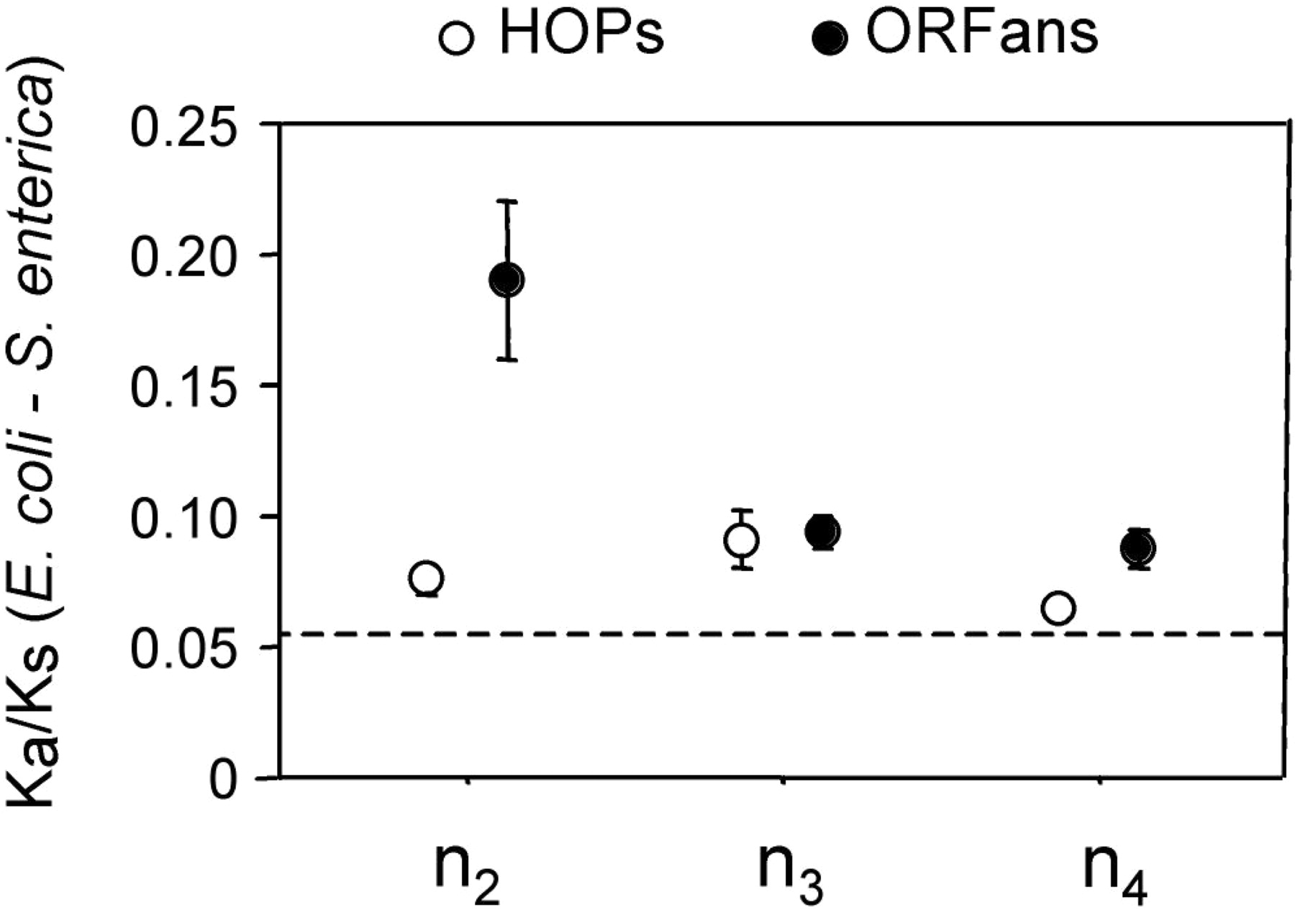
Vincent Daubin and Howard Ochman: Bacterial Genomes as New Gene Homes: The Genealogy of ORFans in E. coli. Genome Research 14:1036-1042, 2004
The ratio of non-synonymous to synonymous substitutions for genes found only in the E.coli - Salmonella clade is lower than 1, but larger than for more widely distributed genes.
Increasing phylogenetic depth
Fig. 3 from Vincent Daubin and Howard Ochman, Genome Research 14:1036-1042, 2004

Slide 6
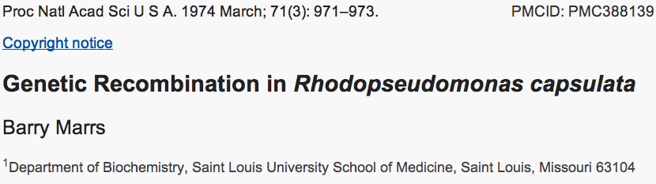
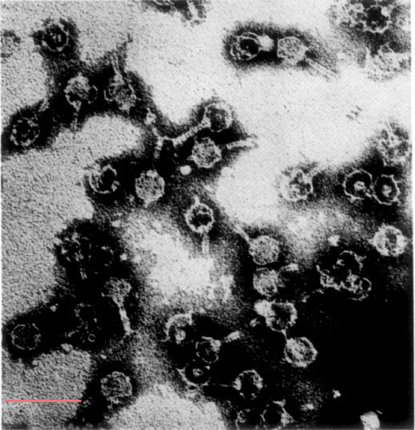
Gene Transfer Agents
An electron micrograph of
GTA particles from Rhodobacter capsulatus made soon after their discovery showing their resemblence to tailed phages. Negative staining with phosphotungstic acid.
Bar = 100 nm.
From: http://schaechter.asmblog.org/schaechter/2008/09/you-cant-judge.html

Slide 7
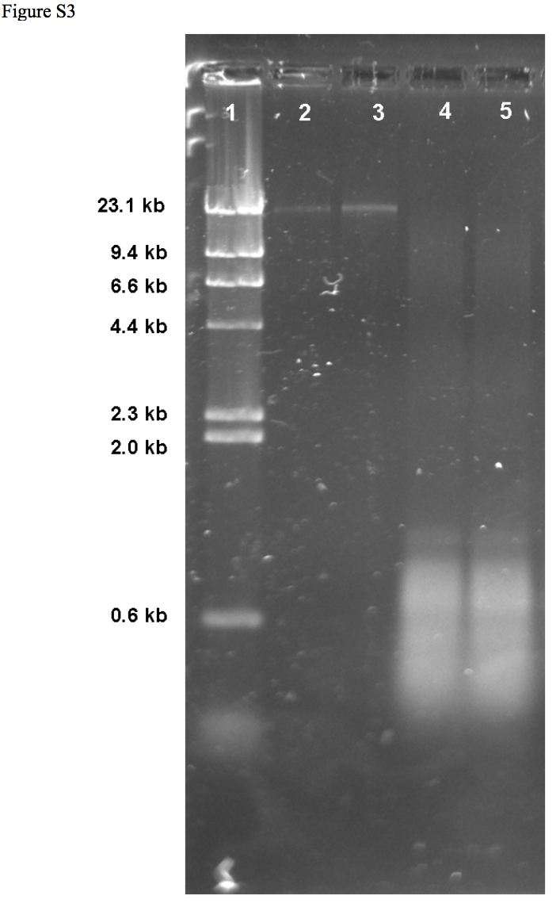
Figure S3: R. nubinhibens GTA DNA. Lane 1, λ HindIII ladder; Lane 2, uncut λ DNA; Lane 3, R. nubinhibens chromosomal DNA; Lanes 4 and 5, R. nubinhibens GTA DNA.
From: Lauren D. McDaniel, Elizabeth Young, Jennifer Delaney, Fabian Ruhnau, Kim B. Ritchie and John H. Paul:
High Frequency of Horizontal Gene Transfer in the Oceans
Science 1 October 2010:
Vol. 330 no. 6000 p. 50

Slide 8
Gene Transfer Agents
Lauren D. McDaniel, Elizabeth Young, Jennifer Delaney, Fabian Ruhnau, Kim B. Ritchie and John H. Paul:
High Frequency of Horizontal Gene Transfer in the Oceans
Science 1 October 2010:
Vol. 330 no. 6000 p. 50
GTAs under ecological conditions transfer DNA between different bacterial phyla at high rates.
“Environmental gene transfer frequencies ranging from 6.7 × 10⁻³ to 4.7 × 10⁻¹ are 1900 to 459 million times the frequency for transformation (2) and 650,000 to 31 million times the frequency of transduction previously measured in the marine environment. ”

Slide 9
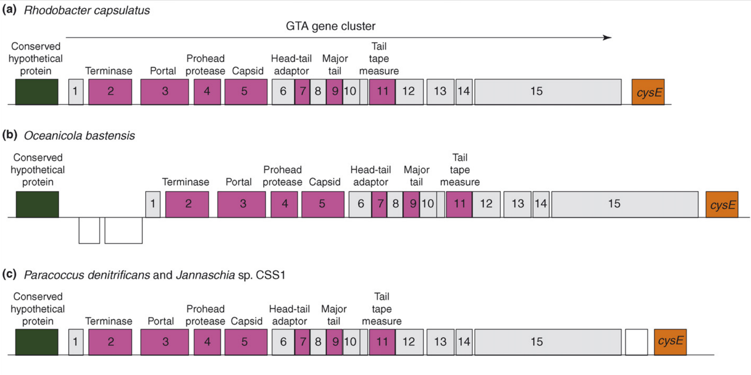
Gene Transfer Agents
Similar to Bacteriophage, often located in syntenic environment, suggesting vertical inheritance.
Lost the ability to specifically package their own DNA.
(Also GTA head too small to package gene cluster.)
From: Andrew S. Lang and J. Thomas Beatty:
Importance of widespread gene transfer agent genes in a-proteobacteria
TRENDS in Microbiology Vol.15 No.2

Slide 10
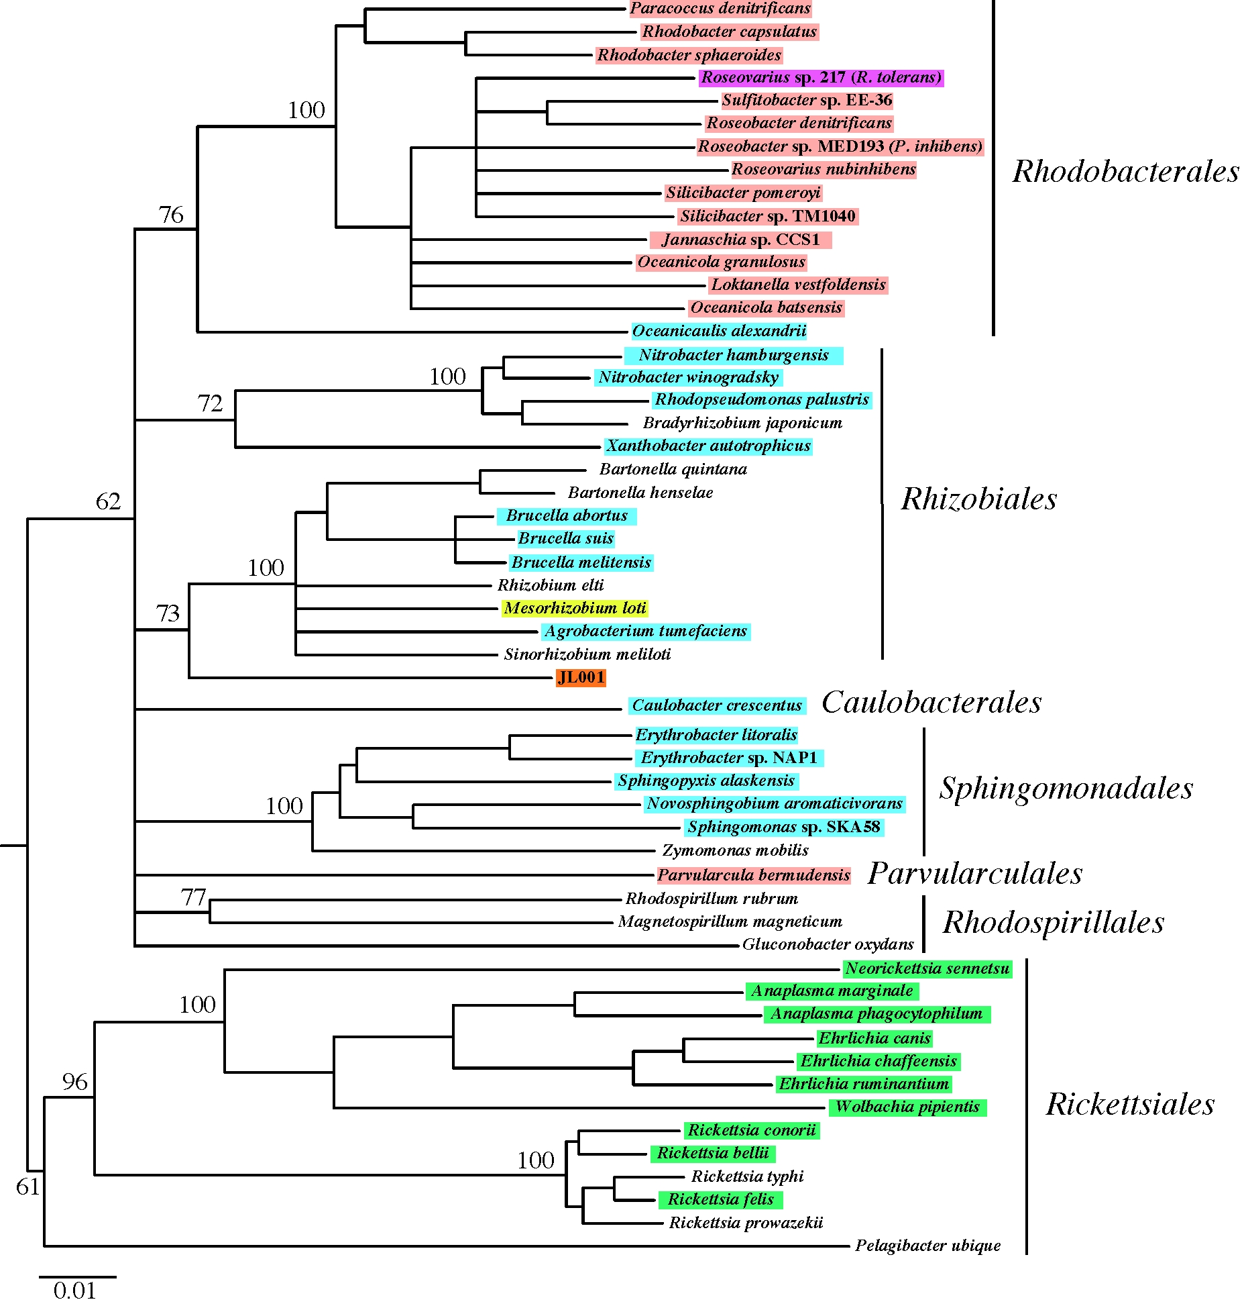
pink and purple:
complete syntenic GTA clusters,
blue and green: >1 GTA gene
white: no GTA genes.
orange:
GTA genes in prophage gene cluster
16S phylogenetic tree
of alpha-proteobacteria
From: Andrew S. Lang and J. Thomas Beatty:
Importance of widespread gene transfer agent genes in a-proteobacteria
TRENDS in Microbiology Vol.15 No.2

Slide 11
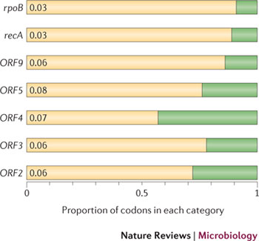
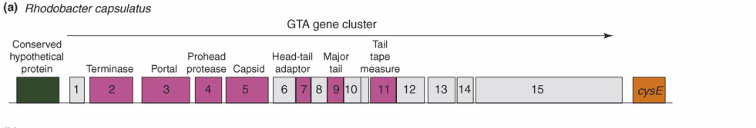
Purifying selection in GTA genes
dN/dS <1 for GTA genes has been used to infer selection for function
GTA genes
Lang AS, Zhaxybayeva O, Beatty JT. Nat Rev Microbiol. 2012 Jun 11;10(7):472-82
Lang, A.S. & Beatty, J.T. Trends in Microbiology , Vol.15, No.2 , 2006
Notes:
The ratio of non-synonymous-to-synonymous (dN/dS, or ω) codon substitution rates can be used as an indication of the selective pressure acting on a protein-coding gene. If a gene (or gene segment) is under purifying selection, non-synonymous mutations (that is, mutations resulting in a change of the encoded amino acid) will be selected against, resulting in ω < 1. In neutrally evolving proteins, synonymous and non-synonymous mutations will be fixed at approximately the same rate, resulting in ω = 1. Because different regions of a protein-coding gene may be under different selective constraints, codons can be divided into two categories: those with ω < 1 (yellow; the estimated ω is indicated on the bar) and those with ω fixed to 1 (green); the estimated proportion of codons in each category is given on the horizontal axis.

Slide 12
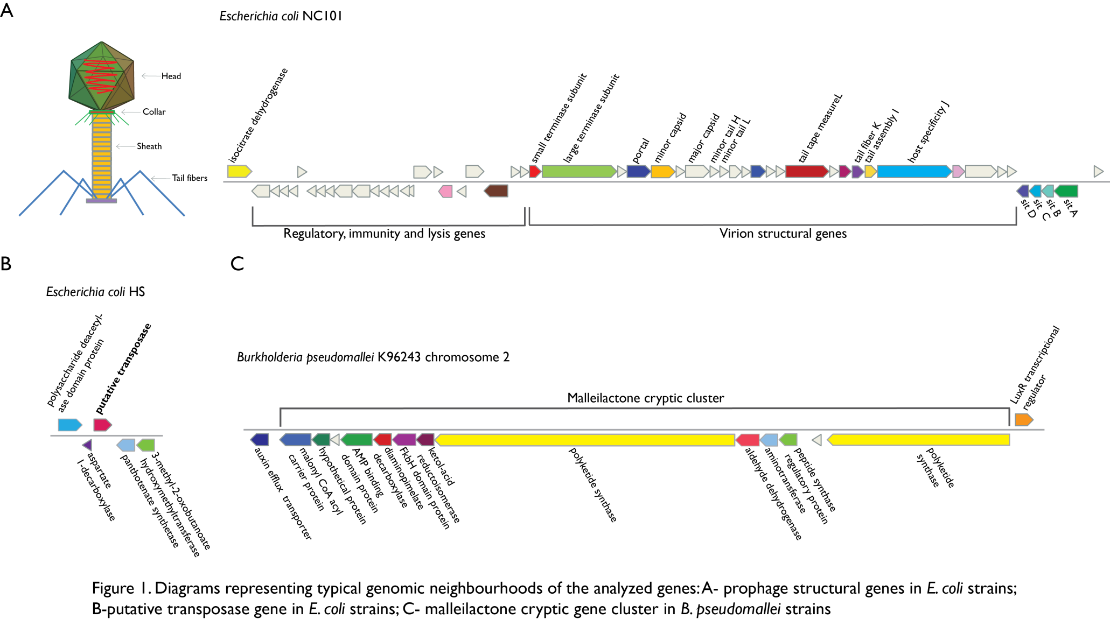
Vertically Inherited Genes Not Expressed for Function

Slide 13
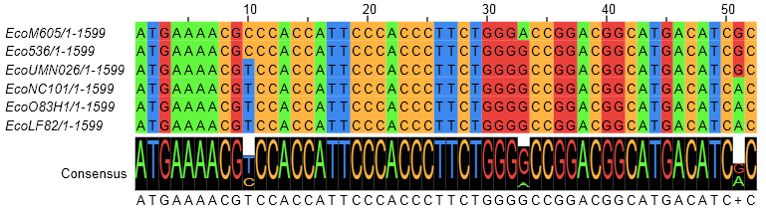
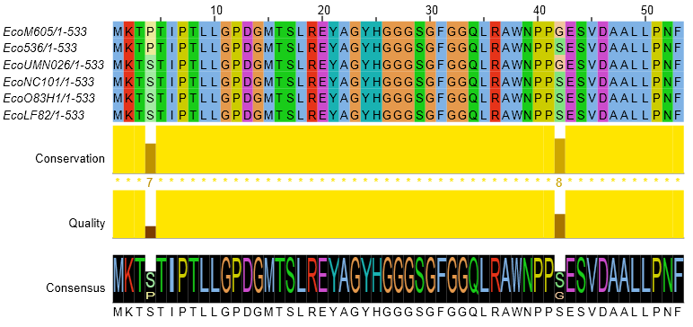
Counting Algorithm
Calculate number of different nucleotides/amino acids per MSA column (X)
Calculate number of nucleotides/amino acids substitutions (X-1)
Calculate number of synonymous changes
S=(N-1)nc-N
assuming N=(N-1)aa
X=2 1 nucleotide substitution
1 non-synonymous change
X=2 1 amino acid substitution

Slide 14
Simulation Algorithm
Calculate MSA nucleotide frequencies (%A,%T,%G,%C)
Introduce a given number of random substitutions ( at any position) based on inferred base frequencies
Compare translated mutated codon with the initial translated codon and count synonymous and non-synonymous substitutions

Slide 15
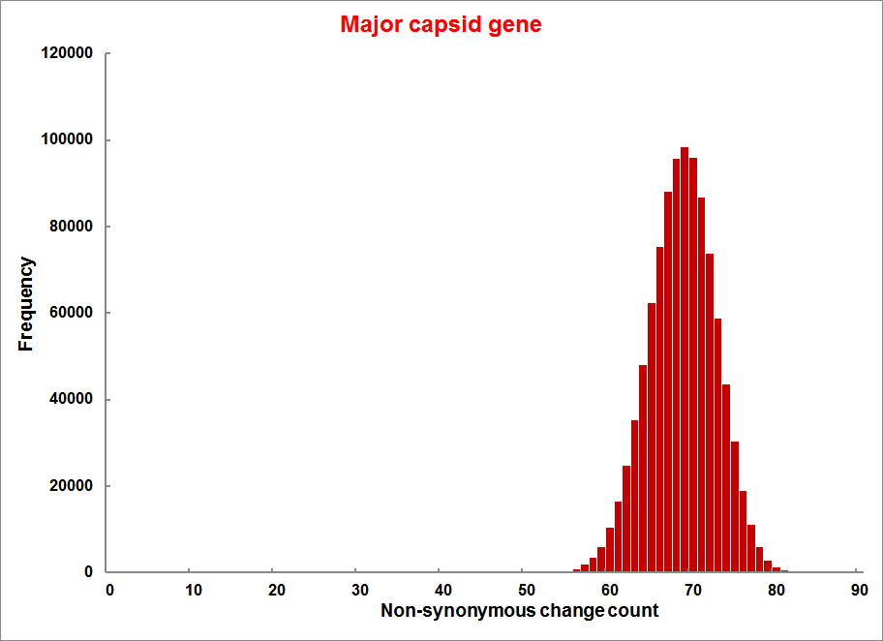
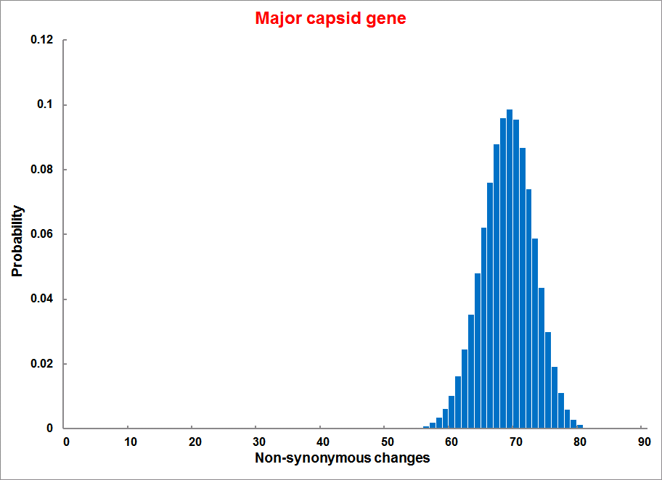
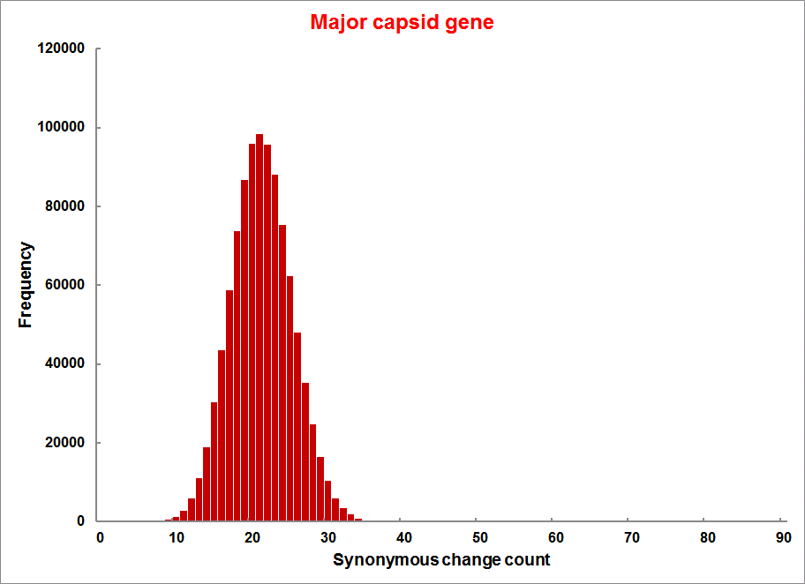
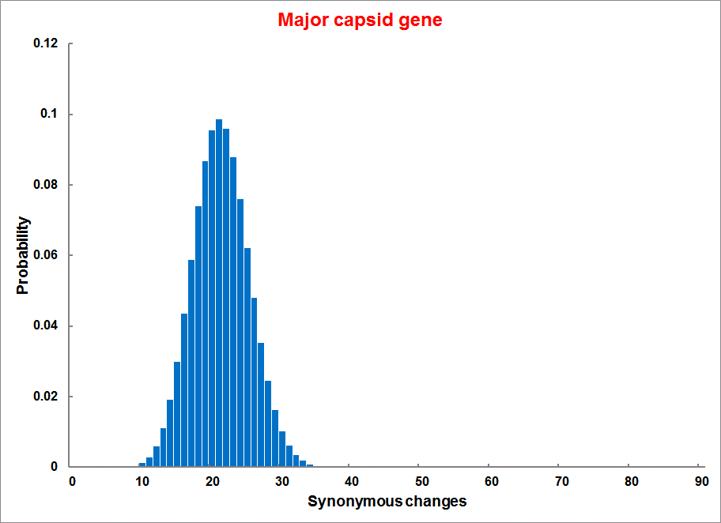
Evolution of Coding DNA Sequences Under a Neutral Model
E. coli Prophage Genes
Count distribution from simulations
Probability distribution
n=90
Non-synonymous
n= 90
k= 24
p=0.763
P(≤24)=3.63E-23
Observed=24
P(≤24) < 10⁻⁶
n=90
Synonymous
n= 90
k= 66
p=0.2365
P(≥66)=3.22E-23
Observed=66
P(≥66) < 10⁻⁶

Slide 16
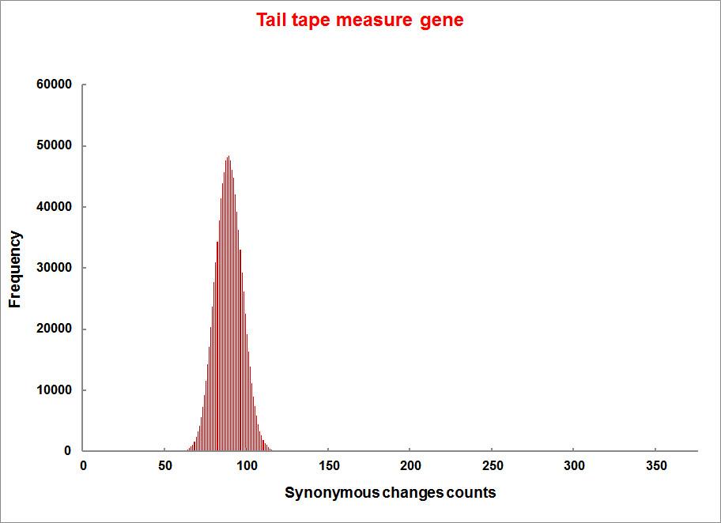
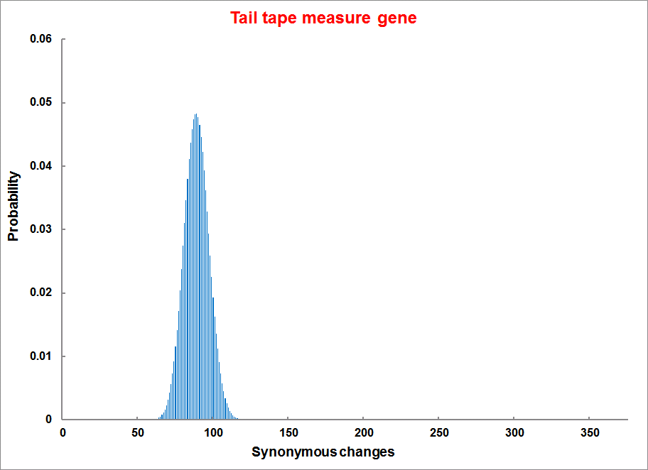
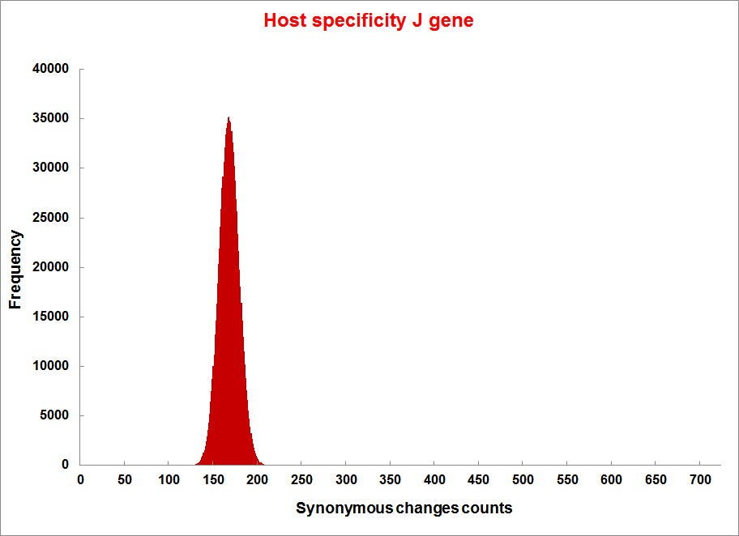
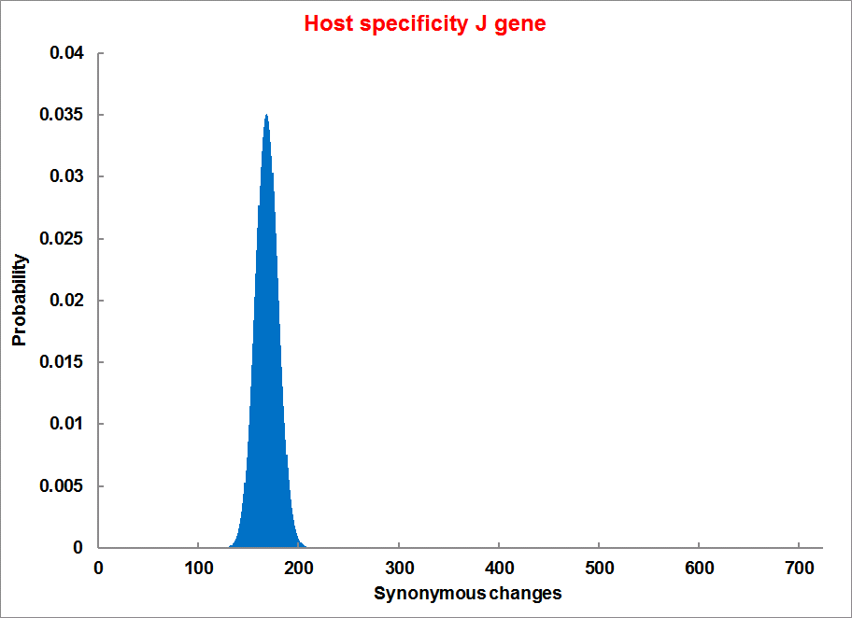
Evolution of Coding DNA Sequences Under a Neutral Model
E. coli Prophage Genes
Count distribution
Probability distribution
n=375
Synonymous
n= 375
k= 243
p=0.237
P(≥243)=7.92E-64
Observed=243
P(≥243) < 10⁻⁶
n=723
Synonymous
n= 723
k= 498
p=0.232
P(≥498)=6.41E-149
Observed=498
P(≥498) < 10⁻⁶

Slide 17
Evolution of Coding DNA Sequences Under a Neutral Model
E. coli Prophage Genes
 |  | OBSERVED |  | SIMULATED |  | Dnapars | Simulated | Codeml
Gene | Alignment Length (bp) | Substitutions | Synonymous changes* | Substitutions | p-value synonymous (given *) | Minimum number of substitutions | dN/dS | dN/dS
Major capsid | 1023 | 90 | 66 | 90 | 3.23E-23 | 94 | 0.113 | 0.13142
Minor capsid C | 1329 | 81 | 59 | 81 | 1.98E-19 | 84 | 0.124 | 0.17704
Large terminase subunit | 1923 | 75 | 67 | 75 | 7.10E-35 | 82 | 0.035 | 0.03773
Small terminase subunit | 543 | 100 | 66 | 100 | 1.07E-19 | 101 | 0.156 | 0.25147
Portal | 1599 | 55 | 46 | 55 | 1.36E-21 | *64 | 0.057 | 0.08081
Protease | 1329 | 55 | 37 | 55 | 4.64E-11 | 55 | 0.162 | 0.24421
Minor tail H | 2565 | 260 | 168 | 260 | 1.81E-44 | 260 | 0.17 | 0.30928
Minor tail L | 696 | 30 | 26 | 30 | 1.30E-13 | 30 | 0.044 | 0.05004
Host specificity J | 3480 | 723 | 498 | 723 | 6.42E-149 | *773 | 0.137 | 0.17103
Tail fiber K | 741 | 41 | 28 | 41 | 1.06E-09 | 44 | 0.14 | 0.18354
Tail assembly I | 669 | 39 | 33 | 39 | 3.82E-15 | 40 | 0.064 | 0.07987
Tail tape measure protein | 2577 | 375 | 243 | 375 | 7.92E-64 | 378 | 0.169 | 0.27957
Values well under the p=0.01 threshold, suggesting rejection of the null hypothesis of neutral evolution of prophage sequences.

Slide 18
Evolution of Coding DNA Sequences Under a Neutral Model
B. pseudomallei Cryptic Malleilactone Operon Genes and
E. coli transposase sequences
 |  | OBSERVED |  | SIMULATED
Gene | Alignment Length (bp) | Substitutions | Synonymous changes* | Substitutions | p-value synonymous (given *)
Aldehyde dehydrogenase | 1544 | 13 | 3 | 13 | 4.67E-04
AMP- binding protein | 1865 | 9 | 6 | 9 | 1.68E-02
Adenosylmethionine-8-amino-7-oxononanoate aminotransferase | 1421 | 20 | 12 | 20 | 6.78E-04
Fatty-acid CoA ligase | 1859 | 13 | 2 | 13 | 8.71E-01
Diaminopimelate decarboxylase | 1388 | 7 | 3 | 7 | 6.63E-01
Malonyl CoA-acyl transacylase | 899 | 2 | 1 | 2 | 4.36E-01
FkbH domain protein | 1481 | 17 | 9 | 17 | 2.05E-02
Hypothethical protein | 431 | 3 | 2 | 3 | 1.47E-01
Ketol-acid reductoisomerase | 1091 | 2 | 0 | 2 | 1.00E+00
Peptide synthase regulatory protein | 1079 | 10 | 5 | 10 | 8.91E-02
Polyketide-peptide synthase | 12479 | 135 | 66 | 135 | 4.35E-27
 |  | OBSERVED |  | SIMULATED
Gene | Alignment Length (bp) | Substitutions | Synonymous changes* | Substitutions | p-value synonymous (given *)
Putative transposase | 903 | 175 | 107 | 175 | 1.15E-29

Slide 19
Other ways to detect positive selection
Selective sweeps -> fewer alleles present in population
(see contributions from archaic Humans for example)
Repeated episodes of positive selection -> high dN
(works well for repeated positive – aka diversifying – selection; e.g. virus interaction with the immunesystem)

Slide 20

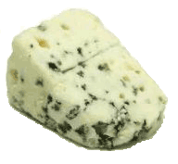
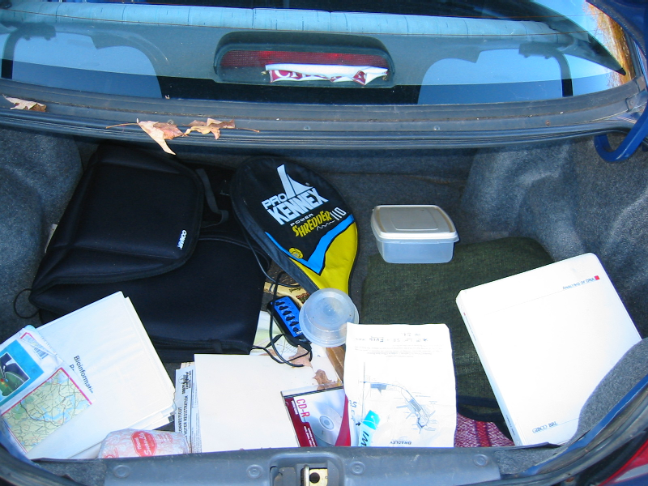
Trunk-of-my-car analogy: Hardly anything in there is the is the result of providing a selective advantage. Some items are removed quickly (purifying selection), some are useful under some conditions, but most things do not alter the fitness. See here for a published version.
Could some of the inferred purifying selection be due to the acquisition of novel detrimental characteristics (e.g., protein toxicity, HOPELESS MONSTERS)?

Slide 21
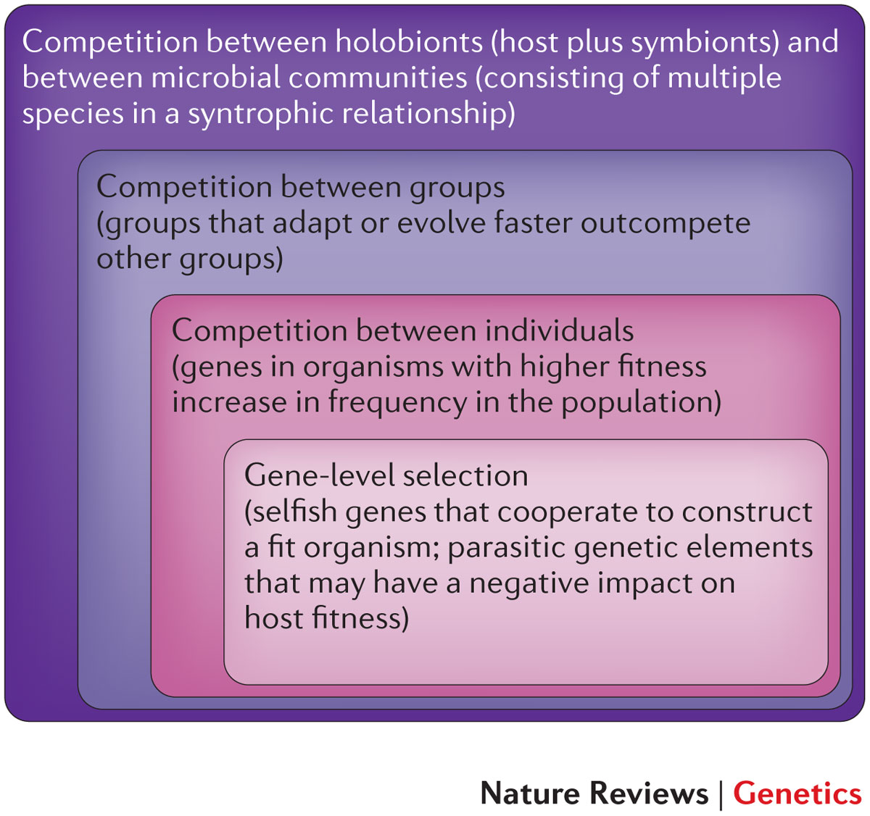

Slide 22
Could GTAs be maintained in a population because they are beneficial to the popopuation (group selection)?
Rosie Redfield had an ongoing discussion of this on her blog. The latest installment is here.
Her answer is NO
Three factors together require that production of GTA particles reduces the total number of GTA+ cells in the population:
Problem 1: GTA particles can only be released to the environment if the GTA+ producer cell lyses. So each production event removes one GTA+ cell from the population.
Problem 2: The GTA genes in the producer cell are not over-replicated as a phage genome would be, so each production event can produce at most one G+ particle (containing the GTA gene or cluster).
If all steps occurred with 100% efficiency, problems 1 and 2 would allow, at best, replacement of the lost GTA+ cell with a new one created by GTA-mediated recombination. But this would not maintain the numbers of GTA+ cells in the face of occasional loss of GTA genes by mutation or deletion. Nor would it allow GTA+ cells to invade a GTA- population.

Slide 23
Other ways to detect positive selection
Selective sweeps -> fewer alleles present in population
(allele shows little within allele divergence - see contributions from archaic Humans for example),
SNP or neighboring SNPs are at higher frequency within a population.
Repeated episodes of positive selection -> high dN

Slide 24
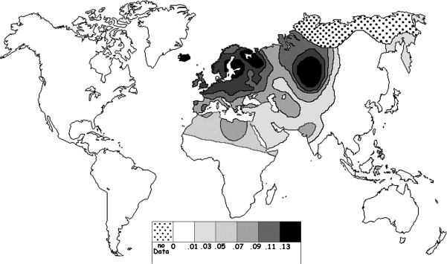
Fig. 1 Current world-wide frequency distribution of CCR5-Δ32 allele frequencies. Only the frequencies of Native populations have been evidenced in Americas, Asia, Africa and Oceania. Map redrawn and modified principally from <ce:cross-ref refid="bib5"> B...
Eric Faure , Manuela Royer-Carenzi
Is the European spatial distribution of the HIV-1-resistant CCR5-Δ32 allele formed by a breakdown of the pathocenosis due to the historical Roman expansion?
Infection, Genetics and Evolution, Volume 8, Issue 6, 2008, 864 - 874
http://dx.doi.org/10.1016/j.meegid.2008.08.007

Slide 25
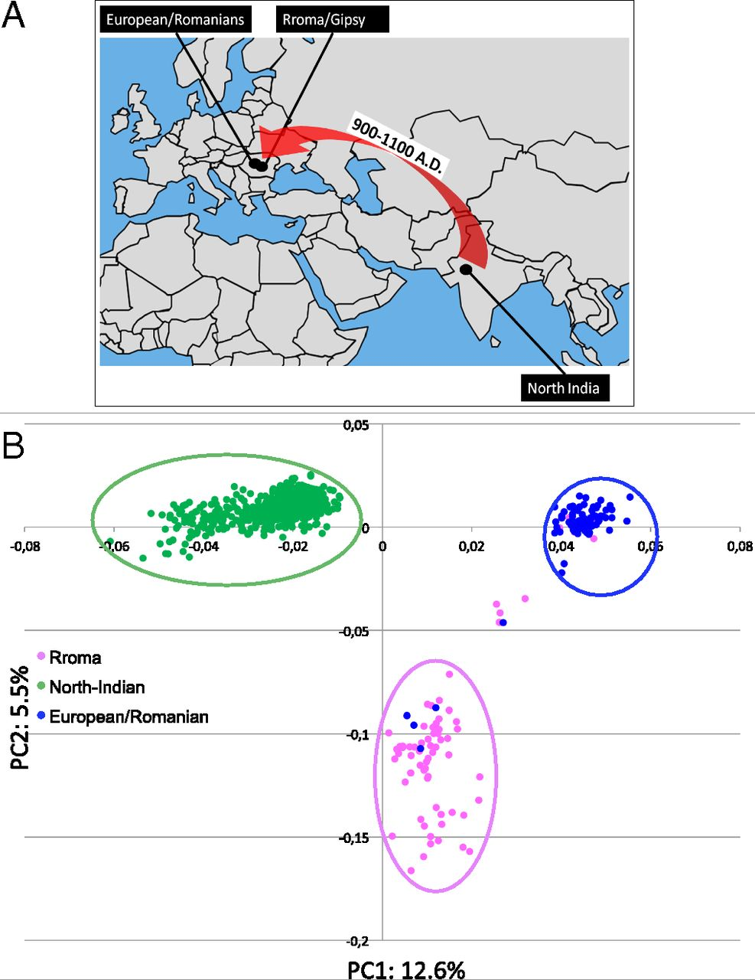
Geographic origin of the three populations studied.
196,524 SNPs
-> PCA
Hafid Laayouni et al. PNAS 2014;111:2668-2673
©2014 by National Academy of Sciences
Notes:
Geographic origin of the three populations studied. (A) European/Romanians and Rroma/Gipsy share the same location, even if the origin of the latter is in North India. (B) Plot of the populations under analysis according to the coordinates to the two main eigenvectors of smartpca (Eigensoft) analysis, in which each dot represents an individual. Individuals within the circles and the same color have been considered for the study; those of different colors represent false population allocation and those intermediate represent admixed individuals. ROM, nongypsy Romanians; INDI, individuals from North India; GYP, Rroma/Gypsies living in Romania.

Slide 26
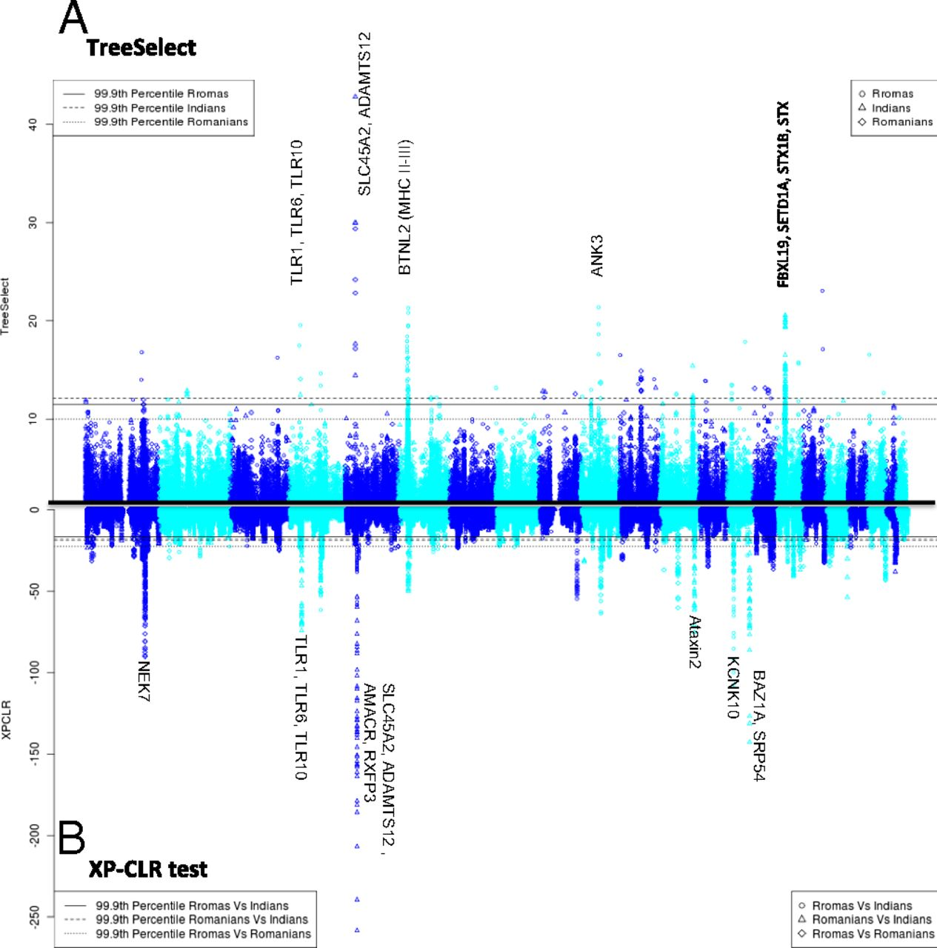
Manhattan plot of results of selection tests in Rroma, Romanians, and Indians using TreeSelect statistic (A) and XP-CLR statistic (B).
SNP frequencies within and between populations
selective sweeps detected through linkage disequilibrium
Laayouni H et al. PNAS 2014;111:2668-2673
Convergent evolution in European and Rroma populations reveals pressure exerted by plague on Toll-like receptors.
©2014 by National Academy of Sciences
Notes:
Manhattan plot of results of selection tests in Rroma, Romanians, and Indians using TreeSelect statistic (A) and XP-CLR statistic (B). Chromosomes ordered from chromosome 1 to chromosome 22.

Slide 27
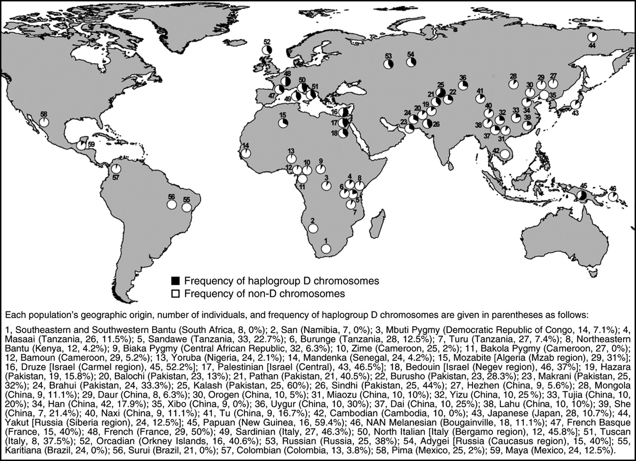
Variant arose about
5800 years ago

Slide 28
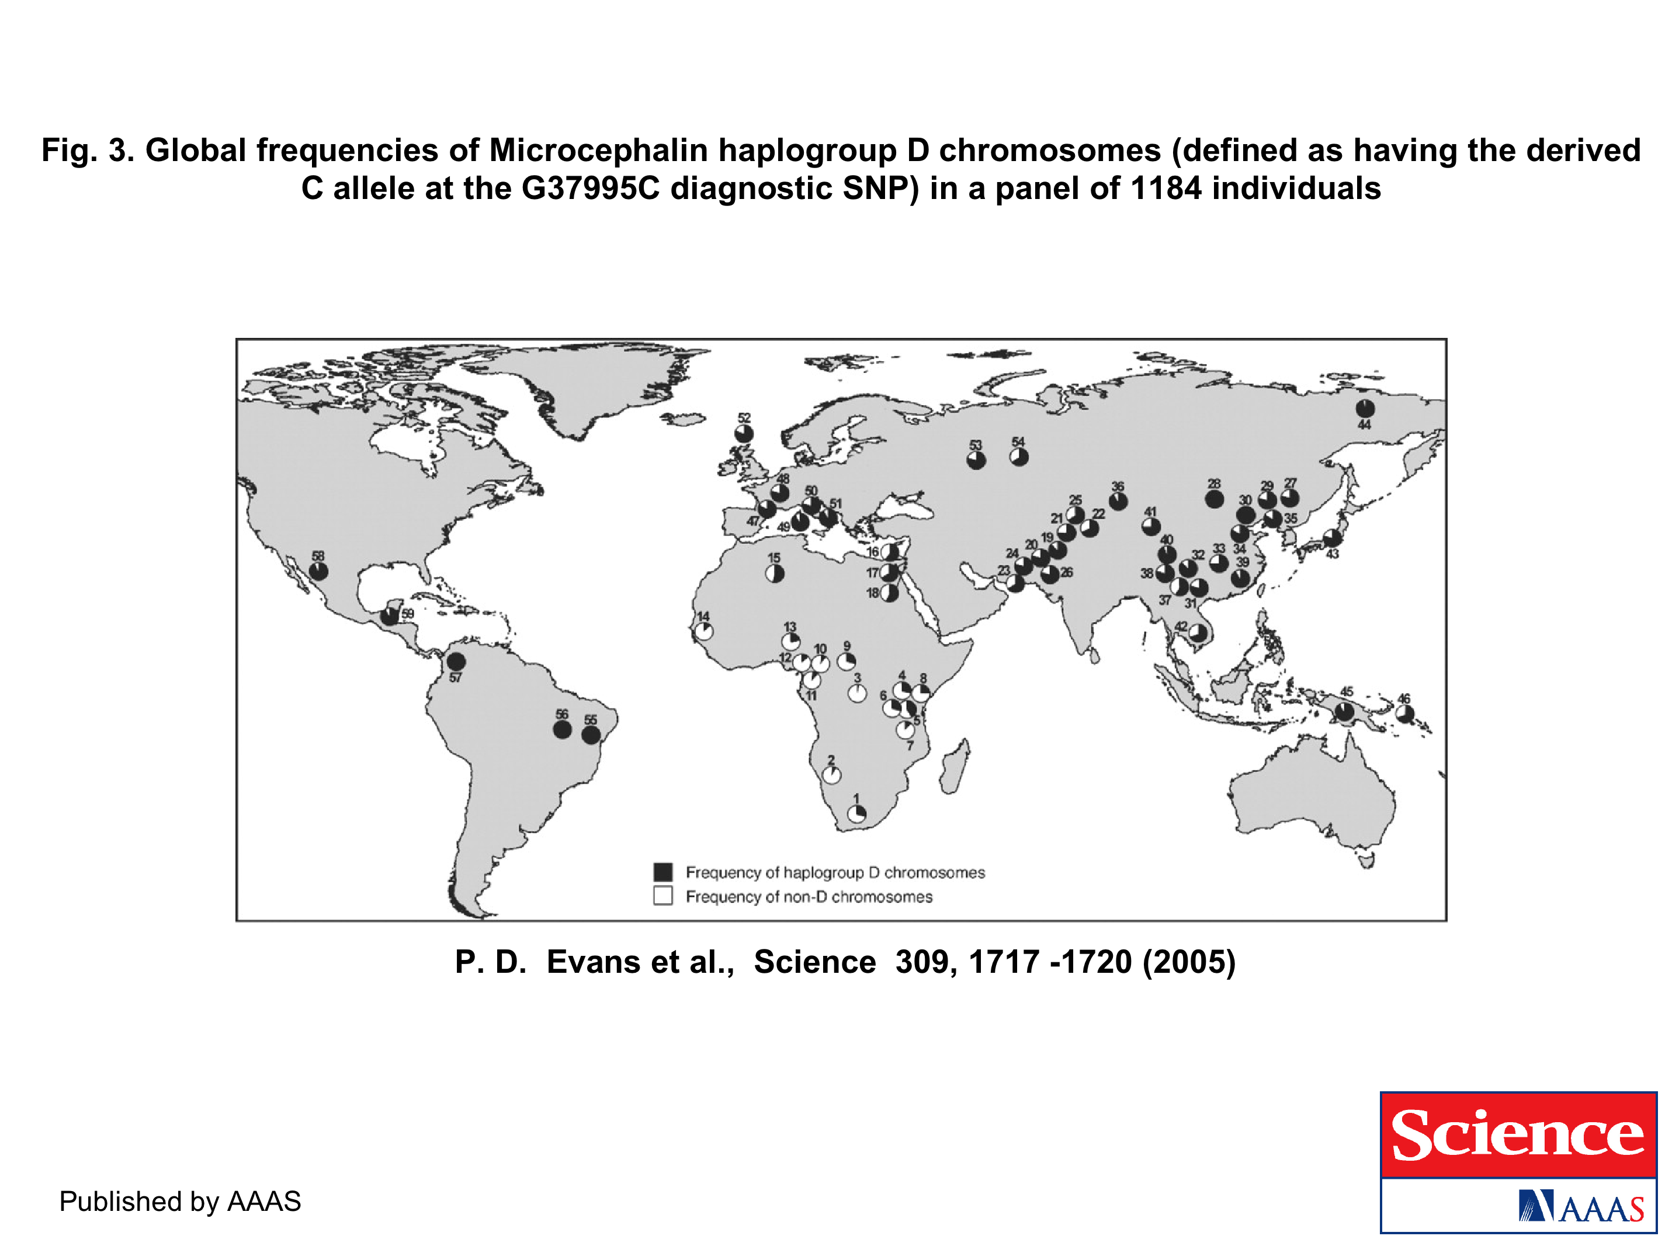
The age of haplogroup D was found to be ~37,000 years

Slide 29
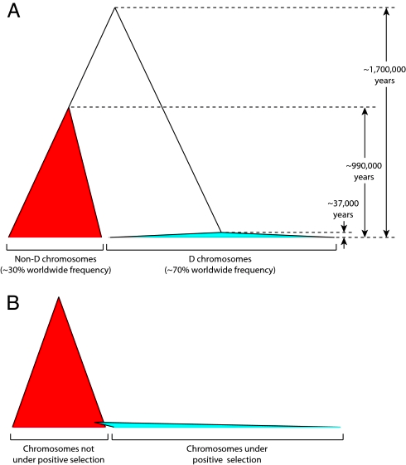
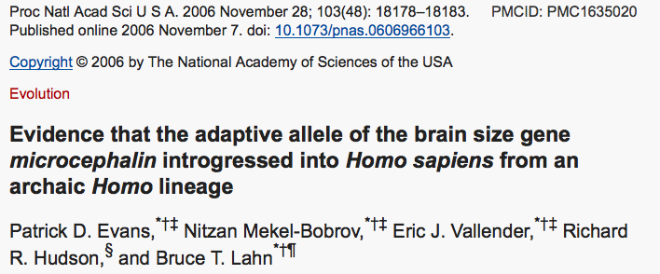

Slide 30
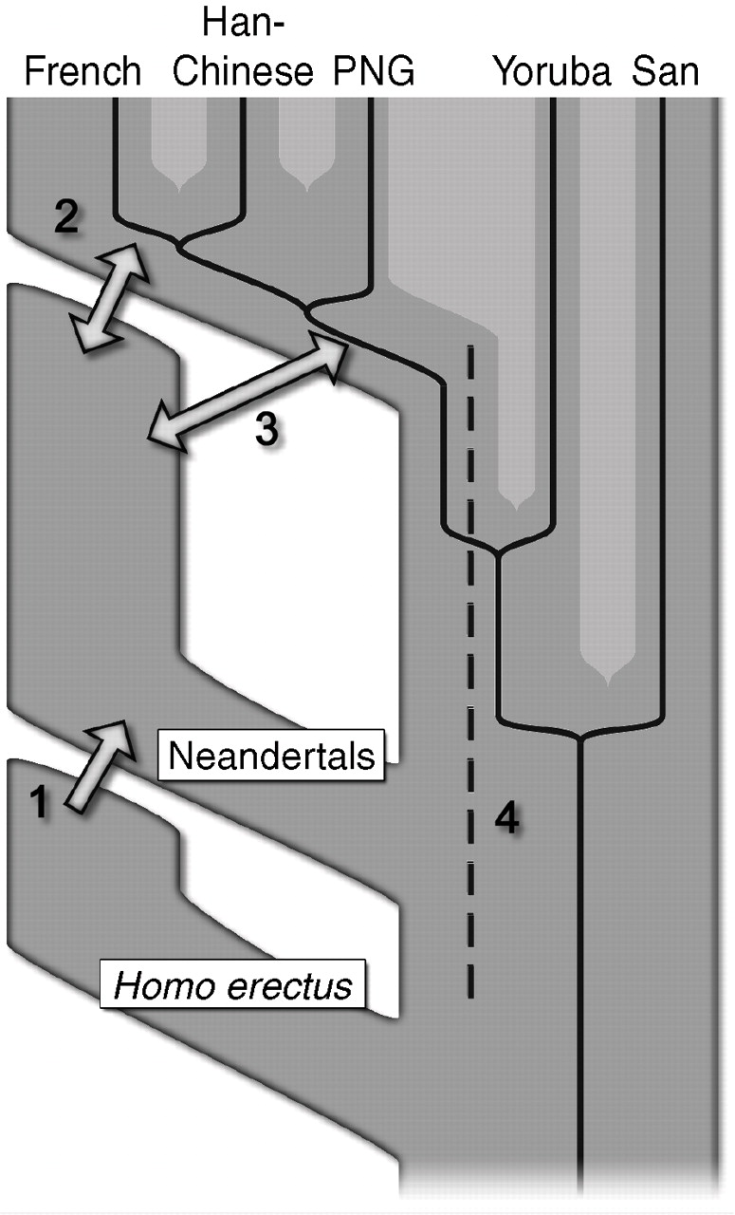

Fig. 6 Four possible scenarios of genetic mixture involving Neandertals.
R E Green et al. Science 2010;328:710-722
Published by AAAS
Notes:
Four possible scenarios of genetic mixture involving Neandertals. Scenario 1 represents gene flow into Neandertal from other archaic hominins, here collectively referred to as Homo erectus. This would manifest itself as segments of the Neandertal genome with unexpectedly high divergence from present-day humans. Scenario 2 represents gene flow between late Neandertals and early modern humans in Europe and/or western Asia. We see no evidence of this because Neandertals are equally distantly related to all non-Africans. However, such gene flow may have taken place without leaving traces in the present-day gene pool. Scenario 3 represents gene flow between Neandertals and the ancestors of all non-Africans. This is the most parsimonious explanation of our observation. Although we detect gene flow only from Neandertals into modern humans, gene flow in the reverse direction may also have occurred. Scenario 4 represents old substructure in Africa that persisted from the origin of Neandertals until the ancestors of non-Africans left Africa. This scenario is also compatible with the current data.

Slide 31
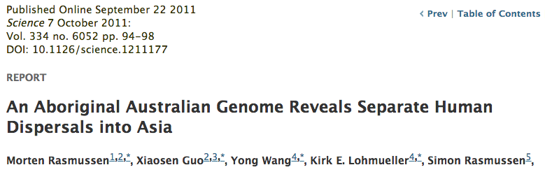
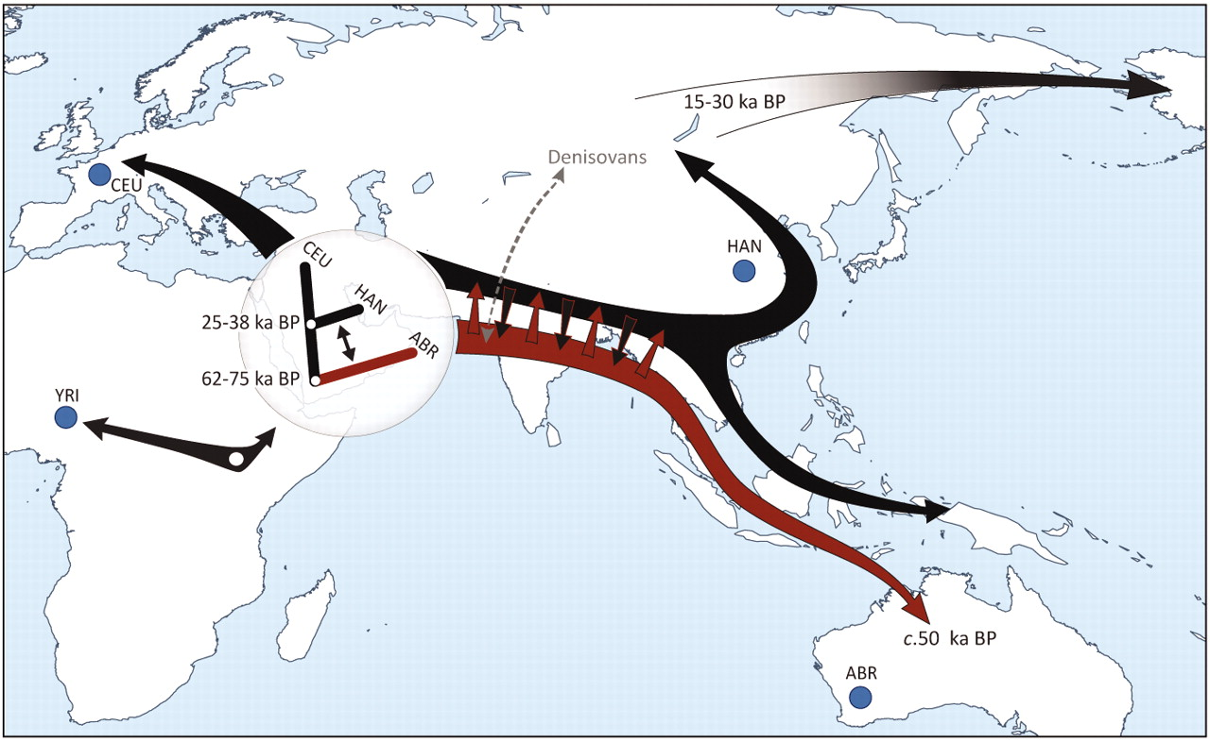

Slide 32
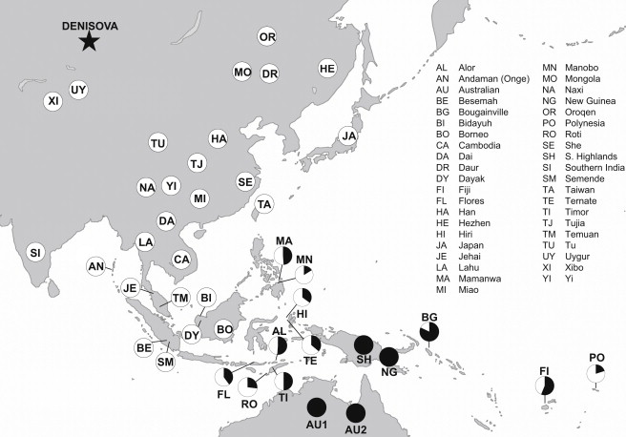
Figure 1 Denisovan Genetic Material as a Fraction of that in New Guineans Populations are only shown as having Denisova ancestry if the estimates are more than two standard errors from zero (we combine estimates for populations in this study wit...
David Reich , Nick Patterson , Martin Kircher , Frederick Delfin , Madhusudan?R. Nandineni , Irina Pugach , Albert...
Denisova Admixture and the First Modern Human Dispersals into Southeast Asia and Oceania
The American Journal of Human Genetics Volume 89, Issue 4 2011 516 - 528
http://dx.doi.org/10.1016/j.ajhg.2011.09.005

Slide 33
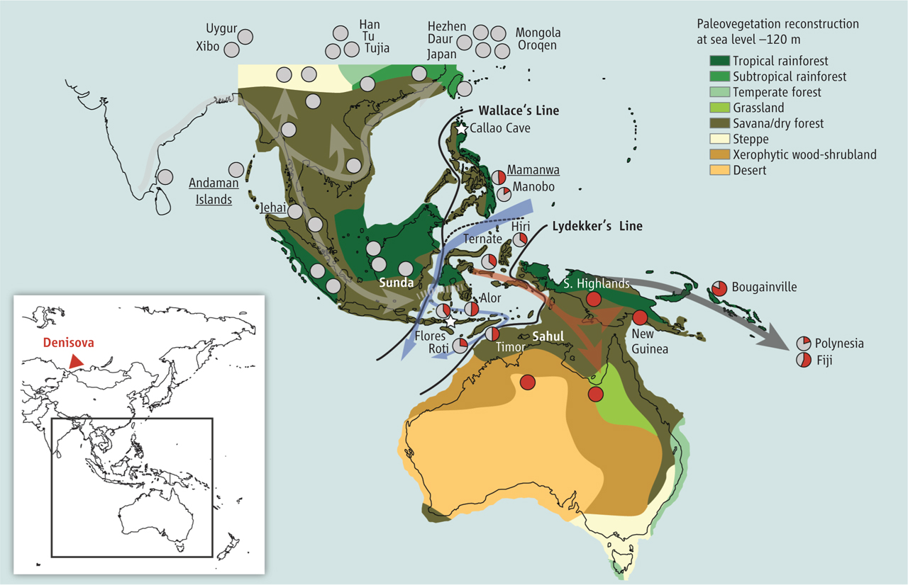
Did the Denisovans Cross Wallace's Line?
Science 18 October 2013:
vol. 342 no. 6156 321-323
Ancient migrations.
The proportions of Denisovan DNA in modern human populations are shown as red in pie charts, relative to New Guinea and Australian Aborigines (3). Wallace's Line (8) is formed by the powerful Indonesian flow-through current (blue arrows) and marks the limit of the Sunda shelf and Eurasian placental mammals.

Slide 34
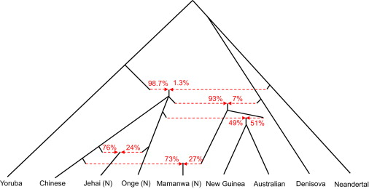
Figure 3 A Model of Population Separation and Admixture that Fits the Data The admixture graph suggests Denisova-related gene flow into a common ancestral population of Mamanwa, New Guineans, and Australians, followed by admixture of New Guinean...
David Reich , Nick Patterson , Martin Kircher , Frederick Delfin , Madhusudan R. Nandineni , Irina Pugach , Albert...
Denisova Admixture and the First Modern Human Dispersals into Southeast Asia and Oceania
The American Journal of Human Genetics Volume 89, Issue 4 2011 516 - 528
http://dx.doi.org/10.1016/j.ajhg.2011.09.005

Slide 35
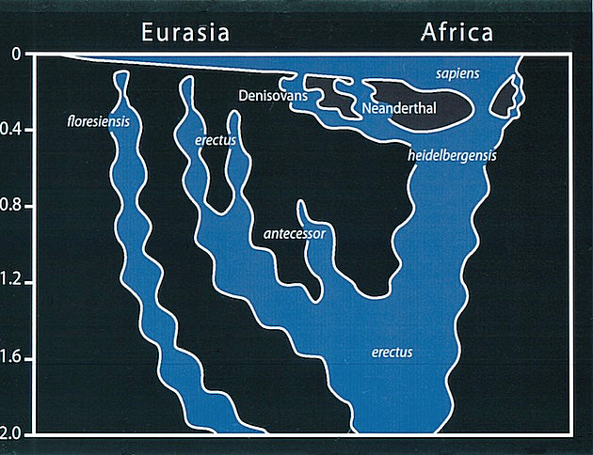
Archaic human admixture with modern Homo sapiens
From: http://en.wikipedia.org/wiki/Archaic_human_admixture_with_modern_Homo_sapiens

Slide 36
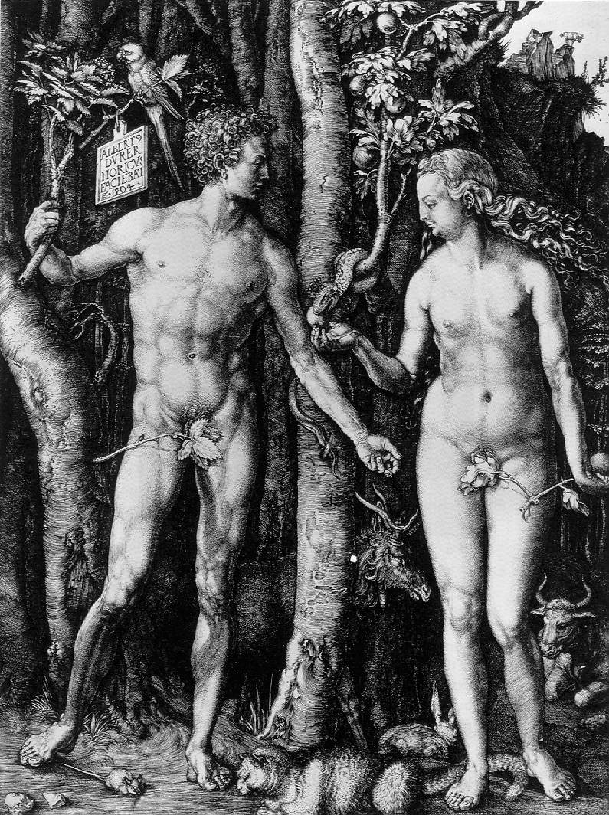
Y chromosome
Adam
Mitochondrial
Eve
Lived
approximately
40,000 years ago
Lived
166,000-249,000
years ago
Thomson, R. et al. (2000) Proc Natl Acad Sci U S A 97, 7360-5
Underhill, P.A. et al. (2000) Nat Genet 26, 358-61
Mendez et al. (2013) American Journal of Human Genetics 92 (3): 454.
Cann, R.L. et al. (1987) Nature 325, 31-6
Vigilant, L. et al. (1991) Science 253, 1503-7
Albrecht Dürer, The Fall of Man, 1504
Adam and Eve never met ☹
The same is true for ancestral rRNAs, EF, ATPases!

Slide 37
“Genotyping of a DNA sample that was submitted to a commercial genetic-testing facility demonstrated that the Y chromosome of this African American individual carried the ancestral state of all known Y chromosome SNPs.”
Mendez , et al. 2013
An African American Paternal Lineage Adds an Extremely Ancient Root to the Human Y Chromosome Phylogenetic Tree
The American Journal of Human Genetics Volume 92, Issue 3 2013 454 - 459
http://dx.doi.org/10.1016/j.ajhg.2013.02.002

Slide 38
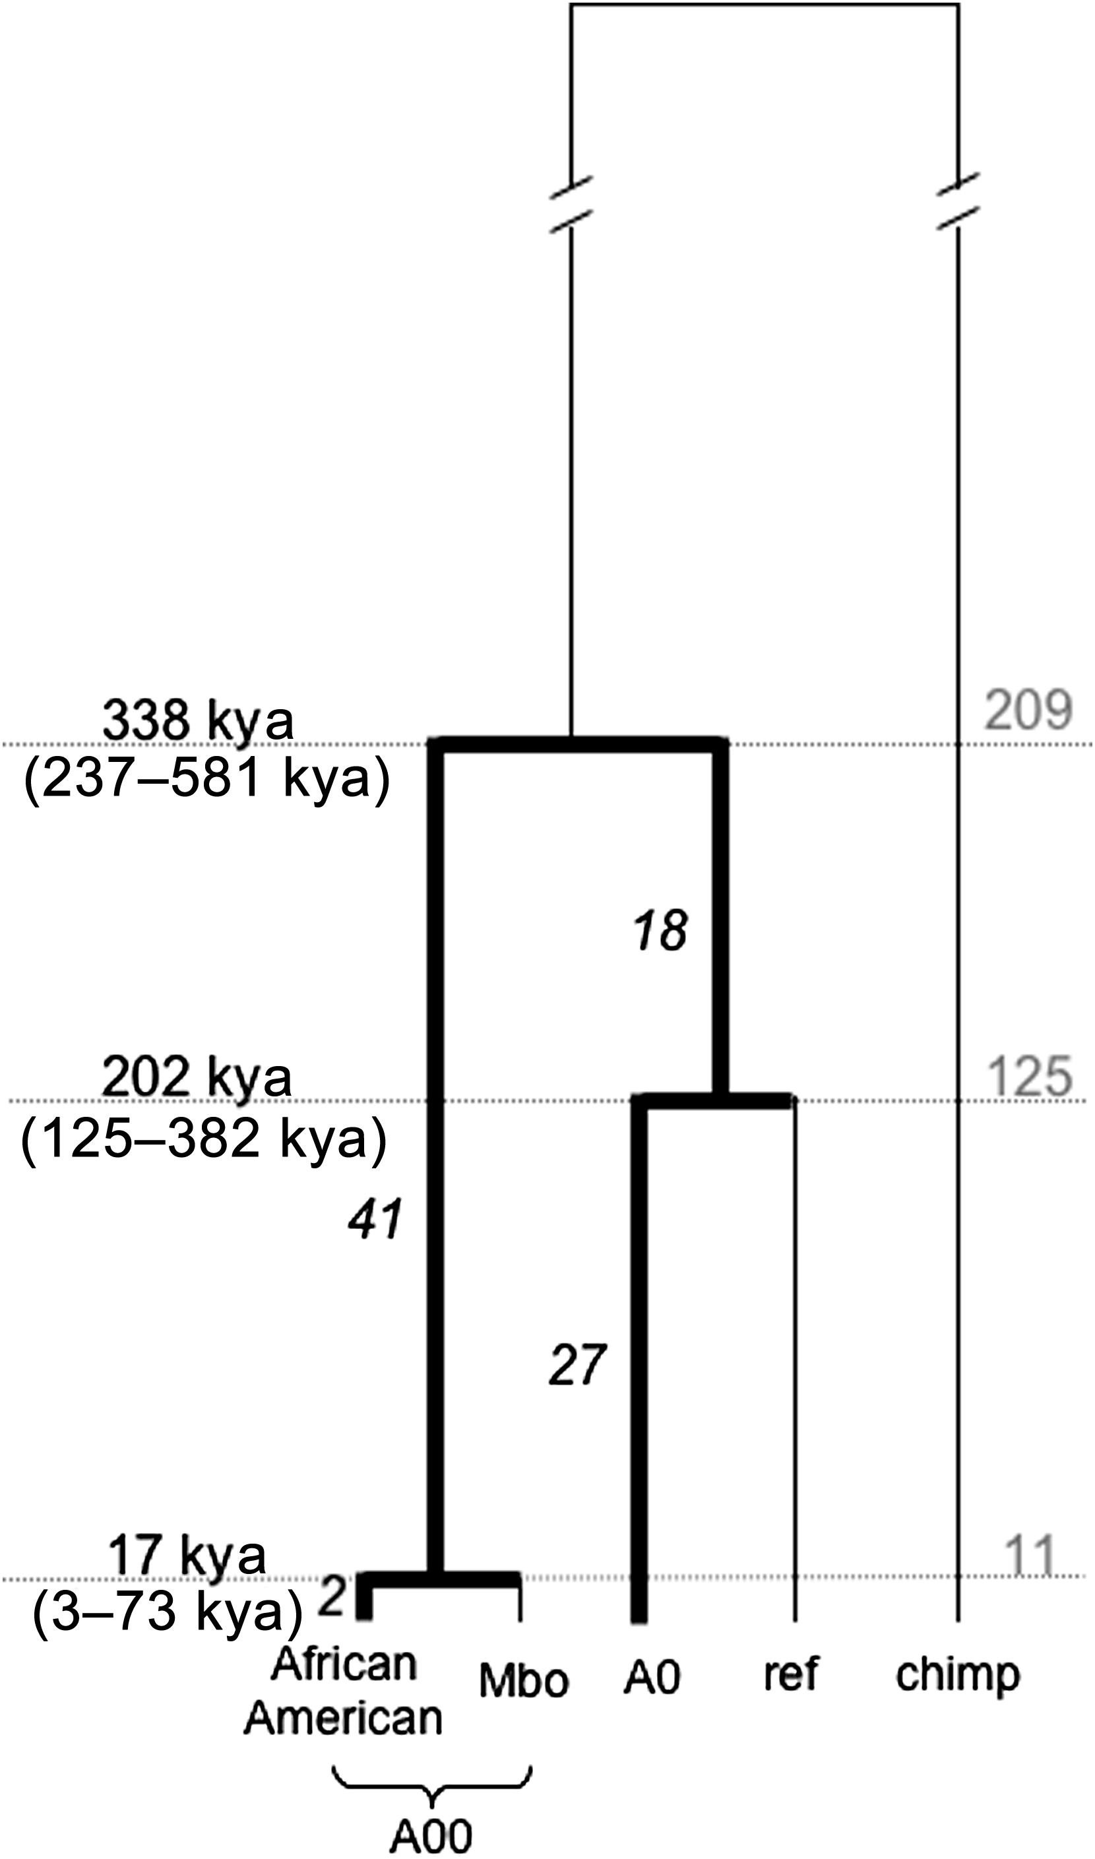
Figure 1 Genealogy of A00, A0, and the Reference Sequence Lineages on which mutations were identified and lineages that were used for placing those mutations on the genealogy are indicated with thick and thin lines, respectively. The numbers of ...
Mendez , et al. 2013
An African American Paternal Lineage Adds an Extremely Ancient Root to the Human Y Chromosome Phylogenetic Tree
The American Journal of Human Genetics Volume 92, Issue 3 2013 454 - 459
http://dx.doi.org/10.1016/j.ajhg.2013.02.002

Slide 39
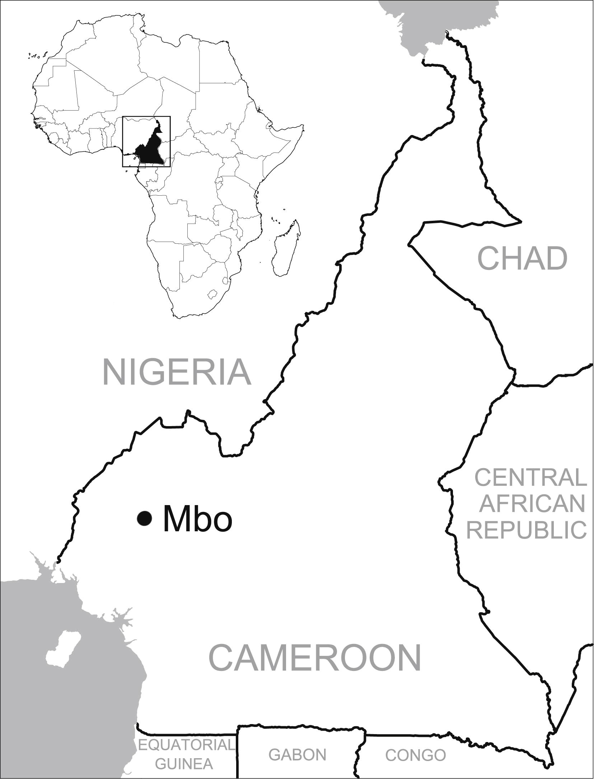
Figure 2 Map Showing Cameroon and the Approximate Location where Mbo Speakers Live
Fernando L. Mendez , Thomas Krahn , Bonnie Schrack , Astrid-Maria Krahn , Krishna R. Veeramah , August E. Woerner ...
An African American Paternal Lineage Adds an Extremely Ancient Root to the Human Y Chromosome Phylogenetic Tree
The American Journal of Human Genetics Volume 92, Issue 3 2013 454 - 459
http://dx.doi.org/10.1016/j.ajhg.2013.02.002

Slide 40
For more discussion on archaic and early humans see:
http://en.wikipedia.org/wiki/Denisova_hominin
http://www.nytimes.com/2012/01/31/science/gains-in-dna-are-speeding-research-into-human-origins.html
http://www.nytimes.com/2014/10/23/science/research-humans-interbred-with-neanderthals.html?
http://www.sciencedirect.com/science/article/pii/S0002929711003958
http://www.abc.net.au/science/articles/2012/08/31/3580500.htm
http://www.sciencemag.org/content/334/6052/94.full
http://www.sciencemag.org/content/334/6052/94/F2.expansion.html
http://haplogroup-a.com/Ancient-Root-AJHG2013.pdf

Slide 41
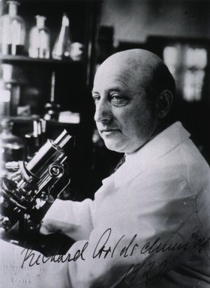
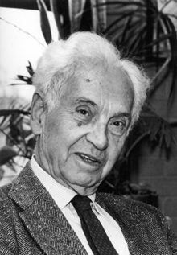
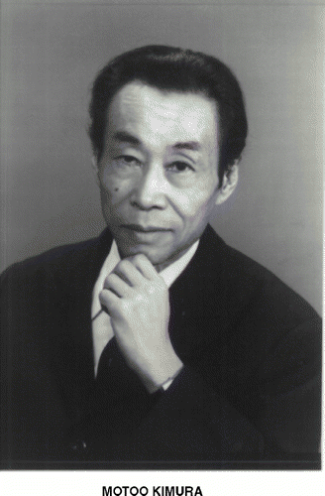
How do you define evolution?
Richard Goldschmidt 1940
hopeful monsters
Mutationism HGT/WGD!
Punctuated Equilibrium
Few genes / large effect
Vilified by Mayr, celebrated 1977 Gould & Evo-devo
Ernst Mayr 1942
NeoDarwinian Synthesis
Natural Selection
Gradualism
Many genes/small effect
Dario – “Fisher right”
Motoo Kimura 1968
Neutral Theory
Genetic Drift is main force for changing allele frequencies
Slide from Chris Pires
Notes:
Goldschmitdt,R. (1940). The Material Basis of Evolution
Mayr, Ernst (1942). Systematics and the origin of species, from the viewpoint of a zoologist

Slide 42
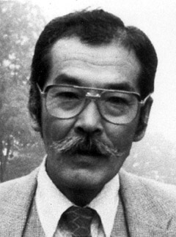
Duplications and Evolution
Ohno postulated that gene duplication plays a major role in evolution
Small scale duplications (SSD)
Whole genome duplications (WGD)
Polyploid: nucleus contains three or more copies of each chromosome
Autopolyploid: formed within a single species
Diploids AA and A’A’ Polyploid AAA’A’
Allopolyploid: formed from more than one species
Diploids AA and BB Polyploid AABB
Susumu Ohno 1970
Evolution by gene duplication
1R and 2R hypothesis
“Junk DNA” 1972
Slide from Chris Pires

Slide 43
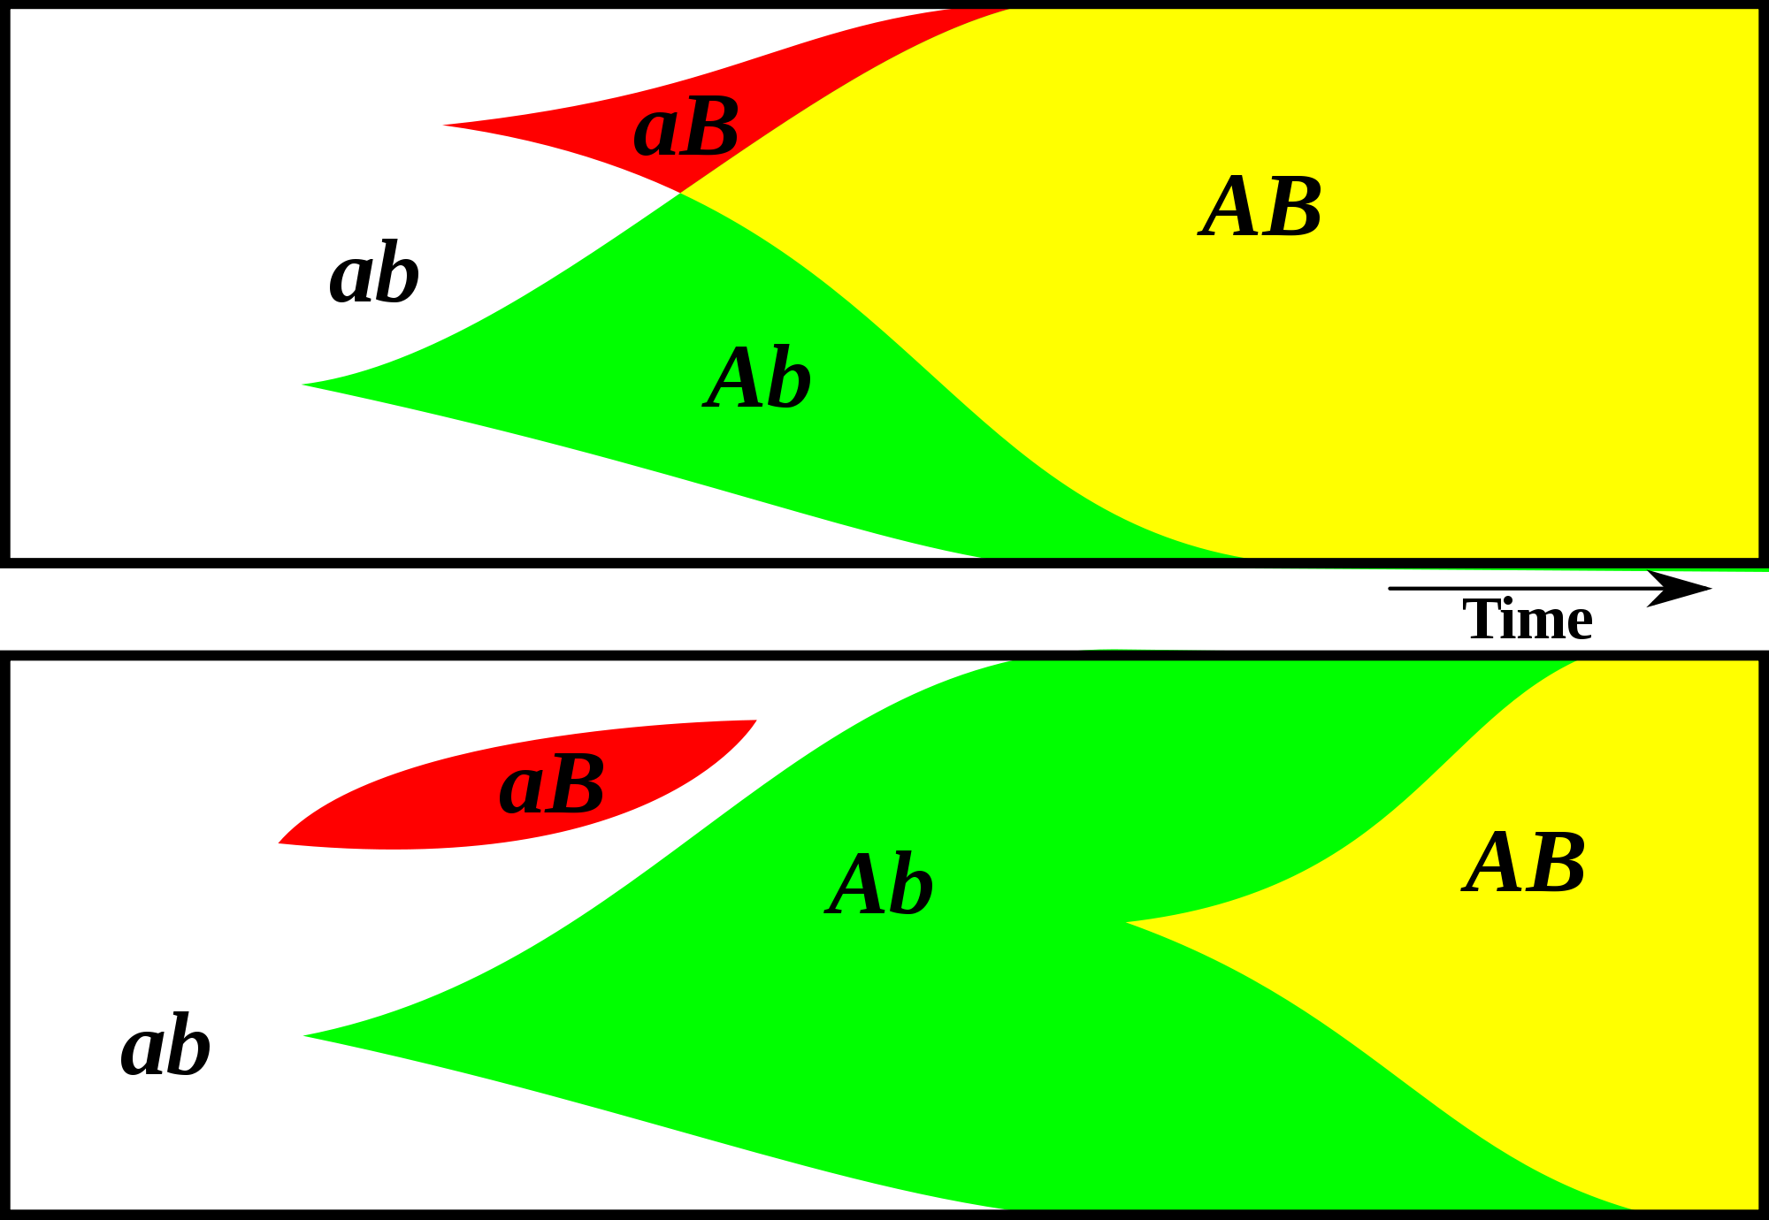
Gene Transfer, Sex, and Recombination:
Inventions do not need to be made sequentially
Gene transfer, followed by homologous or non-homologous recombination, allows inventions to be shared across the tree of life

Slide 44
Aside: Gene and genome duplication versus
Horizontal Gene Transfer
Gene family expansion through horizontal gene transfer –
the most common process in prokaryotes
Gene duplication through lineage fusion
Very common in plants, but also in animals
Autochtonous gene/genome
duplication are rare
in prokaryotes

Slide 45
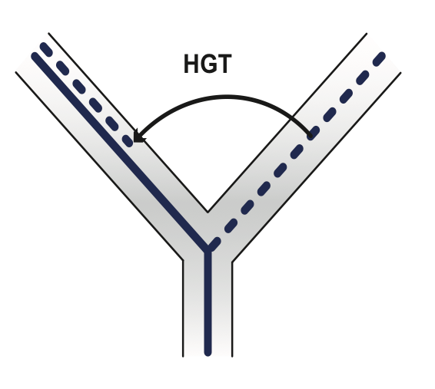
Horizontal Gene Transfer (HGT) and the
Acquisition of New Capabilities
Most important process to adapt microorganisms to new environments.
E.g.: Antibiotic and heavy metal resistance,
pathways that allow acquisition and breakdown of new substrates.
Creation of new metabolic pathways.
HGT not autochthonous gene duplication is the main
process of gene family expansion in prokaryotes.
Also important in the recent evolution of multicellular eukaryotes
(HGT between fish species and between grasses).
Selection acts on the Holobiont (= Host + Symbionts)
To adapt to new conditions, new symbionts can be acquired, or existing symbionts can acquire new genes through HGT.
(But in many cases it is not clear that selection has actually acted on the holobiont - in the algal cell wall example, this might have just have been an empty niche for the gut bacteria with the appropriate capabilities.
(For more discussion see here, for the case of hyena’s see here)

Slide 46
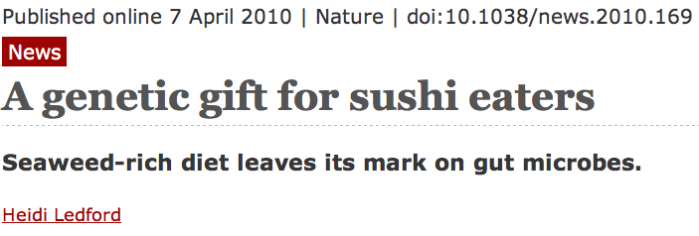
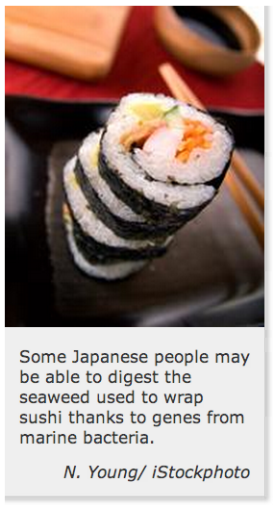
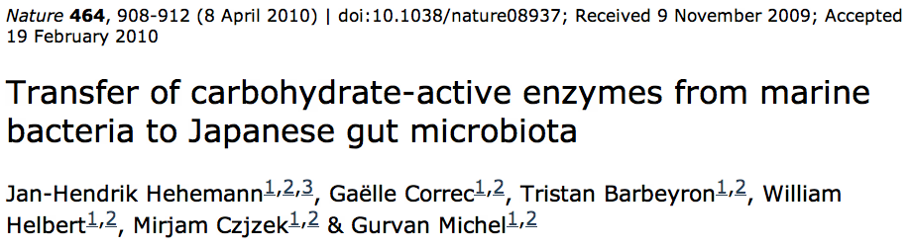


Gene Transfer in Eukaryotes
Bacterial parasites on red algae
HGT
Human gut symbiont

Slide 48


Slide 49

Gene Transfer in Eukaryotes – Example 2
Highlights
Key genes for C₄ photosynthesis were transmitted between distantly related grasses
These genes contributed to the adaptation of the primary metabolism
Their transmission was independent from most of the genome
Curr Biol. 2012 Mar 6;22(5):445-9. Epub 2012 Feb 16.
Adaptive Evolution of C(4) Photosynthesis
through Recurrent Lateral Gene Transfer.
Christin PA, Edwards EJ, Besnard G, Boxall SF, Gregory R, Kellogg EA, Hartwell J, Osborne CP.
Eric H. Roalson Current Biology Vol 22 No 5 R162

Slide 50

Gene Transfer in Eukaryotes – Example 2
From: Christin PA, Edwards EJ, Besnard G, Boxall SF, Gregory R, Kellogg EA, Hartwell J, Osborne CP.
Adaptive Evolution of C(4) Photosynthesis
through Recurrent Lateral Gene Transfer. Curr Biol. 2012 Mar 6;22(5):445-9. Epub 2012 Feb 16.

Slide 51


Gene Transfer in Eukaryotes – Example 3

Slide 52
More Examples in
Horizontal gene transfer: building the web of life
https://www.nature.com/articles/nrg3962

Slide 53
This is how far we got on 4/2
Remainder will follow next week

Slide 54


“As buds give rise by growth to fresh buds, and these, if vigorous, branch out and overtop on all sides many a feebler branch, so by generation I believe it has been with the great Tree of Life, which fills with its dead and broken branches the crust of the earth, and covers the surface with its ever-branching and beautiful ramifications.”
Charles Darwin in
“On the Origin of Species by Means of Natural Selection or the Preservation of Favoured Races in the Struggle for Life”,
p 162 ff, London, John Murray, 1859

Slide 55



Small Subunit Ribosomal RNA based Tree of Life.
Carl Woese
George Fox

Slide 56

Ochiai, K., Yamanaka, T., Kimura, K., and Sawada, O. (1959)
Inheritance of drug resistance (and its transfer) between Shigella strains and Between Shigella and E.coli strains.
Hihon Iji Shimpor 1861: 34 (in Japanese)
Gray GS, Fitch WM (1983):
Evolution of antibiotic resistance genes: the DNA sequence of a kanamycin resistance gene from Staphylococcus aureus.
Mol Biol Evol 1983, 1(1):57-66.
Sorin Sonea (1988):
The global organism:
A new view of bacteria.
The Sciences, 28:38-45.
Lynn Margulis
Symbiogenesis (1967)
(based on Konstantin Mereschkowski)
Gaia Hypothesis (1974)
(together with James Lovelock)

Slide 57


1993:
1995:
GOGARTEN, J.P. (1995): The early evolution of cellular life, Trends in Ecology and Evolution, 10, 147-151.

Slide 58


1998:
Science, 280, p.672ff (1998)

Slide 59
2010: Homeoalleles
Variants that have the same general function, but can have distinct characteristics (e.g., resistance against antibiotics).
Gene pool contains different homeoalleles, but individual strains and species usually contain only one of the alleles.
Can be brought together temporarily in a lineage through HGT
Andam, Williams, Gogarten 2010 PNAS
Notes:
The two TyrRS enzymes can be seen as variants similar to alleles in a population. Individual lines of descent possess one or the other of these variants, and in rare instances, they can possess both. We propose to call these variants homeoalleles. Like alleles, they have the same general function, but can have distinct characteristics. As is the case for homeologs in polypoids, homeoalleles cannot be considered orthologs, even though they are homologs with the same function. The line of descent has access to a gene pool that contains both TyrRS homeoalleles, whereas individual strains and species usually contain only one of the alleles. Genes in the accessible gene pool have different propensity to be swapped into an individual line of decent. Genes present in members of the same strain in the same environment likely have the highest propensity of being acquired, genes from organisms with similar regulatory promoter sequences and similar composition will be more frequently acquired than genes with less similar composition and promoters. Genes from divergent organisms will frequently fall in the latter category, and may contain sequence motifs incompatible with the genome organization of the recipient (36).
The two TyrRS types are so divergent (approximately 28 % identity between the two Pseudomonas TyrRS types) that the possibility of homologous recombination between the TyrRS homeoalleles is unlikely. Consequently, in case of TyrRS homeoalleles we expect that the unit of successful horizontal gene transfer includes at least the complete tyrRS gene. Homeoalelles can then be brought together temporarily in a lineage following horizontal transfer, but due to largely overlapping function, only one of the alleles is likely to survive in a lineage on the long run. The surviving allele may be selected due to an adaptive advantage under prevailing conditions.

Slide 60


Slide 61

glutamate
synthase
penicillin-bp
ArgRS synteny
between types in Pseudomonadales and Oceanospirillales
aroB
malic enz
ArgRS A&B
PilQ
PriA
HsIU

Slide 62

The genomic neighborhood of tyrRS homeoallele in γ-proteobacteria
Andam, Williams, Gogarten 2010 PNAS
Notes:
similar neighboring gene identity and order for both tyrRS types A and B
The similarities in tyrRS region but differences in tyrRS type imply that transfer of tyrRS types among these genomes followed by homologous recombination. Although the two tyrRS types have low identity, homologous replacement with breakpoints in the neighboring genes may have facilitated the switching between TyrRS types. P. aeruginosa also carries tyrRS type A, but the genomic neighborhood of this gene does not show synteny with that of the tyrRS type A of other closely related taxa.
The finding of similar tyrRS gene neighborhoods in close relatives carrying either type A or type B provides evidence for the replacement of one form of tyrRS with another. Significantly, this rejects the differential loss hypothesis for these organisms. If the last common ancestor possessed both types of enzymes, we would expect the genes coding for each type of tyrRS to possess dissimilar genes flanking them.
The two TyrRS types are so divergent (approximately 28 % identity between the two Pseudomonas TyrRS types) that the possibility of homologous recombination within the TyrRS homeoalleles is unlikely. Consequently, in case of TyrRS homeoalleles, we expect that the unit of successful horizontal gene transfer includes at least the complete tyrRS gene.

Slide 63
PAN-GENOME OF CLOSELY RELATED ORGANISMS:
CORE AND SHELL
Edwards-Venn cogwheel
A.W.F. Edwards 1998

Slide 64


Organismal Evolution:
“Tree of Life” or “Tangled Web”?
October 27th, “Exceptions and the Unexpected”, Swarthmore College
Genome content tree
Similar trees see: Tekaia et al. (1999) Genome Res 9:550- 557; Snel et al. (1999) Nat Genet 21:108-110; Lin & Gerstein (2000) Genome Res 10:808-818; Fitz-Gibbon & House (1999) Nucleic Acids Res 27:4218-4222 and (2002) J Mol Evol 54:539-47; Charlebois et al. (2003) Nature 421:217; Wolf et al. (2001), BMC Evol. Biol 1:8
NeighborNet (version 1, David Bryant 2002, http://www.mcb.mcgill.ca/~bryant/NeighborNet/)
Same data, different algorithm

Slide 65
HGT as a force creating new pathways

Slide 66

HGT as a force creating new pathways – Example I
Acetoclastic Methanogenesis
Unique to subset of Archaea
Energy production via reduction of multiple carbon substrates to CH₄
900 Million metric tons of biogenic methane produced annually.
Over 66% of biogenic methane is produced from acetate, mostly by Methanosarcina genera.
From: Galagan et al., 2002
Fournier and Gogarten (2008) Evolution of Acetoclastic Methanogenesis in Methanosarcina via Horizontal Gene Transfer from Cellulolytic Clostridia. J. Bacteriol. 190(3):1124-7

Slide 67


Clostridia acetigenic pathway
Methanosarcina
acetoclastic pathway
AckA
HGT
PtaA
PtaA
AckA
Figures drawn with Metacyc (www.metacyc.org)

Slide 68

HGT as a force creating new pathways – Example 2
Oxygen producing photosynthesis

Slide 69

A heterologous fusion model for the evolution of oxygenic photosynthesis based on phylogenetic analysis.
Xiong J et al. PNAS 1998;95:14851-14856
©1998 by National Academy of Sciences
Notes:
A heterologous fusion model for the evolution of oxygenic photosynthesis based on phylogenetic analysis. Details of the model are provided in the text.

Slide 70
HGT as a force creating new pathways – Example 3
Acetyl-CoA Assimilation: Methylaspartate Cycle
Acetate
Alcohols
Polyhydroxybutyrate
Fatty acids
acetyl-CoA
Lysine, leucine
oxaloacetate
citrate
malate
isocitrate
CO
2
fumarate
acetyl-CoA
2-oxoglutarate
Poly-γ -glutamate
succinate
glutamate
Proteins
glyoxylate
γ-Glutamylcystein
succinyl-CoA
methylaspartate
CO
Osmoadaptation
2
propionyl-CoA
mesaconate
3-methylmalyl-CoA
mesaconyl-CoA
Khomyakova, Bükmez, Thomas, Erb, Berg, Science, 2011

Slide 71
Comparison of different anaplerotic pathways
acetyl-CoA
acetyl-CoA
acetyl-CoA
acetyl-CoA
crotonyl-CoA
oxaloacetate
citrate
oxaloacetate
citrate
CO
2
malate
isocitrate
acetyl-CoA
ethylmalonyl-CoA
CO
2
fumarate
acetyl-CoA
2-oxoglutarate
malate
isocitrate
methylsuccinyl-CoA
glyoxylate
succinate
glutamate
CO
2
mesaconyl-CoA
glyoxylate
2-oxoglutarate
3-methylmalyl-CoA
succinyl-CoA
methylaspartate
fumarate
CO
propionyl-CoA
glyoxylate
2
propionyl-CoA
mesaconate
CO
2
CO
2
acetyl-CoA
succinate
succinyl-CoA
3-methylmalyl-CoA
mesaconyl-CoA
succinyl-CoA
malate
Citric acid cycle and
Glyoxylate cycle
Ethylmalonyl-CoA
pathway
Methylaspartate cycle
Bacteria, Eukarya and some Archaea
α-Proteobacteria, streptomycetes
haloarchaea

Slide 72
HGT as a force creating new pathways – Example 3
Acetyl-CoA Assimilation: methylaspartate cycle
Haloarchaea
Haloarcula marismortui,
Natrialba magadii
Glutamate fermentation,
Bacteria
Propionate assimilation
Acetate
assimilation, Bacteria
Khomyakova, Bükmez, Thomas, Erb, Berg, Science, 2011

Slide 73


Tree, Web, or Coral of Life?
“The tree of life should perhaps be called the coral of life, base of branches dead”
Charles Darwin
painted by George Richmond in the late 1830
Page B26 from Charles Darwin’s (1809-1882) notebook (1837/38)

Slide 74



Which Type of Coral ?

Slide 75

Darwin’s Coral a Red Algae?
(Bossea orbignyana)
According to Horst Bredekamp, parts of the diagram in Darwin's origin of species (center) may reflect the branching properties of a specimen Darwin collected himself.
From Florian Maderspacher:
“The captivating coral--the origins of early evolutionary imagery.”
Current Biology 16: R476-8 2006

Slide 76
Y chromosome
Adam
Mitochondrial
Eve
Lived
approximately
40,000 years ago
Lived
166,000-249,000
years ago
Thomson, R. et al. (2000) Proc Natl Acad Sci U S A 97, 7360-5
Underhill, P.A. et al. (2000) Nat Genet 26, 358-61
Mendez et al. (2013) American Journal of Human Genetics 92 (3): 454.
Cann, R.L. et al. (1987) Nature 325, 31-6
Vigilant, L. et al. (1991) Science 253, 1503-7
Albrecht Dürer, The Fall of Man, 1504
Adam and Eve never met ☹
The same is true for ancestral rRNAs, EF, ATPases!

Slide 77



The Watershed of Life
Jonathan Eisen in his Tree of Life Blog on
"Top Five Metaphors Charles Darwin Considered"
http://phylogenomics.blogspot.com/2008/06/top-five-metaphors-darwin-considered.html
http://www.southcom.mil/appssc/files/Blogs/633600980055909252.jpg
Meeting of the meeting of Solimões and Negro rivers at Origin of the Amazon

Slide 78

THE POTATO OF LIFE
Bacteria
Archaea
Eukaryotes
Successive independent crystallization of the three domains of life from a population of pre-cells
extinct
lineage
Glansdorff N, Xu Y, Labedan B: The Last Universal Common Ancestor: emergence, constitution and genetic legacy of an elusive forerunner.
Biol Direct 2008, 3:29.
Kandler O (1994) The early diversification of life. In Early Life on Earth, Nobel Symposium, vol. 84, pp. 152-509: Columbia Univ. Press.
Woese CR (2002) On the evolution of cells. PNAS 99: 8742-7
photo from www.sonnentaler.net

Slide 79

The Coral of Life (Darwin)
ZHAXYBAYEVA and GOGARTEN (2004):
Cladogenesis, Coalescence and the Evolution of the Three Domains of Life.
Trends in Genetics 20 (4): 182- 187
Notes:
The “Coral of Life” and the transfer of characters from now extinct into surviving lineages

Slide 80

The Coral of Life (Darwin)
ZHAXYBAYEVA and GOGARTEN (2004):
Cladogenesis, Coalescence and the Evolution of the Three Domains of Life.
Trends in Genetics 20 (4): 182- 187
Notes:
The “Coral of Life” and the transfer of characters from now extinct into surviving lineages

Slide 81
The Coral of Life (Darwin)
ZHAXYBAYEVA and GOGARTEN (2004):
Cladogenesis, Coalescence and the Evolution of the Three Domains of Life.
Trends in Genetics 20 (4): 182- 187
Notes:
The “Coral of Life” and the transfer of characters from now extinct into surviving lineages

Slide 82

leucyl-tRNA synthetase
phylogeny
Ancient origin of the divergent forms of leucyl-tRNA synthetases in the Halobacteriales
Cheryl P Andam, Timothy J Harlow, R Thane Papke and
J Peter Gogarten
BMC Evolutionary Biology 12:85

Slide 83
Phylogeny of selected class II amino acyl tRNA synthetases

Slide 84
Phylogeny of Ser and Thr aa tRNA synthetases
Notes:
ML tree showing the common and rare types of SerRS and ThrRS. Branch colors depict Euryarchaeota (red), TACK groups (Thaumarchaeota, Crenarchaeota, Korarchaeota) (orange), Bacteria (blue) and Eukarya (green). More narrow taxonomic designations are bracketed and labeled. Ancestral nodes of rare and common aaRS types within the tree are labeled (A-D). Dotted lines represent branches with <50% BS support; major clades with >80% BS support are labeled with respective BS support values. Italic numbers represent posterior probability (PP) support values from tree reconstruction in PB. Significant conflict between the ML and PB trees is shown by an alternative diagonal branching. The full alignment used for the ML tree contains 201 taxa, an alignment length of 1322 amino acids and was reciprocally rooted using each aaRS family paralog. For the PB reconstruction, a decomposed alignment was used, concatenating global and aaRS family-specific well-aligned sites as identified by GUIDANCE for a total alignment length of 453 amino acids (see methods). Branch lengths depict substitutions/site. (*)PP support value in the alternative PB topology.

Slide 85

Coalescence – the process of tracing lineages backwards in time to their common ancestors. Every two extant lineages coalesce to their most recent common ancestor. Eventually, all lineages coalesce to the cenancestor.
t/2
(Kingman,
1982)
Illustration is from J. Felsenstein, “Inferring Phylogenies”, Sinauer, 2003

Slide 86


Simulations of organismal evolution by coalescence
One extinction and one speciation event per generation
Horizontal transfer event once in 10 generations
RED: organismal lineages (no HGT)
BLUE: molecular lineages (with HGT)
GRAY: extinct lineages
RESULTS:
Most recent common ancestors are different for organismal and molecular phylogenies
Different coalescence times
Long coalescence of the last two lineages

Slide 87


The deviation from the “long branches at the base” pattern could be due to
under sampling
an actual radiation
  due to an invention that was not transferred
  following a mass extinction
Bacterial 16SrRNA based phylogeny (from P. D. Schloss and J. Handelsman, Microbiology and Molecular Biology Reviews, December 2004.)

Slide 88

From: http://www.origin-life.gr.jp/3603/3603055/3603055.html
Alternative: tail of early heavy bombardment; however, see Marchi et al.
Nature 511:578-82 2014 for a recent update on the early impact history.

Slide 89
Gene Transfer and Phylogenetic Reconstruction: Friends or Foes?
Popular view
Gene transfer is a disruptive force in phylogenetic reconstruction.
New view
Events of ancient gene transfer are valuable tools for reconstructing organismal phylogeny.

Slide 90

1. Any ancient gene transfer to the ancestor of a major lineage implicitly marks the recipient and descendents as a natural group.
2. The donor must exist at the same time or earlier than the recipient.
Ancient HGTs

Slide 91
Gene transfer as a tool to correlate evolutionary events and define clades
  Animals – Fungi diverge after split of Haloarchaea into lineages that contain Halobacterium and Haloarcula, respectively.
  Archaeplastida (glaucocystophytes, red-, and green algae) diverge after Chlamydiae split into lineages containing Chlamydia and Parachlamydia, respectively.
  Bacterial and archaeal groups had already diverged into different families and genera, before the major eukaryotic kingdoms diverged.
  All Prochlorococcus strains possess a threonyl RS acquired from a marine gamma Proteobacterium.

Slide 92
Can one reconstruct microbial phylogeny?
PHYLOGENY:
from Greek phylon, race or class, and -geneia, born.
“the origin and evolution of a set of organisms, usually of a species” (Wikipedia);
Phylogeny does not necessarily occur in a tree-like process!

Slide 93



Rope as a metaphor to describe an organismal lineage
(Graham Cairns-Smith, Gary Olsen)
Individual fibers = genes that travel for some time in a lineage.
While no individual fiber present at the beginning might be present at the end, the rope (or the organismal lineage) nevertheless has continuity.

Slide 94

However, the genome as a whole will acquire the character of the incoming genes (the rope turns solidly red over time).

Slide 95


HGT can generate reproducible patterns in molecular phylogenies.
Gogarten, J.P., Doolittle, W.F., Lawrence, J.G., Mol. Biol. Evol. 2002 19:2226-2238.

Slide 96
HGT can generate reproducible patterns
in molecular phylogenies.
Evolution of Organismal Lineages
Molecular Phylogenies
Group A
Group B
Group C
A
B
C
A
B
C

Slide 97


The Phylogenetic Position of Thermotoga
(a) Most genome based approaches
(b) according to 16S & other ribosomal markers
(c) according to phylogenetically discordant genes
Zhaxybayeva O, Fournier G, Lapierre P, Swithers K, Nesbø C, Gogarten JP, Doolittle WF, Noll KM: Phylogenetic position of Thermotogales revisited: conflicting signals and evidence for thermophilic ancestral proteome, PNAS 3/24/2009
Gophna U, Doolittle WF & Charlebois RL:
Weighted genome trees: refinements and applications. J. Bacteriol. (2005)
Gogarten JP & Townsend JP: Horizontal gene transfer, genome innovation, and evolution Nature Reviews in Microbiology 3(9) 679-687(2005)

Slide 98
Progressive gene gain in the Thermotogales
Bacillus/Clostridium
Other
Archaea
Aquificae
Thermotoga specific
The acquisition of archaeal and clostridial genes appears to be an ongoing process.

Slide 99



Slow sites, recoded
rplL-rpoB-rpoC phylogeny

Slide 100



“The Sphaerochaeta genomes are highly enriched in fermentation and carbohydrate metabolism genes relative to other spirochetes, indicating a fermentative lifestyle. Remarkably, most of the enriched genes appear to have been acquired from non spirochetes, particularly clostridia, in several massive horizontal gene transfer events (>40% of the total number of genes in each genome).”
43 single-copy informational gene sequences
the values next to the arrows indicate the numbers of genes exchanged (out of a total of 178 genes examined).

