Slide 1
Pan-genomes & Playing Cards:
A Shared Resource and the Black Queen
MCB 5472
26 Feb 18
Presented by:
Matthew Fullmer

Slide 2
What is the pan-genome?
The combined genomes of a group of organisms is their pan-genome.
Usually, this refers to a related group of organisms. Either in the abstract:
- i.e., the pan-genome of E. coli
Or a specific subset:
- The pan-genome of the STEC infection in a gut. Or the Bacillus strains colonizing a niche.
Edwards-Venn cogwheel
A.W.F. Edwards 1998

Slide 3
More terminology
Typically, the term is used exclusively to a related taxonomic group, like a species or genus.
Sometimes it refers to a broader set like the entire contents of a gut
But this is usually referred to as a meta-genome and considered a separate phenomenon.
But sometimes it applies well to groups of closely interacting organisms that may not be closely related.
Edwards-Venn cogwheel
A.W.F. Edwards 1998

Slide 4
A definition!
The combined genomic repertoire of a group of organisms is their pan-genome.
Usually fixated on genes/ORFs.
All strains in a group will share a “core” of genes.
The rest are the auxiliary genes.
  Define strains
  Environmental adaptation
  Transitory genes “passing through” the host
  Parasites that have not swept.
  Etc.
Edwards-Venn cogwheel
A.W.F. Edwards 1998

Slide 5
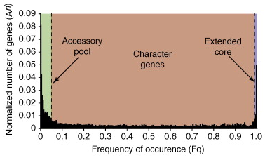
The pan-genome
Lapierre and Gogarten defined the auxiliary genome as having two components:
Accessory genes: Often found in single genomes. Appear to often be transitory.
Character genes: Often define strain types and facilitate adaptation to environments.
Lapierre and Gogarten, 2009

Slide 6
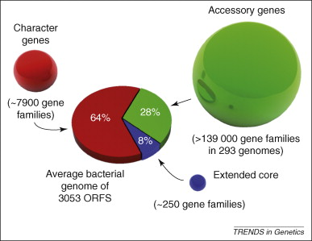
The pan-genome
Or, to visualize that data a little differently: ->
Only a small fraction of a strain’s genome is part of the core.
Most of the genome is composed of character genes found in a narrow range of species.
The remainder comes from a very large pool of rarely found genes.
Lapierre and Gogarten, 2009

Slide 7
How do we get a pan-genome?
There are several methods.
The most common is annotating your genomes to call ORFs and then using a sequence comparison tool, such as BLAST, to identify genes which belong in the same homologous group (HG).
Ideally, HGs equate to gene families.

Slide 8
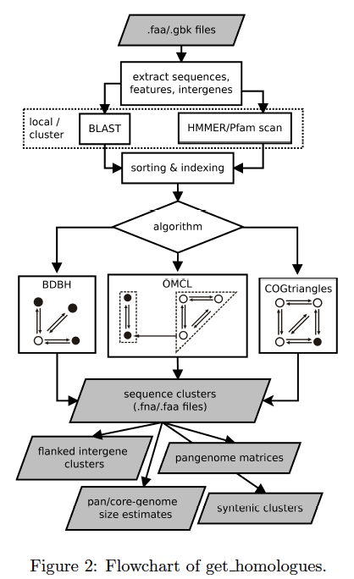
How do we get a pan-genome?
There are several methods.
The most common is annotating your genomes to call ORFs and then using a sequence comparison tool, such as BLAST, to identify genes which belong in the same homologous group (HG).
Ideally, HGs equate to gene families.
But there is actually a lot else going on, too.

Slide 9
How do we get a pan-genome?
There are many methods of deciding how to group genes together (or break them apart).
How to deal with paralogs is also a major question with many answers.
Some approaches use genome alignments to inform decisions
Others infer a phylogenies to help guide choices.
All have pros and cons

Slide 10
How do we get a pan-genome?
On Wednesday we will use a program called GET_HOMOLOGUES to build and help analyze a small pan-genome.
This package is user-friendly and handles most of the complicated math and choices internally.

Slide 11
Uses of a pan-genome
So that is cool, but what can we do with a pan-genome?
As you might imagine, quite a lot.

Slide 12
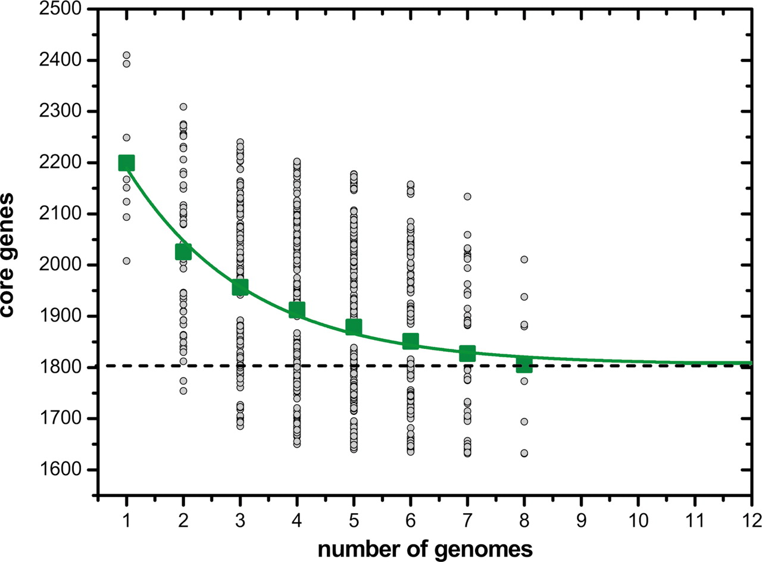
One can infer the size of the core genome
Hervé Tettelin et al. PNAS 2005;102:13950-13955
©2005 by National Academy of Sciences
Notes:
GBS core genome. The number of shared genes is plotted as a function of the number n of strains sequentially added (see Materials and Methods). For each n, circles are the 8!/[(n – 1)!·(8 – n)!] values obtained for the different strain combinations. Squares are the averages of such values. The continuous curve represents the least-squares fit of the function Fc = κc exp[–n/τc] + Ω (see Eq. 1 in Supporting Text) to data. The best fit was obtained with correlation r2 = 0.990 for κc = 610 ± 38, τc = 2.16 ± 0.28, and Ω= 1,806 ± 16. The extrapolated GBS core genome size Ω is shown as a dashed line.

Slide 13
Or estimate if the entire pan-genome has been sampled yet

Slide 14
Aside: Rarefaction and Frequency histogram contain equivalent information
Analysis of 57 Aeromonas veronii genomes. The histogram on the left gives the U-shaped fre­quency distribution of gene families typically observed for bacterial taxa.

Slide 15
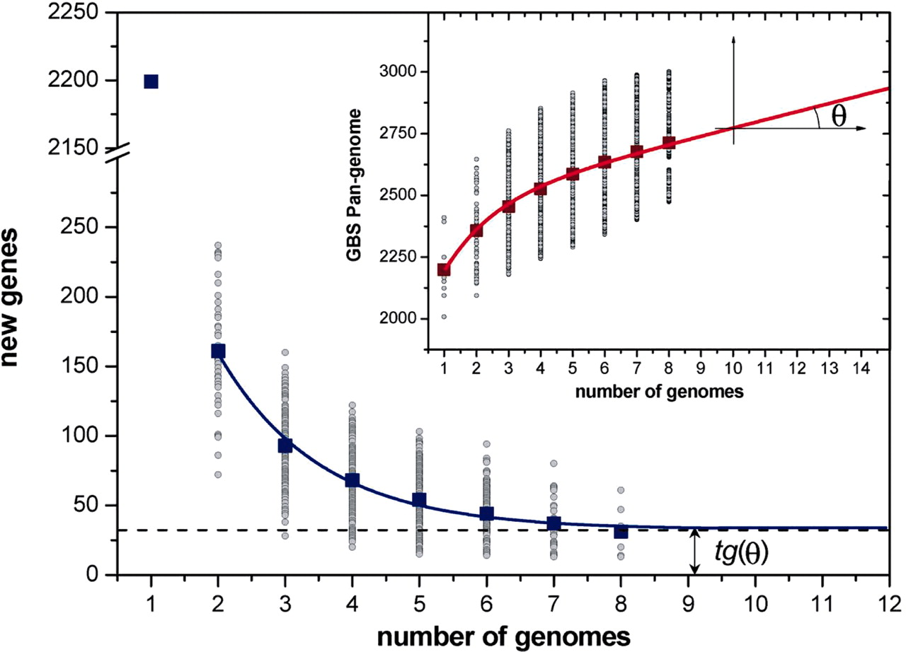
And as a byproduct, calculate the new genes added by every new genome
GBS pan-genome.
Pan-genome size
Hervé Tettelin et al. PNAS 2005;102:13950-13955
©2005 by National Academy of Sciences
Notes:
GBS pan-genome. The number of specific genes is plotted as a function of the number n of strains sequentially added (see Materials and Methods). For each n, circles are the 8!/[(n – 1)!·(8 – n)!] values obtained for the different strain combinations; squares are the averages of such values. The blue curve is the least-squares fit of the function Fs(n) = κs exp[–n/τs] + tg(θ) (see Eq. 2 in Supporting Text) to the data. The best fit was obtained with correlation r2 = 0.995 for κs = 476 ± 62, τs = 1.51 ± 0.15, and tg(θ) = 33 ± 3.5. The extrapolated average number tg(θ) of strain-specific genes is shown as a dashed line. (Inset) Size of the GBS pan-genome as a function of n. The red curve is the calculated pan-genome size \documentclass[12pt]{minimal} \usepackage{amsmath} \usepackage{wasysym} \usepackage{amsfonts} \usepackage{amssymb} \usepackage{amsbsy} \usepackage{mathrsfs} \setlength{\oddsidemargin}{-69pt} \begin{document} \begin{equation*}\;P(n)=D+tg({\theta})[n-1]+{\kappa}_{{\mathrm{s}}}\hspace{.167em}{\mathrm{exp}}[-2/{\tau}_{{\mathrm{s}}}]{\cdot}\frac{1-{\mathrm{exp}}[-(n-1)/{\tau}_{{\mathrm{s}}}]}{1-{\mathrm{exp}}[-1/{\tau}_{{\mathrm{s}}}]} \end{equation*}\end{document} (see Eq. 4 in Supporting Text), with values of the parameters obtained from the fit of Fs(n) (see Eq. 2 in Supporting Text).

Slide 16
Practical Uses
You can do more overtly useful things, too.
One of my favorites is to use the core to build phylogenies.
We usually choose to use a “relaxed” or “expanded” definition of core where genes only need to be in say 90% of genomes to count, rather than the “strict” core where everything needs to be in everything.
This allows us to be less concerned about sequencing, assembly, and annotation errors losing important genes.
Treebuilding methods: usually either multi-HG concatenation, or supertree of individual HG (gene) trees. Could also use preence-absence of HGs.

Slide 17
Aeromonas relaxed/expanded core phylogeny
All genes present in 90% of the 56 genomes.
Collossal concatenation into single “super-gene.”
Inferred under a maximum-likelihood model…because anything less than maximum is too little.
Lots of high support values.
Most species cluster together as expected.
Found some misclassified taxa.
Colston, Fullmer et al., 2014

Slide 18
MLSA vs. Expanded Core Trees
Colston, Fullmer et al., 2014

Slide 19
Switching Gears A Little…
Let us go back to theory a little bit and cover some interesting ideas about how pan-genomes might behave in the wild.

Slide 20
The pan-genome as a shared resource
Horizontal Gene Transfer (HGT) is any exchange of genes between two organisms that was not the result of vertical descent.
  Carried on a prophages, transposons, plasmids etc.
HGT is more frequent between close relatives (Andam and Gogarten, 2011) with a log-linear decline with relationship distance.
The pan-genome of an strain/species/genus may represent a set of genes that are freely available to any individual cell through HGT at potentially any time.
Weakly selected for functions can be shed when not favorable in a given niche but rapidly re-acquired through HGT when conditions change.

Slide 21
An extreme form of a pan-genome
Jeffrey Lawrence proposed a meta-cell model in 1999 in which many small micelles exchange genes with high frequency.
Each micelle is so small that its genome space is limited and it cannot maintain a full-sized genome with all of the genes required to replicate.
The result is a co-operative population with critical genes shuffled about rapidly.
Some or all of the auxiliary pan-genome is actually part of the core to the population as a whole.
Let me show you how this works…

Slide 22
Cells without complete genomes
Cell with limited genome size:
Genes that produce:
Resources:

Slide 23
Cells without complete genomes
Cell with limited genome size:
Genes that produce:
Resources:

Slide 24
Cells without complete genomes
Cell with limited genome size:
Genes that produce:
Resources:

Slide 25
Cells without complete genomes
The population of micelles can be thought of as a single “meta-cell.”
This meta-cell is reminiscent of Woese’s progenote (Woese, 1998) and Kandler’s pre-cell populations (Kandler, 1994)
The exchange of genes coding for vital products can be thought of as analogous to multiple divers taking turns on an oxygen tank.
Or the members of a baseball lineup taking turns at bat.

Slide 26
The black queen hypothesis
First described by Morris et al. in 2012 to explain the absence of peroxide defenses in Prochlorococcus.
Not related to the well known Red Queen hypothesis.
The name derives from the card game Hearts, where the goal is to avoid taking any hearts cards or the (black) queen of spades.
  Unless you can take all of them

Slide 27
The black queen hypothesis
The heart cards and black queen represent leaky common good functions in microbes.
Common goods include anything secreted that others can then benefit from
  Siderophores
  Extracellular antibiotic defense enzymes (i.e. β-lactamases)
  Elastases
  Intracellular detoxification of diffusible compounds
  Free-radical neutralization
  Degradation of membrane-diffusible antibiotics (i.e. rifampicin)

Slide 28
The black queen hypothesis
Cells:
Genes that produce:
Resources:

Slide 29
The black queen hypothesis
Energy savings!
Cells:
Genes that produce:
Resources:
Energy savings!

Slide 30
The model predicts this will continue
Energy savings!
More savings!
Cells:
More savings!
Genes that produce:
Resources:
Energy savings!

Slide 31
…but only for the initial cheaters
Least energy expended
Most energy expended
Cells:
Least energy expended
Genes that produce:
Resources:

Slide 32
The black queen hypothesis
There are two paths that cells can move down:
  Retain production of all common goods
  Shed production of common goods
These sound a lot like cheaters and cooperators
The cooperators become essential to community maintenance and resemble keystone species.
Maybe there is a more extreme version of the 2nd path that does not devolve into simple cheaters and cooperators…

Slide 33
The “strong” black queen hypothesis
Cells:
Genes that produce:
Resources:

Slide 34
The “strong” black queen hypothesis
The upshot of this is that the various members of the community are locked in co-dependence.
If any member deletes any additional common goods then the entire community will collapse.
This is what we want to explore: A decentralized communal pan-genome.

Slide 35
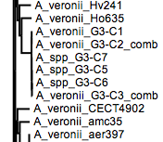
A simple use of a pan-genome
Six A. veronii isolates from the gut of the same leech.
Their genomes are very highly similar to each other.
If their genomes harbor different common goods functions it would be a feather in the cap supporting the strong black queen hypothesis.

Slide 36
Six Aeromonas strain pan-genome

Slide 37
Looking at the protein families
About 100 genes separate the 6 isolates.
Most are hypotheticals.
Among those that are not hypothetical:
  Putative isomerase involved in processing sialic acid
  Tonin peptidase from a family that is often secreted
  Creatine aminohydrolase

Slide 43
Acknowledgements
Dr. J. Peter Gogarten
Dr. Joerg Graf
Dr. R. Thane Papke
Dr. Spencer Nyholm
Dr. Paul Lewis
Dr. Jonathan Klassen
The Gogarten lab
  Shannon Soucy
  Thiberio Rangel
  Seila Omer
  Tim Harlow
  Amanda Dick
  Ryan Englander
Former lab members
  Dr. Erica Lasek-Nesselquist
Collaborators
  Sophie Colston
  Lidia Beka
  Dr. Andrew Collins
  Nikhil Ram Mohan
  Shannon Soucy
Funding
  National Science Foundation (DEB0919290 and DEB0830024)
  NASA Astrobiology: Exobiology and Evolutionary Biology Program Element (NNX12AD70G)
  NIH (R01 GM095390)
  USDA-ARS 58-1930-4-002
Notes:
Funding sources

Slide 44
Preliminary data
This is very exciting. We have worked through some complicated pan-genome ideas and found our research question.
Do we have any existing systems in which we can test the strong black queen hypothesis?
Yes.
We have found evidence worth exploring in several datasets we have previously worked in.

Slide 45
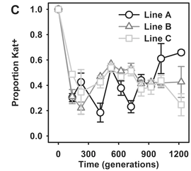
Morris 2014 Discussion
Morris et al., 2014 investigated the predictions of their hypothesis.
Engineered strains of E. coli one mutation away from catalase loss and grew under peroxide stress.
Cheaters emerged rapidly and achieved equilibria with the parent strain.

