Slide 1
Intro to R/RStudio

Slide 2
Step one: Install
Install R through one of the many mirrors
https://cran.cnr.berkeley.edu/
Install RStudio
https://www.rstudio.com/products/rstudio/download/#download

Slide 3
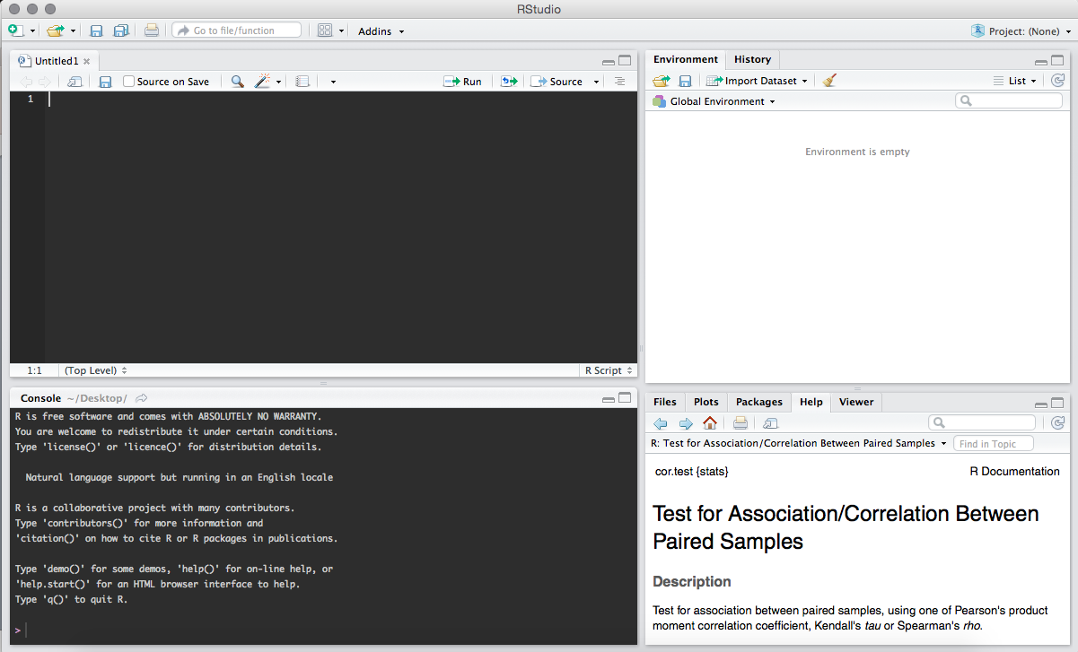
Open RStudio
script window
variables
console
packages and help

Slide 4
Set your working directory
getwd()
This will tell you where you are – same as pwd in shell
setwd()
This will let you pick the directory you want to work in – similar to cd in shell
Set your working directory to the folder I gave you
e.g. ~/Desktop/mcb5472r/
Don’t forget to use tab to finish completing names of directories and files
In some cases, your working directory will be assumed, for example when using RNotebook

Slide 5
Installing R packages
R packages are bundles of R code, documentation, and test sets
Some are full of tools for graphical output
Some can do more advanced statistics
There are thousands available on the Comprehensive R Archive Network (CRAN)
While R has a lot of built-in packages that are really useful, you’ll often want to use other packages to get your work done
I use a few almost daily – dplyr, tidyr, and ggplot2
Installing is easy:
install.packages(“ggplot2”)
Once installed, you’ll have to load the package and you’ll load them each time you open a new R environment
library(ggplot2)

Slide 6
More installation
Install Bioconductor – tools for high-throughput data anlysis packages
https://www.bioconductor.org/
Run:
source("https://bioconductor.org/biocLite.R")
biocLite()
Then use Bioconductor to install other packages
For example, NOISeq and edgeR are used for differential expression analysis of RNA-Seq data
biocLite("NOISeq")
biocLite("edgeR")

Slide 7
R scripts and R Notebooks
R scripts are basically a text editor that you can use to construct your scripts, then run them
R Notebooks may be considered more of an advanced user tool, but I wish that I had learned to use it first, so I’m introducing you to them now
They can help you organize your analysis and send it out in a clean format as an html or pdf

Slide 8
Basic and Useful Functions
Import a dataset
Make objects
Modify the dataset to use how you want
Make basic plots
Do some statistics
Complete an analysis of some sort
Make more plots
I’m not covering every basic R aspect here, but I recommend doing more detailed tutorials – there’s about 10 billion of them online – and you can always just email or come ask me a question

Slide 9
Questions?
If we have time, we can talk about your data and how you might want to analyze it

