Slide 1

MCB 5472
Student Projects,
unix, Perl
J. Peter Gogarten
Office: BPB 404
phone: 860 486-4061,
Email: gogarten@uconn.edu

Slide 2
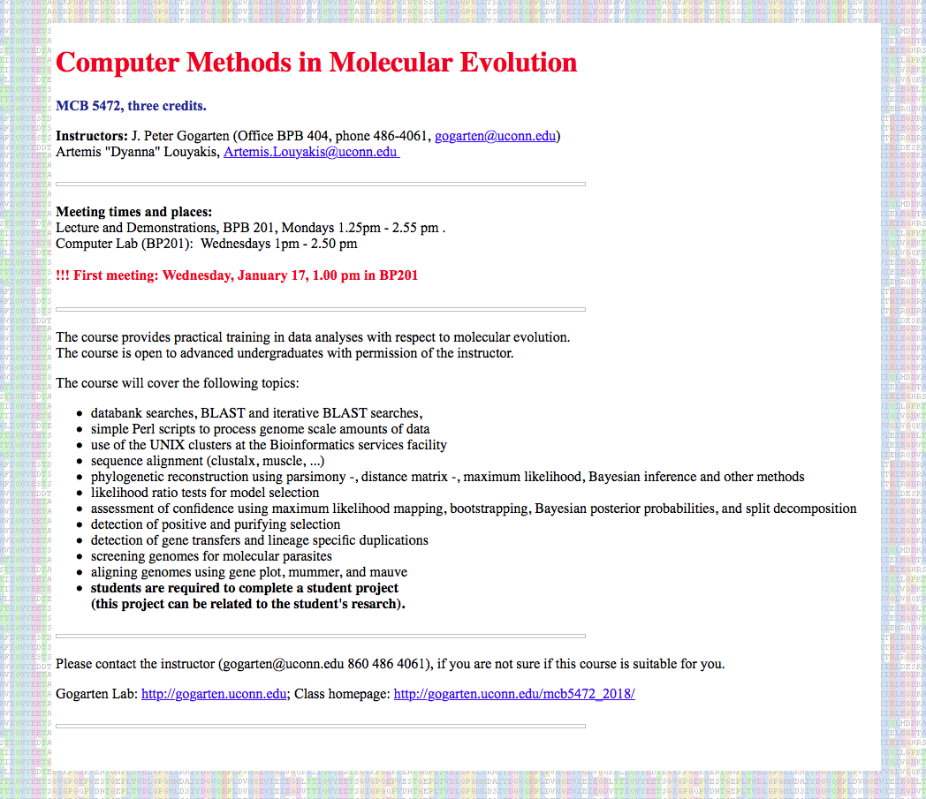

Slide 3
Discuss
Grading
Discussions

Slide 4
Student Projects
Should be related to your interests !!!
Examples for possible projects:

Slide 5
Example: Evolution of a gene family
When in the evolution of the interferon (or whatever you are interested in) gene family did gene family expansions occur (gene transfer of gene duplication)?
Which of the resulting subfamilies (if any) have acquired a new function?
What is the phylogenetic distribution of this subfamily? (Would you expect members of this subfamily to be present in insects, fish, chicken, fungi, archaea?)
Can you detect episodes of positive selection or of relaxed purifying selection?
Is there anything that would suggest gene conversion events?
The “ to-do-list” would include:
gather data (note for some of the questions mentioned above you’ll need aa and nucleotide sequences),
align sequences
build phylogenies
analyze sequences
Calculate dN/dS values (site and branch models)
assess reliability of branches
INTERPRET WHAT YOU GOT!

Slide 6
Example: Can one detect evidence for chimeric genomes?
Genome fusions are the latest rage in evolutionary biology:
For example:
Koonin EV, Mushegian AR, Galperin MY, Walker DR. Comparison of archaeal and bacterial genomes: computer analysis of protein sequences predicts novel functions and suggests a chimeric origin for the archaea.
Mol Microbiol. 1997 Aug;25(4):619-37.
The Eukaryotes are a chimera of at least an archaeal like host cell and a bacterium that evolved into a mitochondrium (+ in some cases a cyanobacterium that evolved into a plastid)
“Origins of major archaeal clades correspond to gene acquisitions from bacteria” & “Acquisition of 1,000 eubacterial genes physiologically transformed a methanogen at the origin of Haloarchaea” – based on unsubstantiated claims of massive HGT at the base of major archaeal groups.
The Thermotogales contain many archaeal genes
Most plants and many fungi (likely including bakers yeast) are aneupolyploids
In most of these instances it is not clear that the transfer (or duplication) really occurred in a single massive event, or if the transfers (duplications) occurred on a gene by gene basis.
(in yeast the type of genes that were duplicated suggest distinct selection pressures, see Benner et al here)

Slide 7
Example: Chimera? continued
In case of a chimera formed in a single historic event one would expect
Two distinct types of phylogenetic affinity.
E.g.: Genes in Thermotoga maritima should either group with the sistergroup of the bacterial partner, or with the sistergroup of the archaeal donor
Related: Ancient genome duplication events are revealed by peaks in the divergence of paralogs.

Slide 8
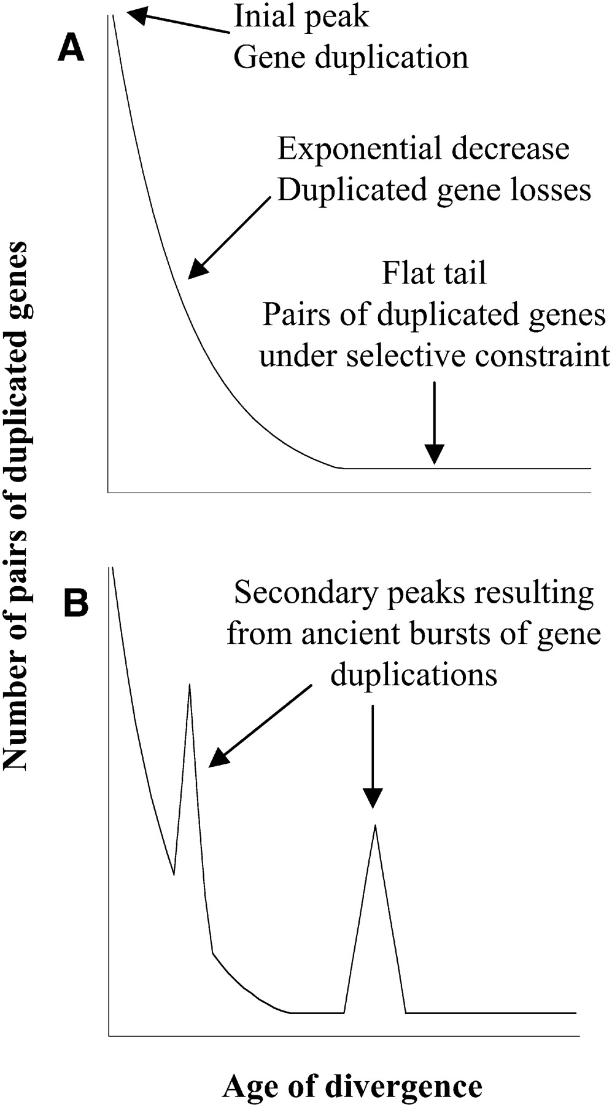

Theoretical Age Distributions of Pairs of Duplicated Genes in a Genome
Blanc, G., et al. Plant Cell 2004;16:1667-1678
Copyright ©2004 American Society of Plant Biologists

Slide 9
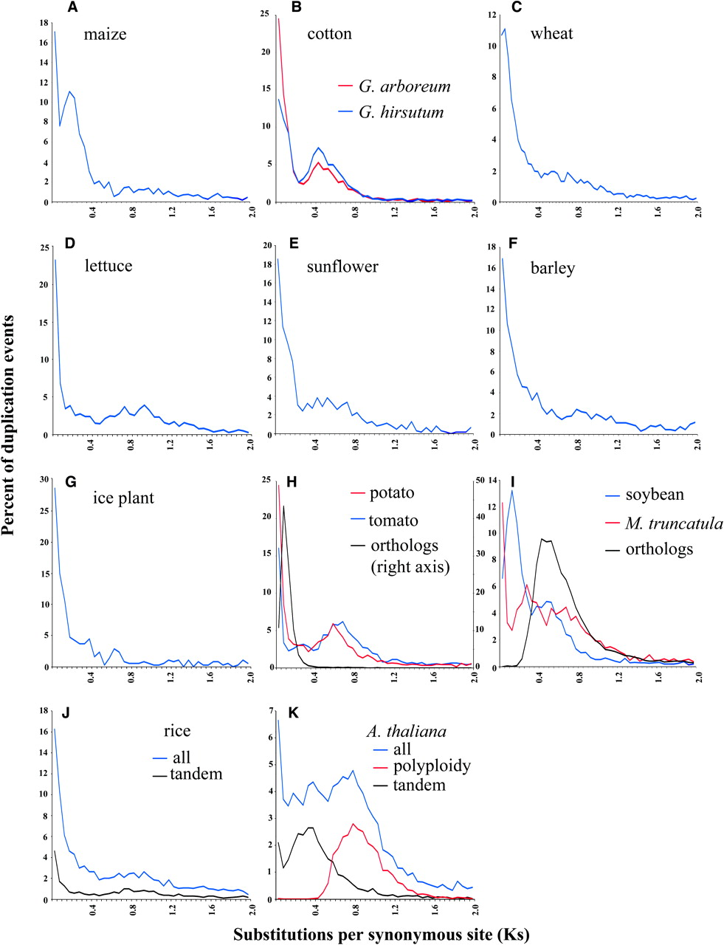
Distributions of the Fraction of Duplication Events as a Function of Their Levels of Synonymous Substitution for 14 Model Plant Species
Blanc, G., et al. Plant Cell 2004;16:1667-1678
Copyright ©2004 American Society of Plant Biologists

Slide 10
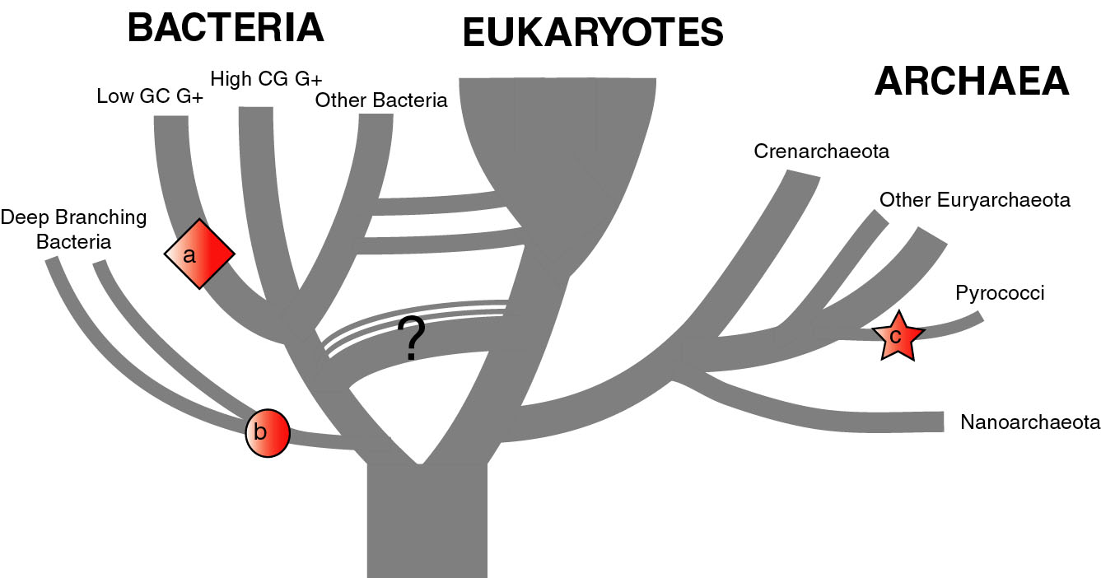
The Phylogenetic position of Thermotoga maritima
(a) concordant genes,
(b) according to 16S (and other conserved genes)
(c) according to phylogenetically discordant genes
Gophna, Doolittle & Charlebois: Weighted genome trees: refinements and applications. J. Bacteriol. here
Gogarten & Townsend: Horizontal gene transfer, genome innovation, and evolution Nature Reviews in Microbiology 3(9) 679-687 (pdf)

Slide 11
Chimera Example, continued
The “ to-do-list” would include:
Formulate the question you want to address
Download and analyze the required genomes
Run blastall (this might take a couple of hours)
Analyze the results in an Excel spreadsheet
Selected some (or all) genes (e.g., the ones that are most archaeal), assemble gene families and reconstruct their phylogenies.
INTERPRET YOUR RESULTS! What does it all mean?

Slide 12
Background for group selection Example:
Selection acts on
genes (as in the selfish gene theory, the genes are the replicators that build the body of the organism). According to this all genes are selfish, most are cooperating with one another, a few are not. To distinguish the latter from the former, I call them parasitic genes (or molecular parasites).
individuals in a population (the survival of the fittest).
groups of organisms (group selection). The group that has properties that allows it to adapt better, or to evolve faster, or to make better use of resources will be selected. In this case the group (community, not necessarily all belonging to the same species) is the unit of selection. (see group selection entry at wikipedia)
Note: in general this is controversial. To what extent is group selection reflecting kin-selection: the organism acting to guarantee survival of genes that are related to its own genes (bees in a beehive are all closely related).

Slide 13
Examples for “group selection” in microbes: (a) Agrobacteria
Agrobacteria that carry a Ti plasmid can transform plant cells with a T DNA. As result of a successful transformation the plant cell has integrated the T DNA into its genome and expresses the encoded genes. This results in the transformed cells forming a tumor, and, in addition, the transformed plant cells also produce a strange amino acid that cannot be utilized by the plant cells, but that serves as a carbon and nitrogen source for the Agrobacteria. The genes responsible for transferring the Ti plasmid between different Agrobacteria (tra genes) are under the control of quorum sensing. The effect is that if one Agrobacterium strain has successfully transformed a plant, and now lives from the plant produced strange amino acid, other Agrobacteria can receive the Ti plasmid, which contains the T DNA transferred into the plant and in addition encodes enzymes that allow the metabolism of the strange amino acids. The Agrobacteria, which receive the Ti-plasmid thus participate in the utilization of the plant produced carbon and nitrogen source. This observation could be described as group selection: the population of Agrobacteria avoids a selective sweep and carries larger genetic diversity into the population living on the transformed plant. The increased diversity will facilitate future adaptations to a changing environment, and will avoid the fixation of slightly deleterious mutations that might have been carried by the Agrobacterium that transformed the plant cell. On the other hand, one can consider this process the outcome of the "selfishness" of the tra-genes and of the Ti plasmid. These genes manage to move themselves into the growing part of the population, and they will benefit form a more diverse group of host organisms.

Slide 14
Examples for “group selection” in microbes (b):
Metal resistance genes in microbial communities inside rocks in the dry valleys of Antarctica
These rocks have high concentrations of toxic heavy metals. The endolithic microbial community readily shares heavy metal resistant genes with microbes that might be able to become part of the community. At the community level the outcome is a higher diversity, and a richer network of metabolic reactions. Presumably the more diverse communities are more stable towards perturbations, and provided the community can propagate as a whole, this would provide a selective advantage to the community. However from the selfish gene point of view, the resistance gene increases its chances of long term survival by invading as many additional species as possible.

Slide 15
Examples for “group selection” in microbes ( c): Gene Transfer Agents (GTA) in alpha proteobacteria
GTAs are prophages that do not specifically pack their own DNA, but that unselectively pack host DNA into the phage head (see here and here).
Are these just defective prophages that lost their sequence specificity in DNA packaging?
Is this an illustration that HGT is beneficial and under group selection?
(Aside: In general, HGT might reflect uptake of DNA for food, recombination might be a negligible side effect (Rosi Redfield, e.g. here), or HGT might reflect the selfishness of the transferred DNA.

Slide 16
Are the genes involved in gene transfer under purifying selection (GTAs or tra –genes that transfer TI plasmids between Agrobacteria)
Possible hypotheses:
GTAs are defective prophages that lost their sequence specificity in DNA packaging?
GTAs evolved from phages but now benefit the group and are under group selection?
The remain being selfish genes – the gene transfer they catalyze will once in a wile repair a defective GTA
Under #2:
The GTA should be more related to one another than to functioning phage
There molecular phylogeny should reflect reflect the phylogeny of the organism (as measured by rRNA and ribosomal proteins
The genes encoding the GTA should be under strong purifying selection (under #1 they should be pseudogenes).

Slide 17
Does a dN/dS ratio <1 reflect purifying selection for function (e.g. here, here), or could it reflect selection against becoming detrimental (here).
How many sites are inferred to be under purifying selection?
Are the dN/dS values for sites part of a “normal” distribution, or are some important sites more conserved?
The same principle is applicable to selfish genes. Are they decaying inside a host? Are important sites still under selection? Our working hypothesis is that many inteins retain a functioning homing endonuclease. Are the key residues of the Endonuclease still unde purifying selection?

Slide 18
other ideas:
Calculate Venn –Diagrams for genome content variation using different approaches: Presence of a significant blast-hit versus best reciprocal blast hit, versus clustering ala get homologs.

Slide 19
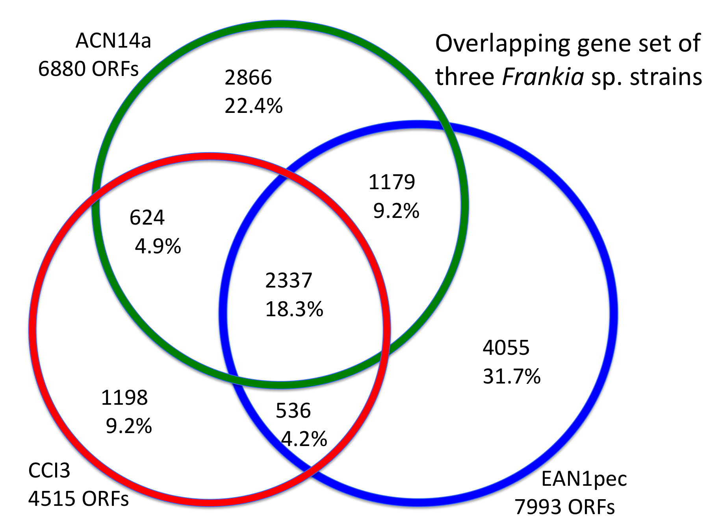
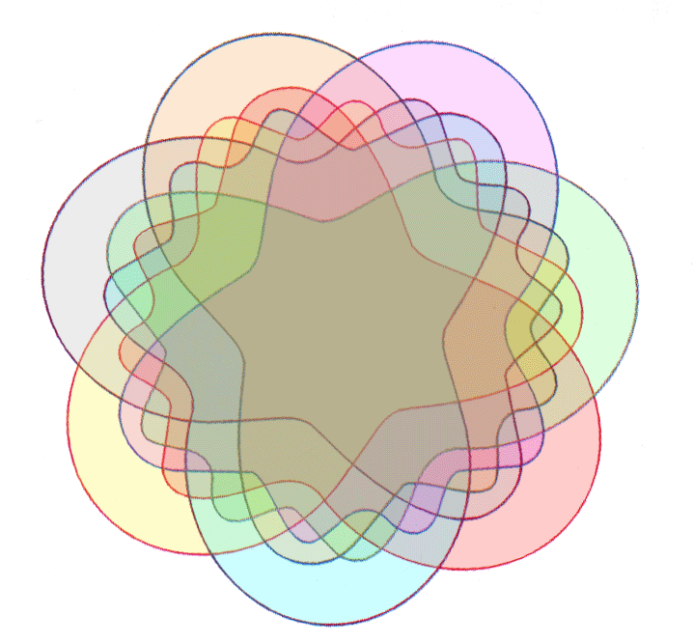
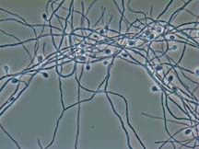
GENOMES OF CLOSELY RELATED ORGANISMS: CORE AND SHELL
From: Normand et al. (2007) Genome Research 17: 7-15
Strain-specific
Dispensable
core
Edwards-Venn cogwheel
A.W.F. Edwards 1998
Dispensable
Image
source:
web.uconn.edu/mcbstaff/benson/Frankia/FrankiaHome.htm

Slide 20
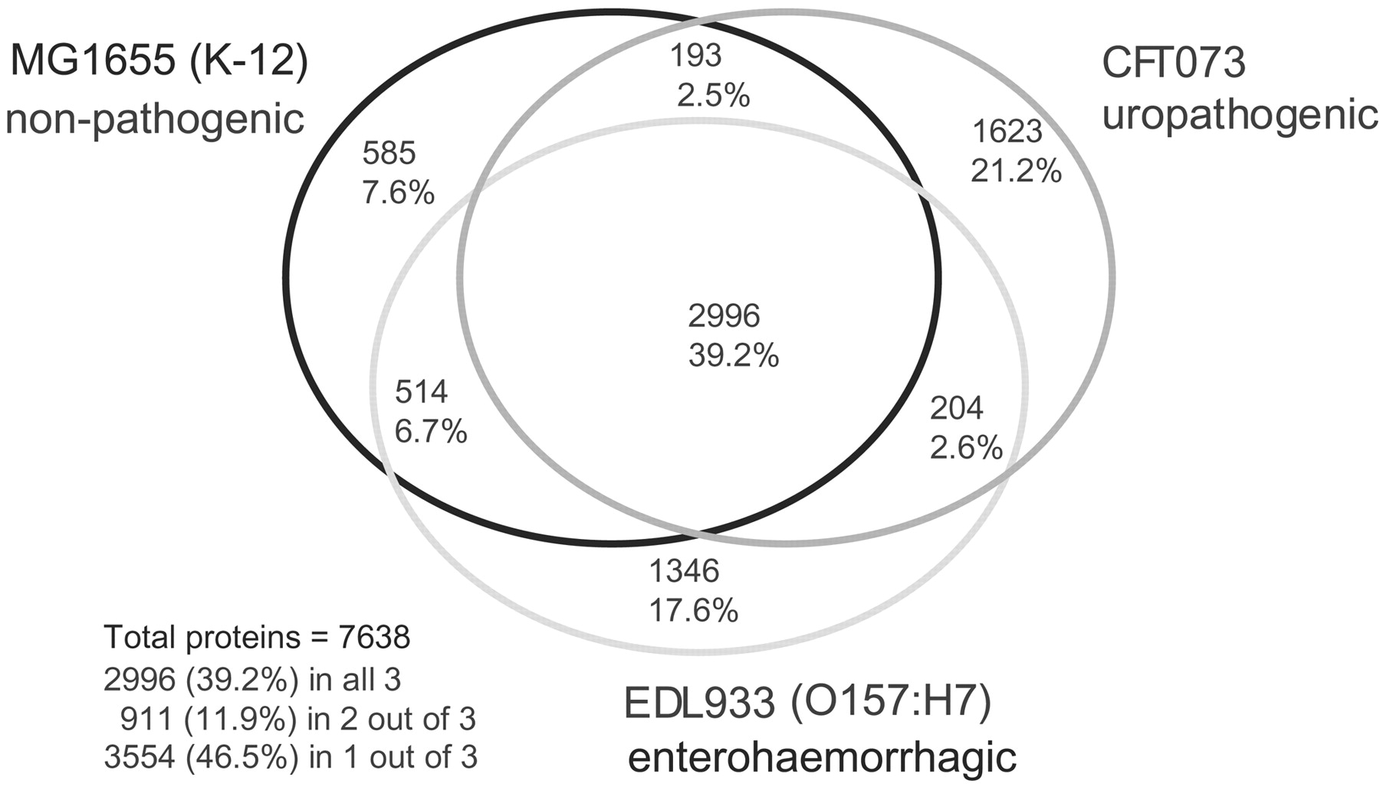
Welch RA, et al.
Proc Natl Acad Sci U S A. 2002; 99:17020-4
Escherichia coli, strain CFT073, uropathogenic
Escherichia coli, strain EDL933, enterohemorrhagic
Escherichia coli K12, strain MG1655, laboratory strain,
“… only 39.2% of their combined (nonredundant) set of proteins actually are common to all three strains.”

Slide 21
Common non-overlapping gene sets (orthology assessed as Reciprocal Best Blast Hits)
Strains of Escherichia coli
Species of Primates
MG1655 K12
Human
256
3,078
3.6%
10.2%
311
1,880
197
6.2%
2,487
4.3%
8.2%
3382
2.7%
14,109
46.9%
46.6%
EDL 1933
CFT 073
O157:H7
Macaque
1271
Gorilla
4,344
17.6%
334
14.4%
2,794
1456
1,572
4.6%
5.2%
9.2%
20.2%

Slide 22
other ideas:
Calculate pan-genomes for a species or population, identify the genes the that are not found in all members of the species, and identify those that might have a niche adapting function. (Also, where did these genes come from? The ancestor of the group, or acquired through HGT?)
Analysis of 57 Aeromonas veronii genomes. The histogram on the left gives the U-shaped fre­quency distribution of gene families typically observed for bacterial taxa.
The rarefaction curve in the right hand panel illustrates that even after sampling over 50 genomes, each additional genome con­tributes genes to the pan-genome.

Slide 23
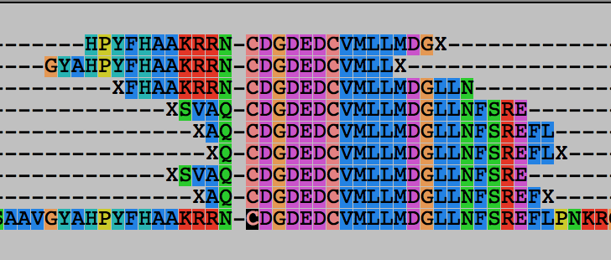
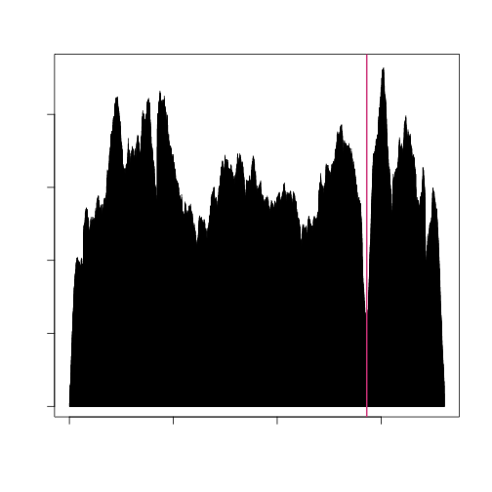
other ideas:
Develop approaches to find rare genome content variants in a metagenome. (Absence of inteins or niche adapting genes)
The question to address could be “Do all members of a population have heir xyz gene invaded by an intein?”
Or: Do all members of a population have the same niche adapting genes? Or: Are some members cheating on others?
One way to address this would be read mapping from a metagenome sequencing project to reference genes/genomes from which the gene of interest has been deleted.

Slide 24
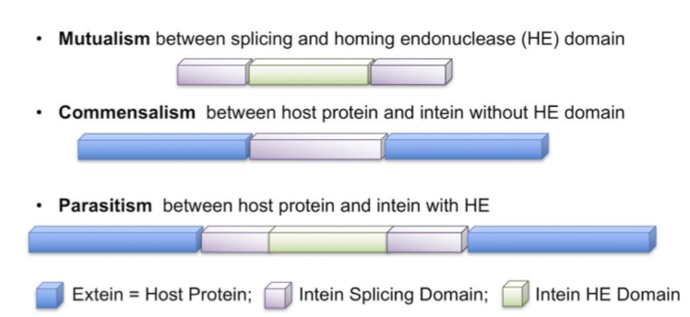
other ideas:
Write a script that identifies all inteins (self splicing proteins) and homing endonucleases in completely sequenced genomes, metagenomes and/or databanks (using Hmmer of PSI blast searches).
Inteins may provide a good measure to assess gene flow within and between species
You could do the same with other molecular parasites

Slide 25
other ideas:
Find niche adapting genes in metagenomes (e.g., sialic acid utilization operon – present in Aeromonads that live in blood digesting animals) in vampire bat gut microbiome).
Develop a script the calculates compositional bias of genes present in a genome to identify those that have a significantly different composition. -- if one determines the distribution of deviations from the mean for all genes, one could use this to determine significance.
Homeoalleles for amino acyl tRNA synthetases provides evidence for gene transfer being strongly biased towards close relatives ( here and here ). Do homeoalleles exist for other aaRSs? A likely reason for the different types is the ongoing war between microorganisms (Andam et al. 2011). One weapon in this war are antibiotics that block aparticular aaRS. Acquiring another type of RS could make the organism resistant to the antibiotic. Aspartyl RS, Leucyl RS in Bacteria, Phenylalanyl RS (at least the spirochetes have thearchaeal version of the enzyme), Tryptophanyl RS would be candidates to look at.
Muciprocin -> IleRS, Cladosporine -> LysRS, Halofuginone ->ProRS, Borrelidin -> ThrRS, and more (see here)

Slide 26
UNIX
Basic UNIX commands
ls, cd, chmod, cp, rm, mkdir, more (or) less, vi, ps, kill -9, man
A brief listing is here
chmod is a particular pain in the ... .
Under unix every file has an owner and the owner, his group and everyone else have permissions to read, write and/or execute the file (or they don’t). If you want to see which permissions are currently assigned to your files, type ls -l at the command prompt.
chmod a+x *.pl gives everyone execute permission for all files that end with .pl the * is a wildcard. (warning don't ever use rm in conjunction with *)
For more on chmod type ”man chmod” or see here.
(In the OSX GUI you can control click at a file, and change permissions in the info box). Most ssh clients (FUGU and SSH) allow you to use a GUI to change file permissions (in FUGU ctrl click).

Slide 27
Unix - command line interface
If you tried to execute a command, and you made a mistake, for example, you mistyped a file name, you can recall the last command using the up arrow (down arrow for more recent).
If you are tired typing long filenames, you can use the tab key to complete the line, provided there is only one way to complete the line. E.g: cd /Desktop could be replaced by cd /D<tab>
If there are two or more choices you hear a boing, if you hit <tab> again, you get a list of choices.

Slide 28
writing Perl scripts
Use unix/ linux /OsX if possible.
A) open a terminal window ; type "which perl <return>"
B) SSH to a unix machine (cluster OsX), log in, type "which perl <return>"
C) to check the version type perl -v <return>The response of the system should tell you, where Perl is installed on your machine (you need to know this for the first line of your perl program, which tells the operating system how to interpret what follows. On most installations this is #!/usr/bin/perl ).
WINDOWS: If you use a windows machine, you can use an ssh program to connect to the biotech cluster. A good ssh client is available at ftp://ftp.ssh.com/pub/ssh/- highly recommended. I am sure that there are editors available that are more useful than notepad, but I don't know of them. :(
MAC OsX: If you use a Mac under OS X, and you do not want to (only) use the PERL locally, you want to install both jellyfish (ssh terminal) and fugu (a secure file transfer program) or FileZilla . Both are available at ftp://ftp.uconn.edu/pub/packages/ssh/mac/ or through the people who wrote the software - GOOGLE) Also, the bbcxsrv1 is available as a server using ssh or afp. You can connect to to it from the finder menu (-> GO -> Connect to Server) pasting the following into the menu box afp://bbcxsrv1.biotech.uconn.edu (select your account).
LINUX: Most editors on linux systems recognize Perl programs and provide context dependent coloring. Ssh and Konquerer work well for file transfer.

Slide 29
characters at the end of lines
File tranfers from Windows to UNIX and return:
End of Line characters are a problem. Under Windows DO NOT use notepad, it does not understand UNIX newline symbols ‘\n’.
Best write your programs under UNIX using vi or vim (or any other editor you are comfortable with)
2nd best is to use a text editor like textwrangler (very nice and free program for UNIX). Like vi and vim it provides context dependent coloring.
3rd best is to remove end of line symbols in a UNIX editor or use sed (Stream EDitor) after you transferred the file:
sed s/.$// name_of_WINDOWS_infile > name_of_UNIX_outfile
(This replaces the last non letter character before the eol ($) with nothing)
Some versions of office allow to change files as UNIX textfiles, but ...
A related problem is encountered by Mac users. Most text editors will use MAC carriage returns at the end of the line. Most unix programs will not be able to handle these. In a terminal window you could use the following command to convert your file:
tr ’\r' ’\n' < name_of_the_Mac_file > name_of_the_unix_file
If you are working in a GUI environment, you also could use the convertNewLines.app program (install it in your application folder, drag the file you want to convert into the icon).
The end of line chaos is rather inconvenient, but there really is no easy solution, tough luck; you better know about this incase something goes wrong.

Slide 30
vi (one possible text editor on most unix systems)
A vi tutorial is at http://www.eng.hawaii.edu/Tutor/vi.html -- however, if you run into problems google usually helps (e.g. google: vi replace unix gives you many pages of info on how to replace one string with another under vi)
vi myprogram.pl #starts the editor and loads the file myprogram.pl into the editor
The following should get you started:
The arrow keys move the cursor in the text (if you have a really dumb terminal you can use the letter hjkl to move the cursor)
x deletes the character under the cursoresc (i.e. the escape key) leaves the edit modei enters the edit mode and inserts before the cursora enters the edit mode and appends
esc : opens a command line (here you can start searches, and replacements)
:w #saves the file
:w new_name _of_file #writes the file into a new file.
:wq #saves the file and exits vi
:q! #exits vi without saving

Slide 31
customizing vi
One of the beauties of vi is that usually it provides context dependent coloring.
You need to tell vi which terminal you use.
One way to do so is to add a file called .vimrc to your home directory.
The following works under both, MAS OSX and using ssh via the secure shell program under windows:
vi .vimrc #opens vi to edit .vimrc (Files that start with a dot are not listed if you list a directory. List with ls -a )
set term=xterm-color #tells the editor that you use a terminal that conforms to some standard
syn on # tells the editor program that you want to use syntax dependent coloring.
esc:wq
This might seem a little inconvenient, but it really comes in handy to trouble shoot the program in the same environment where you want to run it.
(comment on textwrangler alternative, ssh is included inside the grogram)

Slide 32
PERL conventions and rules
Basic Perl Punctuation:
line ends with “;”
empty lines in program are ignored
comments start with #
first line points to path to interpreter:
#! /usr/bin/perl
# "#!" is known as "shebang”;
keep one command per line for readability
For shell scripts the first line would refer to the type of shell to be used, e.g.: #!/bin/bash
use indentation do show program blocks.
Variables start with $calars, @rrays, or %ashes
Scalars: floating point numbers, integers,
non decimal integers, strings

Slide 33
Scalar variable are placeholders that can be assigned a scalar value (either number or string).
Scalar variables begin with $
$n=3; #assigns the numerical value 3 to the variable $n.
#Variables are interpolated, for example if you print text
$b = 4 + ($a = 3); # assign 3 to $a, then add 4 to that
# resulting in $b getting 7
$d = ($c = 5); # copy 5 into $c, and then also into $d
$d = $c = 5; # the same thing without parentheses
$a = $a + 5; # without the binary assignment operator
$a += 5; # with the binary assignment operator
$str = $str . " "; # append a space to $str
$str .= " "; # same thing with assignment operator
"hello" . "world" # same as "helloworld"
'hello world' . "\n" # same as "hello world\n"
"fred" . " " . "barney" # same as "fred barney"
"fred" x 3 # is "fredfredfred"
"barney" x (4+1) # is "barney" x 5, or # "barneybarney……"
(3+2) x 4 # is 5 x 4, or really "5" x 4, which is ”5555”
Note: these are not mathematical equations but assignments!

Slide 34
Numbers can be manipulated using the typical symbols:
2 + 3 # 2 plus 3, or 5
5.1 - 2.4 # 5.1 minus 2.4, or approximately 2.7;
3 * 12 # 3 times 12 = 36;
2**3 # 2 taken to the third power = 2*2*2 = 8
14 / 2 # 14 divided by 2, or 7;
10.2 / 0.3 # 10.2 divided by 0.3, or approximately 34;
10 / 3 # always floating point divide, so approximately 3.3333333...

Slide 35
Special characters:
\n #newline
\t #tab

Slide 36
Double quoted strings are interpolated by the Perl interpreter:
"hello world\n" # hello world, and a newline
"coke\tsprite" # a coke, a tab, and a sprite
The backslash can precede many different characters to mean different things (typically called a backslash escape).

Slide 37
Variable interpolation - single quoted strings are not interpolated:
'hello' # five characters: h, e, l, l, o
'don\'t' # five characters: d, o, n, single-quote, t
'' # the null string (no characters)
'silly\\me' # silly, followed by backslash, followed by me
'hello\n' # hello followed by backslash followed by n
'hello
there' # hello, newline, there (11 characters total)

Slide 38
Assignments for next week:
Think about a topic for your student project!
Please, don’t hesitate to send me an email in case you have a question.
Let me know what you are interested in (email).
What we will do in this course will in part depend on your interests.

Slide 39
Assignment for next Wednesday
1) On the computer that you plan to use for your project set up a connection (or connections) to bbcsrv3 that allows you
(a) ssh to the server using a command line interface
(b) allows you to drop and drag files from your computer to the server.
2) check that your vi editor or nano on bbcsrv3 is set up to have context dependent coloring
3) Install an editor on your computer that provides context dependent coloring (textwrangler, crimson, …).
4) Go through Assignment 00 (we will do this on Wednesday)
5) Read U31 and http://kb.iu.edu/data/abdb.html on the chmod command in unix
6) Create first Perl Program- Hello_world.pl [and make file executable using chmod]
  #!/usr/bin/perl -w
  #replace usr/bin/perl with the directory
  #you get returned typing “which perl”
  print ("Hello, world! \n");
# denotes the beginning of a comment, except in case of the shebang, which gives the location of the interpreter.
What happens, if you leave out the new line character?
You can run the program by typing ./program_name.pl, if the file containing the program is made executable (using chmod u+x *.pl).

