Slide 1
MCB 5472
Sequence alignment
Peter Gogarten
Office: BSP 404
phone: 860 486-4061,
Email: gogarten@uconn.edu

Slide 2
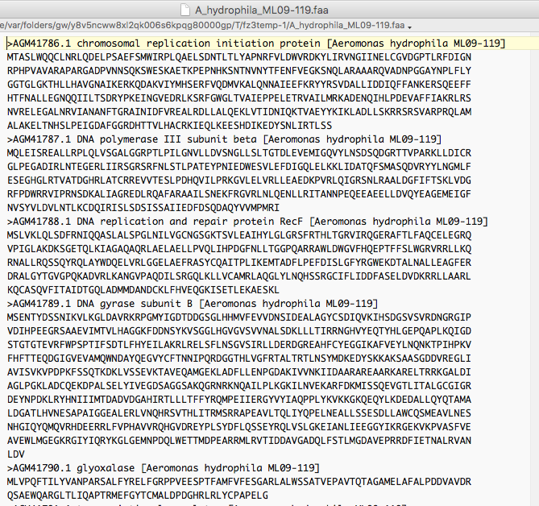
Typical multiple sequence fasta file

Slide 3
Blast output in tabular form

Slide 4
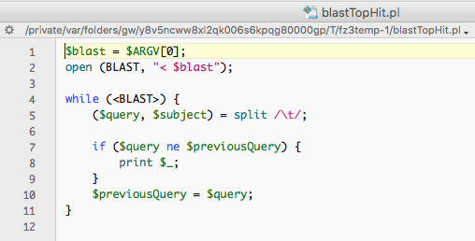

Slide 6
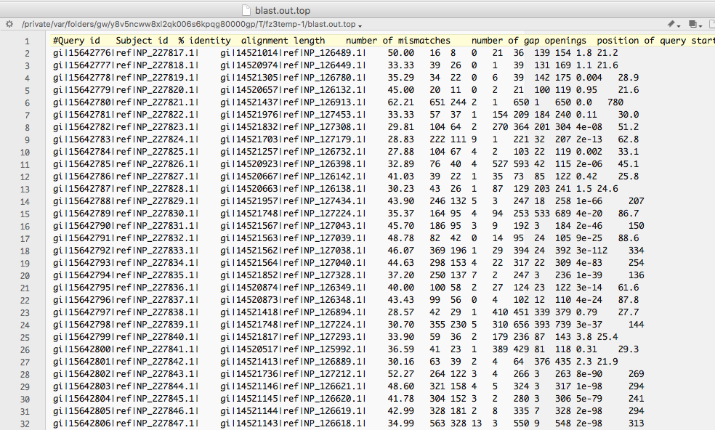
After keeping only the to scoring hit.

Slide 7
Geneplot
Asignments from last week
In a perfect world you do not want to plot gi numbers but positions in a genome. The script addnumnuc.pl adds the nucleotide position of the ORF (the central one) to the beginning of the annotation line.

Slide 8
Feature Table

Slide 9
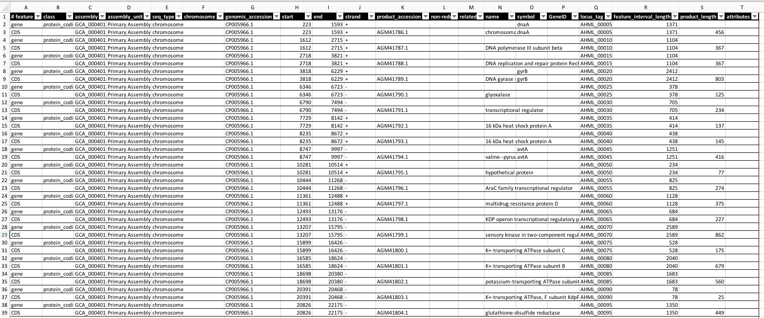
Feature Table as Spread Sheet

Slide 10
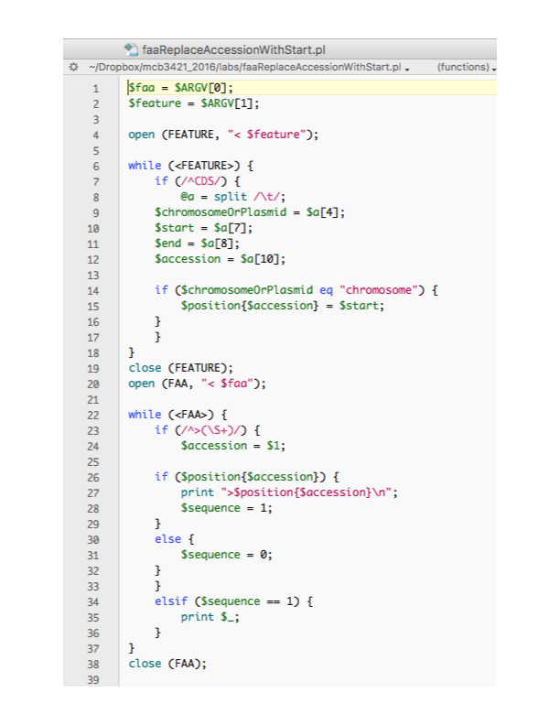

Slide 11
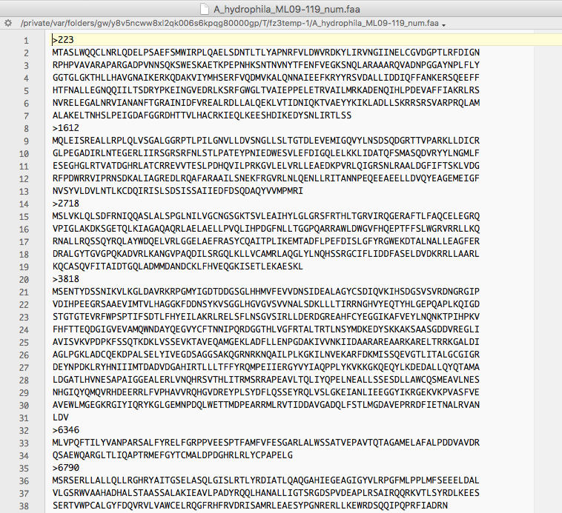
Multiple sequence fasta file with start position instead on accession #

Slide 12
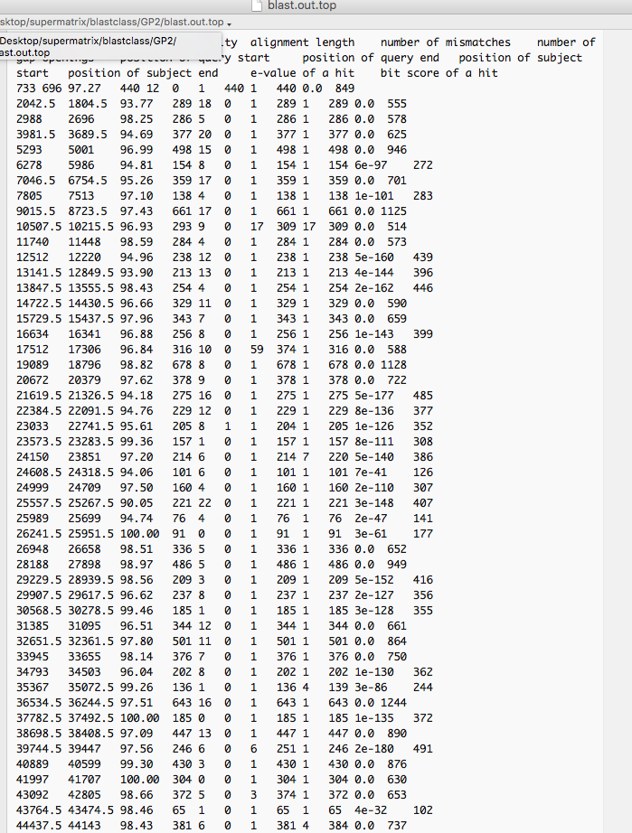
Top scoring hits only
GI number replaced with position in genomes

Slide 13
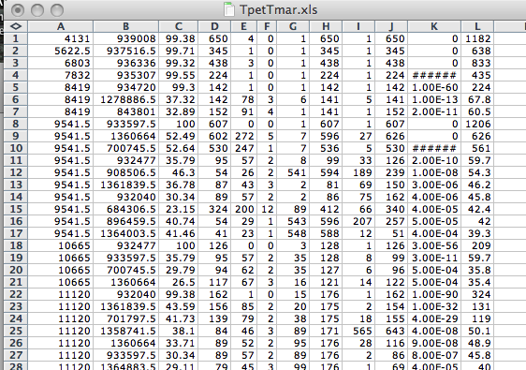
Geneplot using EXCEL part 2
Plotting column B against A ->

Slide 14
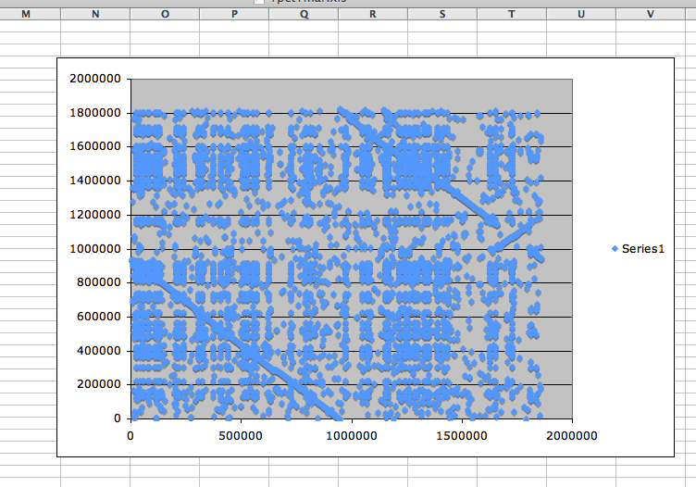
Geneplot using EXCEL part 3
To only plot the top scoring hits use extract_lines.pl -->

Slide 15
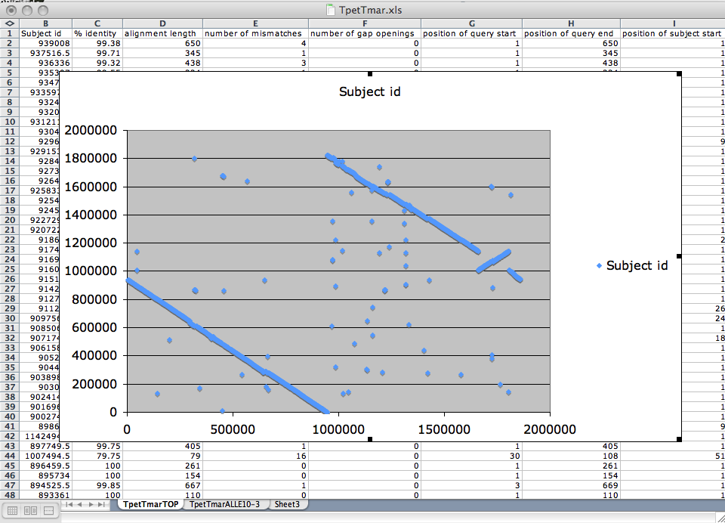
Geneplot using EXCEL part 4
Plotting Tpet_Tmar.tab.top

Slide 16
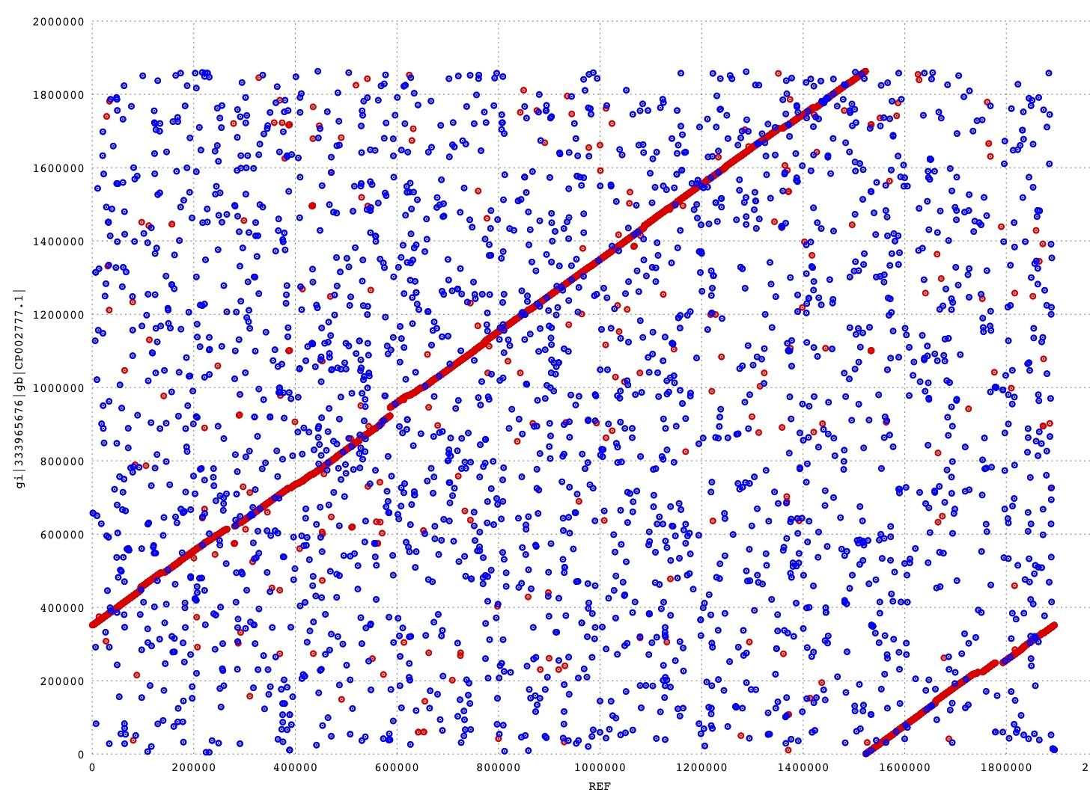
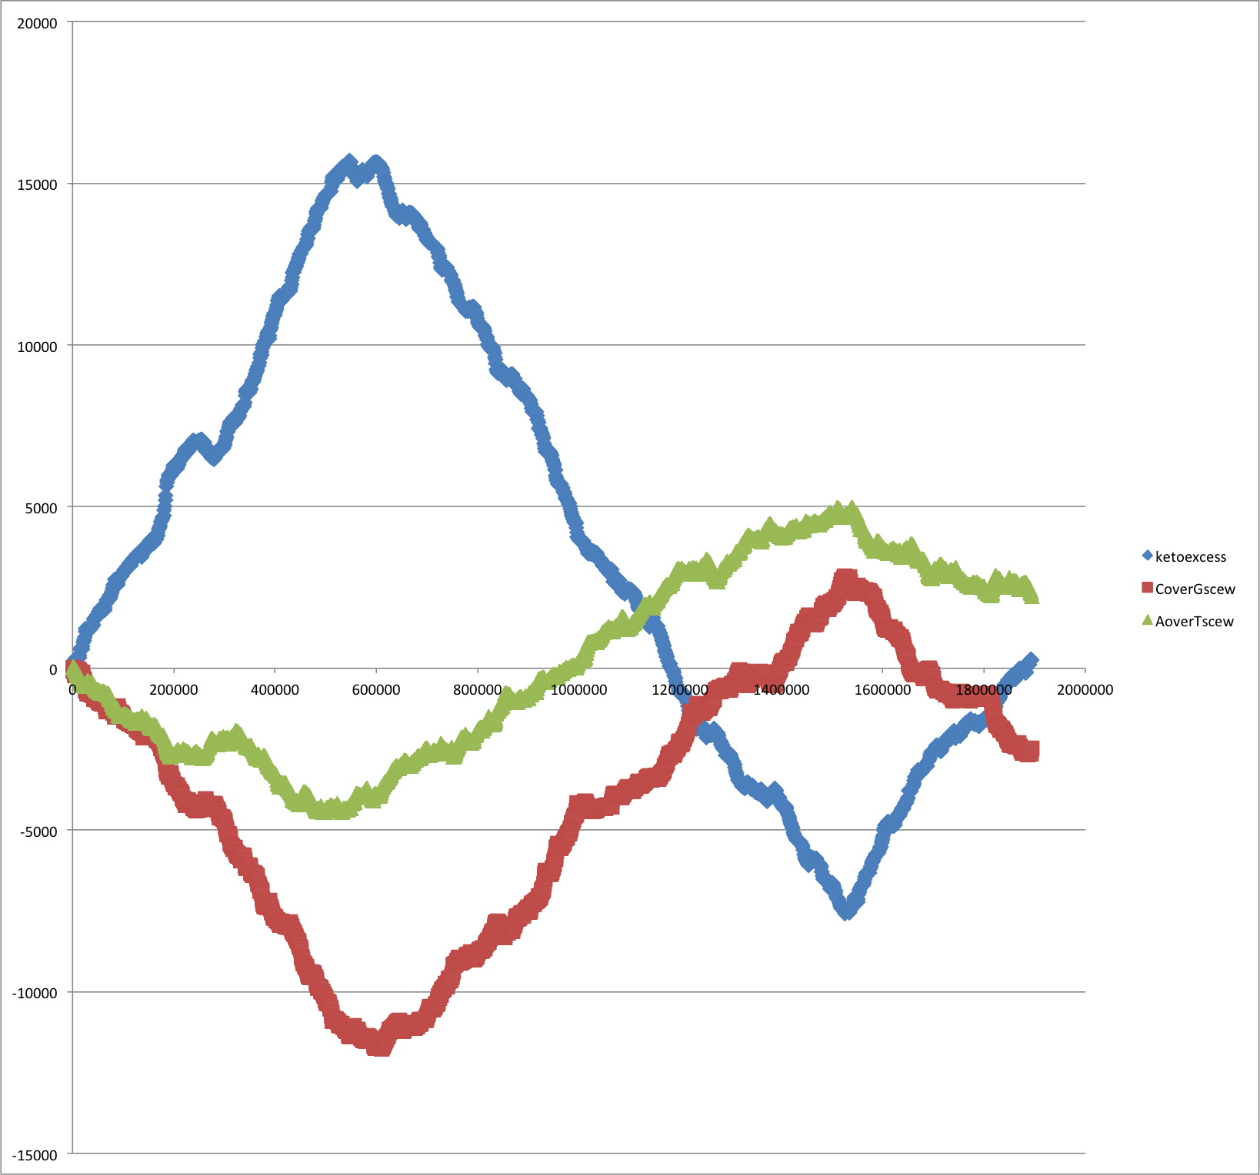
Usually, *.fna files of bacterial genomes start with the origin of replication, and the direction is chosen so that the first encoded protein is DnaA (chromosomal replication initiator protein). Sometimes things go wrong.
Cumulative Strand Bias HB27
Mummer Plot: HB27 versus SG0
Ori
Should be here

Slide 17
OLD ASSIGNMENTS

Slide 18
Write a script that reads in a sequence and prints out the reverse complement.
Modify your script to that it can handle a sequence that goes over several lines.
Background: $comp =~ tr/ATGC/TACG/; #translates every A in $comp into a T; every T into an A; every G into a C and every C into a G
Read P 14 on hashes, write the program suggested in the chapter.

Slide 19
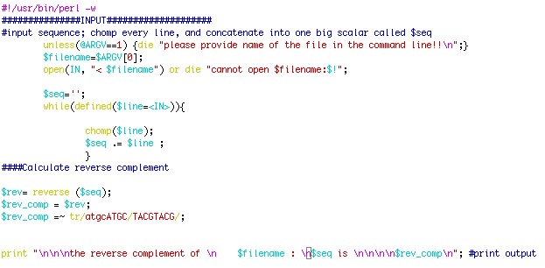
Write a script reads in a sequence and prints out the reverse complement.
Modify your script to that it can handle a sequence that goes over several lines?
Go through class4Answers.pl
Go through sort_example1.pl and sort_example2.pl

Slide 20
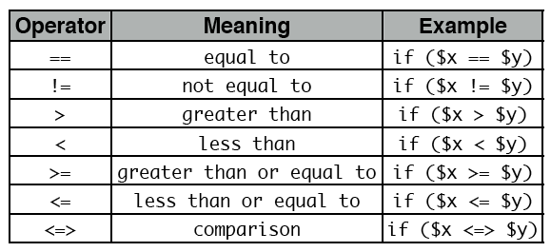
Do the following statements evaluate to true or false? (Check P5)
1
0 && 1
0||1
45
45-45
45/45
45==45
45<=>45
45<=50 from http://korflab.ucdavis.edu/Unix_and_Perl/unix_and_perl_v2.3.3.pdf
55>=50
50<=>70
45!=45
45!=50

Slide 21
True or False?

Slide 22
NEW ASSIGNMENTS
Read through P20. Functions (subroutines)
Turn your script that calculates the reverse complement of a sequence into a subroutine
Write a script that takes all files with the extension .fa (containing a single fasta formated sequence) and writes their contents in a single multiple sequence file.
Read through class05.pl

Slide 23
assignments continued (use class05.pl as sample)
Assume that you have the following non-aligned multiple sequence files in a directory: A.fa : vacuolar/archaeal ATPase catalytic subunits ; B.fa : vacuolar/archaeal ATPase non-catalytic subunits; alpha.fa : F-ATPases non-catalytic subunits, beta.fa : F-ATPases catalytic subunits, F.fa : ATPase involved in the assembly of the bacterial flagella.
Write a perl script that executes muscle and
1) aligns the sequences within each file 2) aligns all the sequences from each of the files into a single alignment.
Hints:
system (command);# executes “command” as if you had typed command in the command line
Muscle homepage is at http://www.drive5.com/muscle/docs.htm
Sequence files are also in script folder.

Slide 24
challenge:
Often one wants to build families of homologous proteins extracted from genomes. One way to do so is to find reciprocal best hits.
Tools:
The script blastall.pl takes the genomes (as .faa files) indicted in the first line and calculates all possible genome against genome searches.
This script simple_rbh_pairs.pl takes two blastall searches (genome A versus genome B) in -m8 format and listing only the top scoring blast hit for each query) and writes the GI numbers of reciprocal best hits into a table.
The script run_pairs.pl runs all possible pairwise extractions of RBHs
Task: write a script that combines the pairwise tables keeping only those families that have a strict reciprocal best blast hit relationship in all genomes.

Slide 25
global vs local
Alignments can be global or local.
BLAST calculates local alignments, for databank searches and to find pairwise similarities local alignments are preferred.
Example using bl2seq with GIs : 137464 versus 6319974 and 137464 versus 254565713
However, for multiple sequences to be used in phylogenetic reconstruction, global alignments are the usual choice.
Two programs are very popular: MUSCLE and CLUSTALW(or clustal omega)
Note: Multiple alignments are more accurate than pairwise alignments! The more sequences one includes, the more reliable the result. Same for phylogenetic reconstruction (taxon sampling).

Slide 26
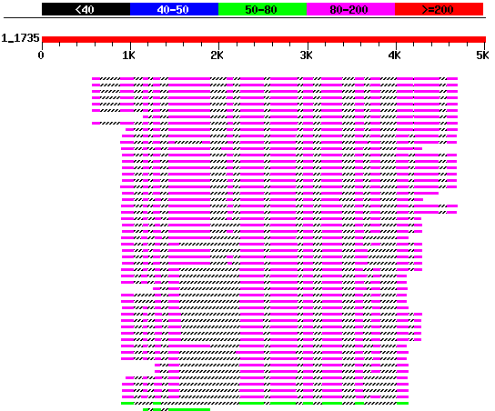
dotlet
The Swiss Institute for Bioinformatics provides a JAVA applet that perform interactive dot plots. It is called Dotlet. The main use of dot plots is to detect domains, duplications, insertions, deletions, and, if you work at the DNA level, inversions (excellent illustrations of the use of dot plots are given on the examples page).
One application of this program is to find internal duplications and to locate exons.
Example: this sequence against itself (if time do in bl2seq as well)
genomic sequence against Protein
As similar result can be obtained using blastx against a protein databank

Slide 27
The Needlemann Wunsch Algorithm
a step by step illustration is here
fill in scoring matrix
calculate max. possible score for each field
trace back alignment through matrix
see http://en.wikipedia.org/wiki/Needleman–Wunsch_algorithm for multiple paths.

Slide 28
Caution
NOTE that clustalw and other multiple sequence alignment programs do NOT necessarily find an alignment that is optimal by any given criterion.
Even if an alignment is optimal (like in the Needleman-Wunsch algorithm), it usually is not UNIQUE. It often is a good idea to take different extreme pathways through the alignment matrix, or to use a program like tcoffee that uses many different alignment programs.

Slide 29
clustalw
runs on all possible platforms (unix, mac, pc), and it is part of most multiprogram packages, and it is also available via different web interfaces. Examples: here, and here.
Clustalw uses a very simple menu driven command-line interface, and you also can run it from the command line only (i.e., it is easy to incorporate into scripts for repeated analyses – to get info on the commanline options type clustalw –options and clustalw -help.)
Clustalx uses the same algorithms as clustalw. However, it has a much nicer interface, it displays information on the level of similarity, and it uses color in the alignment. Especially for amino acids the use of color greatly enhances the ability to recognize conservative replacements. Clustalx is available for different platforms at the ebi's ftp site (follow your platform, clustalx is stored in the clustalw folders)
Clustal reads and writes most formats used by different programs. The easiest format is the FASTA format:
Higgins DG, Sharp PM (1988) CLUSTAL: a package for performing multiple sequence alignment on a microcomputer. Gene 73:237-244; Thompson, J.D., Higgins, D.G. and Gibson, T.J. (1994). CLUSTAL W: improving the sensitivity of progressive multiple sequence alignment through sequence weighting, positions-specific gap penalties and weight matrix choice. Nucleic Acids Research 22, 4673-4680

Slide 30
clustal
To align sequences clustal performs the following steps:
1) Pairwise distance calculation 2) Clustering analysis of the sequences 3) Iterated alignment of two most similar sequences or groups of sequences.
It is important to realize that the second step is the most important. The relationships found here will create a serious bias in the final alignment. The better your guide tree, the better your final alignment.
You can load a guide tree into clustal. This tree will then be used instead of the neighbor joining tree calculated by clustalw as a default. (The guide tree needs to be in normal parenthesis notation WITH branch lengths).
Sample input file Sample output file

Slide 31
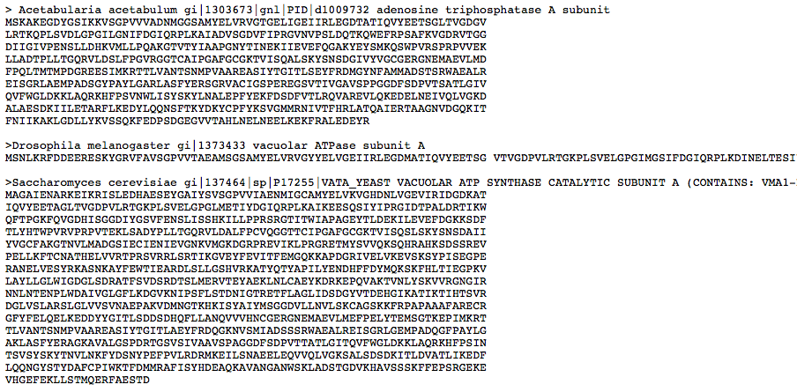
clustal
Sample input

Slide 32
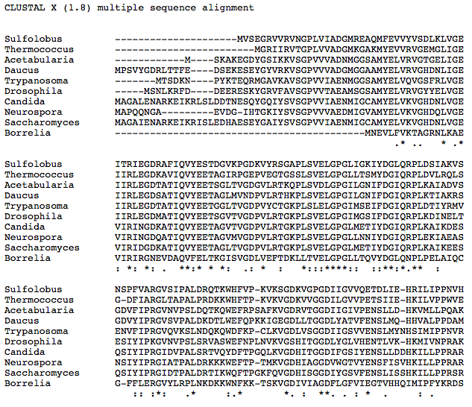
clustal
Sample output file

Slide 33
Clustal
also reads aligned sequences. If you input aligned sequences you can go directly to the tree section. !! Be careful if you make a mistake, and the sequences are not aligned, your tree will look strange!! !!! ALWAYS CHECK YOUR ALIGNMENT!!!
Also be careful when using the ignore positions with gaps option – there might not be many positions left.
Clustal is much better than its reputation. It is doing a great job in handling gaps, especially terminal gaps, and it makes good use of different substitution matrices, and the empirical correction for multiple substitutions is better than many other programs.

Slide 34
tcoffee
TCOFFEE extracts reliably aligned positions from several multiple or pairwise sequence alignments. It requires more thought and attention from the user than clustalw, but it helps to focus further analyses on those sites that are reliably aligned. A web interface is here.

Slide 35
muscle
If you have very large datasets muscle is the way to go. It is fast, takes fasta formatted sequences as input file, and has a refinement option, that does an excellent job cleaning up around gaps.
The muscle home page is here , the manual is here
Muscle allows also allows profile alignments.
muscle -in VatpA.fa -out VatpA.afa
muscle -in VatpA.afa -out VatpA.rafa –refine
muscle -in beta.fa -out beta.afa
muscle -in beta.afa -out beta.rafa -refine
muscle -profile -in1 beta.rafa -in2
VatpA.rafa -out Abeta.afa
muscle –refine –in Abeta.afa –out Abeta.rafa

Slide 36
muscle alignment

Slide 37
muscle vs clustal
more on alignment programs (statalign, pileup, SAM) here

Slide 38
the same region using tcoffee with default settings
more on alignment programs (statalign, SAM, SATè) here

Slide 39
Sequence editors and viewers
Jalview Homepage, Description
Jalview is easy to install and run. Test file is here (ATPase subunits)
(Intro to ATPases: 1bmf in spdbv) (gif of rotation here)
(Load all.txt into Jalview, colour options, mouse use,
PID tree,
Principle component analysis -> sequence space)
More on sequence space here

Slide 40
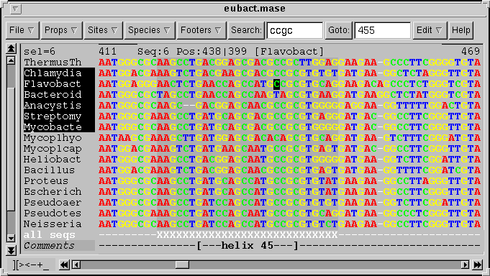
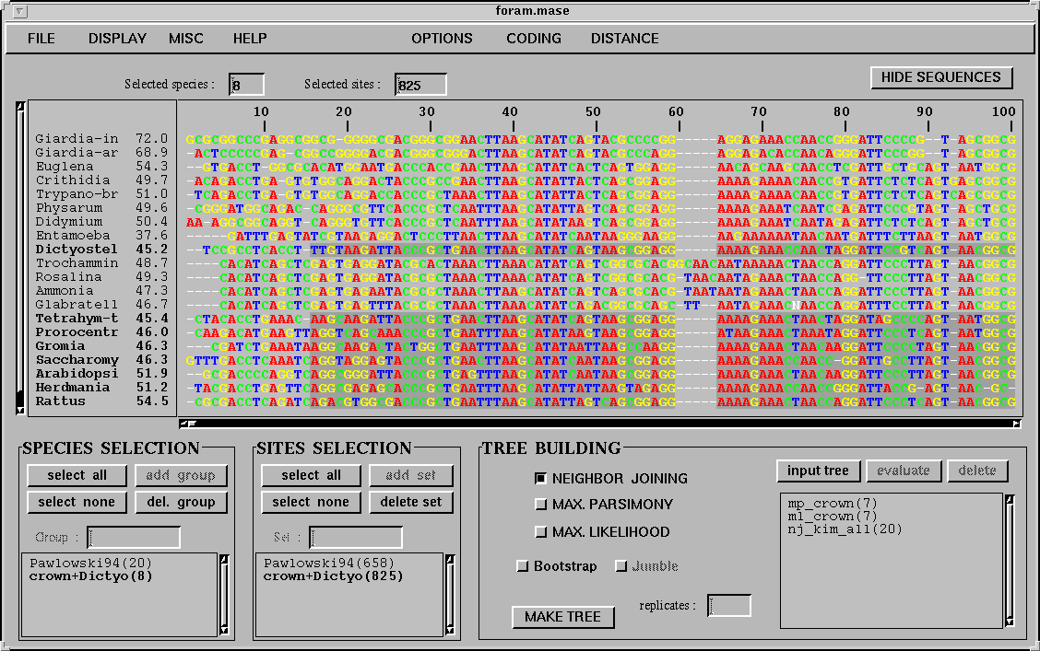
seaview – phylo_win
Another useful multiple alignment editor is seaview, it runs on most platforms, uses either clustal or muscle alignments, andhas simple parsimony, distance and ml programs.

Slide 41
Codon based alignments in Seaview
Load nucleotide sequences (no gaps in sequences, sequence starts with nucleotide corresponding to 1st codon position)
Select view as proteins

Slide 42
Codon based alignments in Seaview
With the protein sequences displayed, align sequences
Select view as nucleotides

Slide 43
Clustalw (and other progressive alignment programs):
Good alignment programs, alignments match regions that have same structures.
Not very useful for phylogenetic reconstruction: Alignment is strongly biased towards guide tree. Also, quality of alignment presumably depends on guide tree.
Solutions:
Use different guide trees, especially if you want to test different phylogenetic hypotheses
Use an alignment program that creates less bias (muscle)
Use a program that optimizes tree and alignment simultaneously.

Slide 44
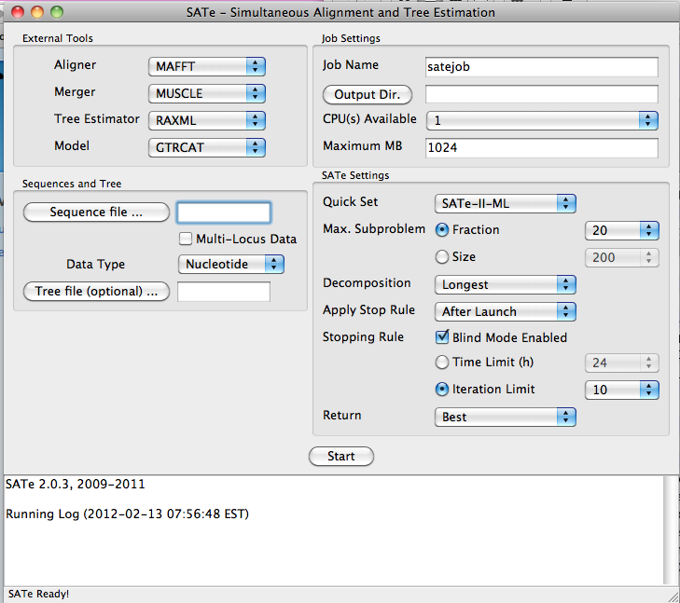
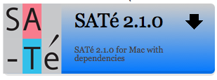
SATé Simultaneous Alignment and Tree Estimation
http://phylo.bio.ku.edu/software/sate/sate.html
GUI works well on iMacs, but uses only local processors.

Slide 45
more alignment programs: statalign
statalign from Jeff Thorne deserves more attention than it receives. Especially for divergent sequences the initial pairwise alignment usually determines the ultimate result of the phylogenetic reconstruction.
Statalign solves this problem by not calculating a multiple sequence alignment, rather it spends a lot of computational power to calculate pairwise alignments and it extract distances (and their potential error) from these pairwise alignments and then uses these in a distance pased reconstruction. The errors from the individual distances are used to generate bootstrap samples for the distance matrices.
More at Thorne JL, Kishino H (1992) Freeing phylogenies from artifacts of alignment. Mol Bio Evol 9:1148-1162
statalign is available in several software archives (e.g. here), the readme file has plenty of information.

Slide 46
more alignment programs: SAM
SAM (sequence alignment and modeling system) by Richard Hughey, Anders Krogh, Christian Barrett, & Leslie Grate at UCSC.
http://www.cse.ucsc.edu/research/compbio/sam.html
The input consists of a multiple sequence file (aligned or not aligned) in FASTA format. The program uses secondary structure predictions, neighboring sites, etc. to place gaps. The program can be accessed through the www and run at UCSC
A linear hidden Markov model is a sequence of nodes, each corresponding to a column in a multiple alignment. In our HMMs, each node has a match state (square), insert state (diamond) and delete state (circle). Each sequence uses a series of these states to traverse the model from start to end. Using a match state indicates that the sequence has a character in that column, while using a delete state indicates that the sequence does not. Insert states allow sequences to have additional characters between columns. In many ways, these models correspond to profiles.

Slide 47
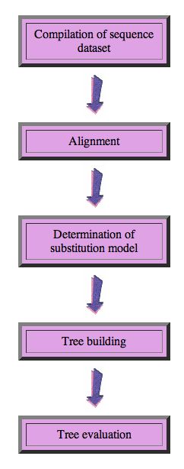
Steps of the phylogenetic analysis
Phylogenetic analysis is an inference of evolutionary relationships between organisms.
Phylogenetics tries to answer the question “How did groups of organisms come into existence?”
Those relationships are usually represented by tree-like diagrams.
Note: the assumption of a tree-like process of evolution is controversial!

Slide 48
Phylogenetic reconstruction - How
Distance analyses
calculate pairwise distances
(different distance measures, correction for multiple hits, correction for codon bias)
make distance matrix (table of pairwise corrected distances)
calculate tree from distance matrix
i) using optimality criterion
(e.g.: smallest error between distance matrix
and distances in tree, or use
ii) algorithmic approaches (UPGMA or neighbor joining) B)

Slide 49
Phylogenetic reconstruction - How
Parsimony analyses
find that tree that explains sequence data with minimum number of substitutions
(tree includes hypothesis of sequence at each of the nodes)
Maximum Likelihood analyses
given a model for sequence evolution, find the tree that has the highest probability under this model.
This approach can also be used to successively refine the model.
Bayesian statistics use ML analyses to calculate posterior probabilities for trees, clades and evolutionary parameters. Especially MCMC approaches have become very popular in the last year, because they allow to estimate evolutionary parameters (e.g., which site in a virus protein is under positive selection), without assuming that one actually knows the "true" phylogeny.

