Slide 1
MCB 5472
Lecture 9
Trees, Terminology and Selection
Peter Gogarten
Office: BSP 404
phone: 860 486-4061,
Email: gogarten@uconn.edu
Note: I had it with snow-days!
If class is cancelled on Wednesday 3/21, I will post the practical part of the midterm online at noon on Wednesday, and you should email me your results before 4pm on Wednesday 3/21!

Slide 2
Phylogenetic reconstruction - How
Distance analyses
  calculate pairwise distances
  (different distance measures, correction for multiple hits, correction for codon bias)
  make distance matrix (table of pairwise corrected distances)
  calculate tree from distance matrix
    i) using optimality criterion
    (e.g.: smallest error between distance matrix
    and distances in tree, or use
    ii) algorithmic approaches (UPGMA or neighbor joining) B)

Slide 3
Phylogenetic reconstruction - How
Parsimony analyses
  find that tree that explains sequence data with minimum number of substitutions
  (tree includes hypothesis of sequence at each of the nodes)
Maximum Likelihood analyses
  given a model for sequence evolution, find the tree that has the highest probability under this model.
  This approach can also be used to successively refine the model.
Bayesian statistics use ML analyses to calculate posterior probabilities for trees, clades and evolutionary parameters. Especially MCMC approaches have become very popular in the last year, because they allow to estimate evolutionary parameters (e.g., which site in a virus protein is under positive selection), without assuming that one actually knows the "true" phylogeny.

Slide 4
Phylogenetic Reconstruction – Why?
A) Systematic classification of organisms
e.g.: Who were the first angiosperms? (i.e. where are the first angiosperms located relative to present day angiosperms?) Where in the tree of life is the last common ancestor located?
B) Evolution of molecules
e.g.: domain shuffling, reassignment of function, gene duplications, horizontal gene transfer, drug targets,
detection of genes that drive evolution of a species/population
(e.g. influenca virus)
C) Identification of organisms
e.g., phylotyping in microbiome samples,
origin of genes and viruses (e.g., HIV virus, recent ebola outbreak)

Slide 5
For a discussion of Bootstrapping go here
http://gogarten.uconn.edu/mcb3421_2017/bs.html

Slide 6
Phylip
written and distributed by Joe Felsenstein and collaborators (some of the following is copied from the PHYLIP homepage)
PHYLIP (the PHYLogeny Inference Package) is a package of programs for inferring phylogenies (evolutionary trees).
PHYLIP is the most widely-distributed phylogeny package, and competes with PAUP* to be the one responsible for the largest number of published trees. PHYLIP has been in distribution since 1980, and has over 15,000 registered users.
Output is written onto special files with names like "outfile" and "outtree". Trees written onto "outtree" are in the Newick format, an informal standard agreed to in 1986 by authors of a number of major phylogeny packages.
Input is either provided via a file called “infile” or in response to a prompt.

Slide 7
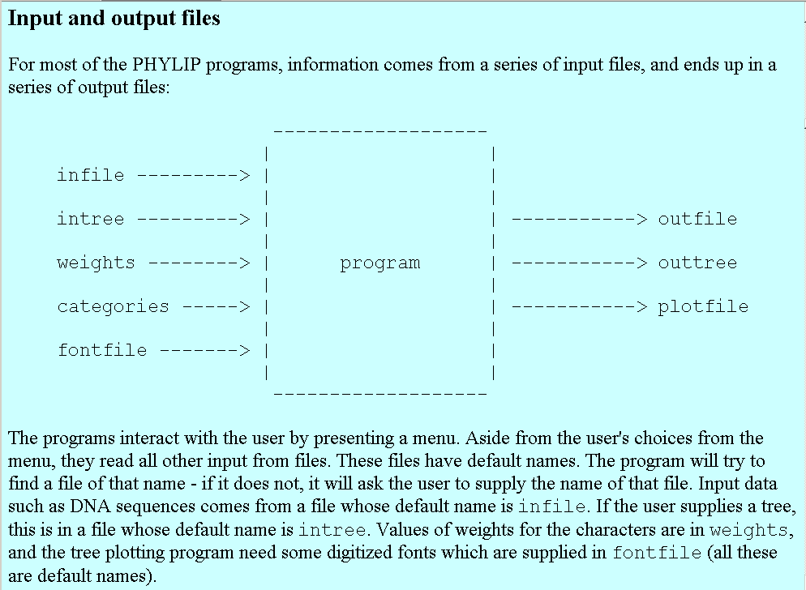
input and output

Slide 8
Trees in Newick or parenthesis format
Trees rooted on a node are usually considered as unrooted
Trees rooted on a branch are usually considered as rooted
((A, B), (C, D), E)
(((A, B), (C, D)), E)
Arbitrarily rooted in a node –
While displayed as rooted in a node, the tree should be considered as unrooted
Strictly bifurcating –
The root is located on the branch leading to E
More links here and here and here

Slide 9
Sequence alignment:
CLUSTALW
MUSCLE
Removing ambiguous positions:
T-COFFEE
FORBACK
Generation of pseudosamples:
SEQBOOT
PROTDIST
TREE-PUZZLE
Calculating and evaluating phylogenies:
PROTPARS
PHYML
NEIGHBOR
FITCH
Comparing phylogenies:
CONSENSE
SH-TEST in TREE-PUZZLE
Comparing models:
Maximum Likelihood Ratio Test
Visualizing trees:
ATV, njplot, or treeview
Phylip programs can be combined in many different ways with one another and with programs that use the same file formats.

Slide 10
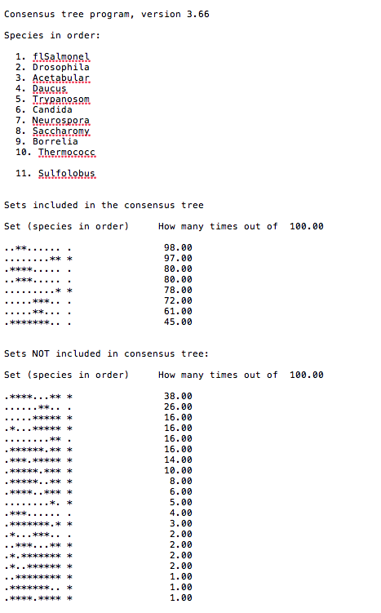
Output from consense

Slide 11
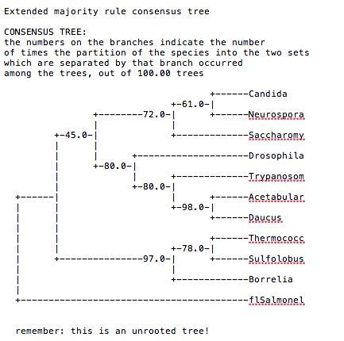
Output from consense

Slide 12
What is in a tree?
Trees form molecular data are usually calculated as unrooted trees (at least they should be - if they are not this is usually a mistake).
To root a tree you either can assume a molecular clock (substitutions occur at a constant rate, again this assumption is usually not warranted and needs to be tested),
or you can use an outgroup (i.e. something that you know forms the deepest branch),
  For example, to root a phylogeny of birds, you could use the homologous characters from a reptile as outgroup; to find the root in a tree depicting the relations between different human mitochondria, you could use the mitochondria from chimpanzees or from Neanderthals as an outgroup; to root a phylogeny of alpha hemoglobins you could use a beta hemoglobin sequence, or a myoglobin sequence as outgroup.
Or you need to have a priory knowledge of which are the primitive character states, and reconstruct these for all nodes and branches in your unrooted phylogeny
Trees have a branching pattern (also called the topology), and branch lengths.
Often the branch lengths are ignored in depicting trees (these trees often are referred to as cladograms - note that cladograms should be considered rooted).
You can swap branches attached to a node, and in an unrooted you can depict the tree as rooted in any branch you like without changing the tree.

Slide 13
Rooting by outgroup, example
Catalytic subunits
Non catalytic subunits
Archaea
Eukarya
Bacteria
Bacteria
Archaea
Eukarya
speciation
time
gene duplication
Notes:
Rooting the Tree of Life by an ancient Gene Duplicaiton

Slide 14
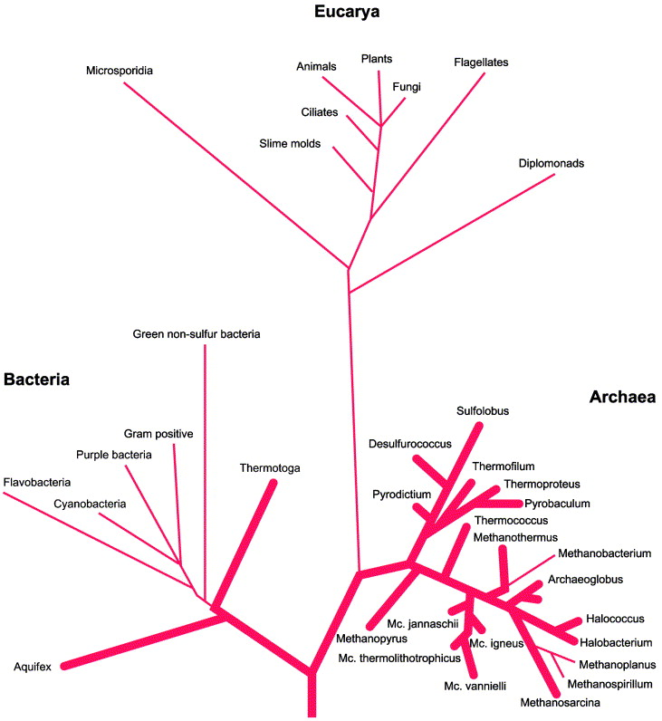
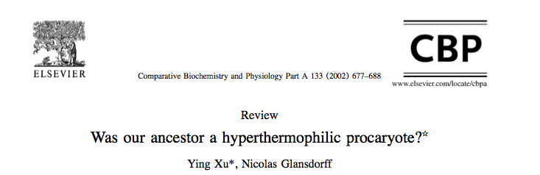
Rooting using primitive characters (temp) often is questionable
How well is the ancestral state reconstructed?
(Do you assume that a node is the average of the descendants, or do you use sequence composition?)
There certainly is a bias in the speed of sequence evolution comparing high to low and low to high temperature.
See here
In contrast to what is suggested in this tree, LUCA likely was not an extreme thermophile
(see here and here for discussion)
Fig. 3. The classical SSUrRNA distance tree, presented as rooted in the bacterial branch. Bold lines indicate extreme hyperthermophiles. From Stetter (1996).

Slide 15
LUCA (located on the “bacterial branch”) was less thermophilic than the ancestor of the bacterial and archaeal domains
Boussau, B, Blanquart, S, Necsulea, A, Lartillot, N and Gouy, M (2008). Parallel adaptations to high temperatures in the Archaean eon. Nature 456(7224): 942-945
Reconstruction of ancestral protein and rRNA sequences
Based on IVYWREL and rRNA stem G+C content LUCA was less thermophilic than the domain ancestors.
Galtier, N, Tourasse, N and Gouy, M (1999).
A nonhyperthermophilic common ancestor to extant life forms. Science 283(5399): 220-221.8
rRNA 60°C80°C
IVYWREL (corrected for GC content) 20°C70°C

Slide 16
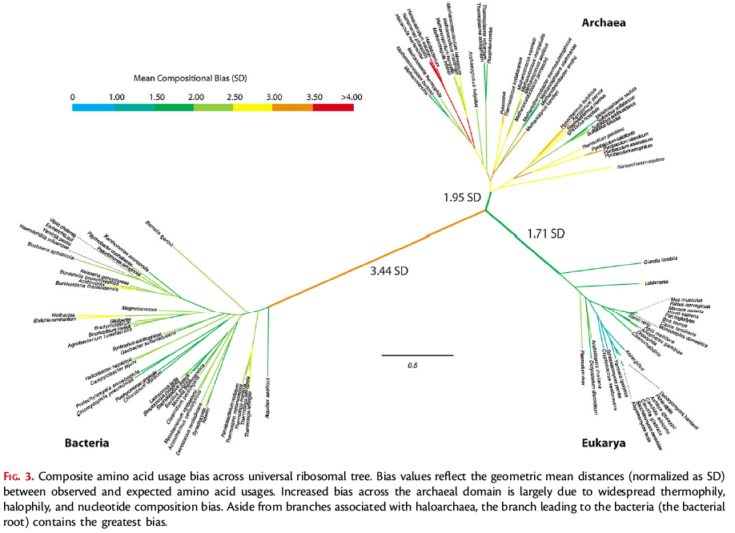
Rooting the Ribosomal Tree of Life using an Echo from the Early Expansion of the Genetic Code
(Fournier and Gogarten, MBE 2010)

Slide 17
Terminology
Branches, splits, bipartitions
In a rooted tree: clades (for unrooted trees sometimes the term clann is used)
Mono-, Para-, polyphyletic groups, cladists and a natural taxonomy
The term cladogram refers to a strictly bifurcating diagram, where each clade is defined by a common ancestor that only gives rise to members of this clade. I.e., a clade is monophyletic (derived from one ancestor) as opposed to polyphyletic (derived from many ancestors). (Note: you do need to know where the root is!)
A clade is recognized and defined by shared derived characters (= synapomorphies). Shared primitive characters (= sympleisiomorphies , aternative spelling is symplesiomorphies) do not define a clade. (see in class example drawing ala Hennig).
Homoplasies (characters that evolved independently, e.g. animals with wings) define polyphyletic groups
To use these terms you need to have polarized characters; for most molecular characters you don't know which state is primitive and which is derived (exceptions:....).
Discussion of Hennig versus Ashlock (and Mayr)
holophyletic, monophyletic, paraphyletic, paraphyletic

Slide 18
C C C c c
B B b b b
A a a a a
I
II
III
IV
V
D -> d
C -> c
B -> b
A -> a

Slide 19
C C C c c
B B b b b
A a a a a
I
II
III
IV
V
D -> d
Shared derived characters (aka synapomorphies) define monophyletic groups
C -> c
B -> b
A -> a

Slide 20
D D D D d
C C C c c
B B b b b
I
II
III
IV
V
D -> d
Shared primitive characters (aka symplesiomorphies) define paraphyletic groups
C -> c
B -> b
A -> a

Slide 21
D D D D d
C C C c c
B B b b b
A a a a a
I
II
III
IV
V
D -> d
C -> c
Derived characters
that are not shared
(as the autapomorphy ‘d’) do not provide phylogenetic information.
If one knowa that A is primitive, this provides useful phylogenetic information
B -> b
A -> a

Slide 22
Terminology
Branches, splits, bipartitions
In a rooted tree: clades (for unrooted trees sometimes the term clann is used)
Mono-, Para-, polyphyletic groups, cladists and a natural taxonomy
The term cladogram refers to a strictly bifurcating diagram, where each clade is defined by a common ancestor that only gives rise to members of this clade. I.e., a clade is monophyletic (derived from one ancestor) as opposed to polyphyletic (derived from many ancestors). (Note: you do need to know where the root is!)
A clade is recognized and defined by shared derived characters (= synapomorphies). Shared primitive characters (= sympleisiomorphies , aternative spelling is symplesiomorphies) do not define a clade. (see in class example drawing ala Hennig).
Homoplasies (characters that evolved independently, e.g. animals with wings) define polyphyletic groups
To use these terms you need to have polarized characters; for most molecular characters you don't know which state is primitive and which is derived (exceptions:....).
Discussion of Hennig versus Ashlock (and Mayr)
holophyletic, monophyletic, paraphyletic, paraphyletic

Slide 23
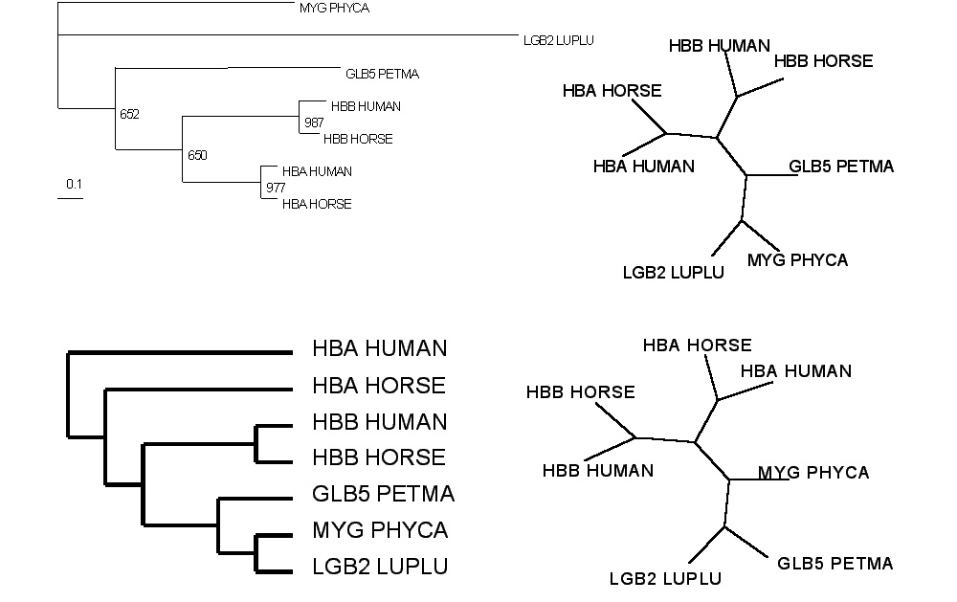
Test:Which of these trees is different?
More tests here

Slide 24
Likelihood estimates do not take prior information into consideration:
e.g., if the result of three coin tosses is 3 times head, then the likelihood estimate for the frequency of having a head is 1 (3 out of 3 events) and the estimate for the frequency of having a head is zero.
The probability that both events (A and B) occur
Both sides expressed as conditional probability
If A is the model and B is the data, then
P(B|A) is the likelihood of model A
P(A|B) is the posterior probability of the model given the data.
P(A) is the considered the prior probability of the model.
P(B) often is treated as a normalizing constant.

Slide 25
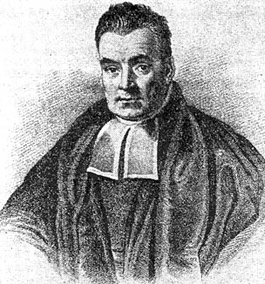
Bayes’ Theorem
Likelihood
describes how well the model predicts the data
P(data|model, I)
P(model|data, I) = P(model, I)
P(data,I)
Posterior
Probability
represents the degree
to which we believe a given model accurately describes the situation
given the available data and all of our prior information I
Prior
Probability
describes the degree to which we believe the model accurately describes reality
based on all of our prior information.
Normalizing
constant
Reverend Thomas Bayes (1702-1761)

Slide 26

Elliot Sober’s Gremlins
Observation: Loud noise in the attic
?
Hypothesis: gremlins in the attic playing bowling
Likelihood =
P(noise|gremlins in the attic)
P(gremlins in the attic|noise)
?
?

Slide 27
Alternative Approaches to Estimate
Posterior Probabilities
Bayesian Posterior Probability Mapping with MrBayes
(Huelsenbeck and Ronquist, 2001)
Problem:
Strimmer’s formula
L_{i}
p_{i}=
only considers 3 trees
(those that maximize the likelihood for
the three topologies)
L₁+L₂+L₃
Solution:
Exploration of the tree space by sampling trees using a biased random walk
(Implemented in MrBayes program)
Trees with higher likelihoods will be sampled more often
N_{i}
p_{i}≈
N_{total}
,where N_{i} - number of sampled trees of topology i, i=1,2,3
N_{total} – total number of sampled trees (has to be large)

Slide 28
Illustration of a biased random walk
Image generated with Paul Lewis's MCRobot
Figure generated using MCRobot program (Paul Lewis, 2001)

Slide 29
homology
Two sequences are homologous, if there existed an ancestral molecule in the past that is ancestral to both of the sequences
Types of Homology
Orthologs: “deepest” bifurcation in molecular tree reflects speciation.
These are the molecules people interested in the taxonomic classification of organisms want to study.
Paralogs: “deepest” bifurcation in molecular tree reflects gene duplication. The study of paralogs and their distribution in genomes provides clues on the way genomes evolved.
Gen and genome duplication have emerged as the most important pathway to molecular innovation, including the evolution of developmental pathways.
Xenologs: gene was obtained by organism through horizontal transfer. The classic example for Xenologs are antibiotic resistance genes, but the history of many other molecules also fits into this category: inteins, selfsplicing introns, transposable elements, ion pumps, other transporters,
Synologs: genes ended up in one organism through fusion of lineages. The paradigm are genes that were transferred into the eukaryotic cell together with the endosymbionts that evolved into mitochondria and plastids
(the -logs are often spelled with "ue" like in orthologues)
see Fitch's article in TIG 2000 for more discussion.

Slide 30
Trees – what might they mean?
Calculating a tree is comparatively easy, figuring out what it might mean is much more difficult.
If this is the probable organismal tree:
species A
species B
species C
species D
what could be the reason for obtaining this gene tree:
seq. from A
seq. from D
seq. from C
seq. from B

Slide 31
lack of resolution
seq. from A
seq. from D
seq. from C
seq. from B
e.g., 60% bootstrap support for bipartition (AD)(CB)

Slide 32
long branch attraction artifact
the two longest branches join together
seq. from A
seq. from D
seq. from C
seq. from B
e.g., 100% bootstrap support for bipartition (AD)(CB)
What could you do to investigate if this is a possible explanation?
use only slow positions,
use an algorithm that corrects for ASRV
add sequences that break-up the long branches

Slide 33
Gene transfer
Organismal tree:
species A
species B
Gene Transfer
species C
species D
molecular tree:
seq. from A
seq. from D
seq. from C
speciation
seq. from B
gene transfer

Slide 34
Lineage Sorting
Organismal tree:
species A
species B
species C
Genes diverge and coexist in the
organismal lineage
species D
molecular tree:
seq. from A
seq. from D
seq. from C
seq. from B

Slide 35
Gene duplication
Organismal tree:
species A
species B
species C
gene duplication
species D
molecular tree:
molecular tree:
molecular tree:
seq. from A
seq. from A
seq. from A
seq. from B
seq. from B
seq. from C
seq. from C
seq. from D
seq. from D
seq. from D
seq.’ from B
seq.’ from B
seq.’ from C
seq.’ from C
seq.’ from C
gene duplication
gene duplication
gene duplication
seq.’ from D
seq.’ from D
seq.’ from D

Slide 36
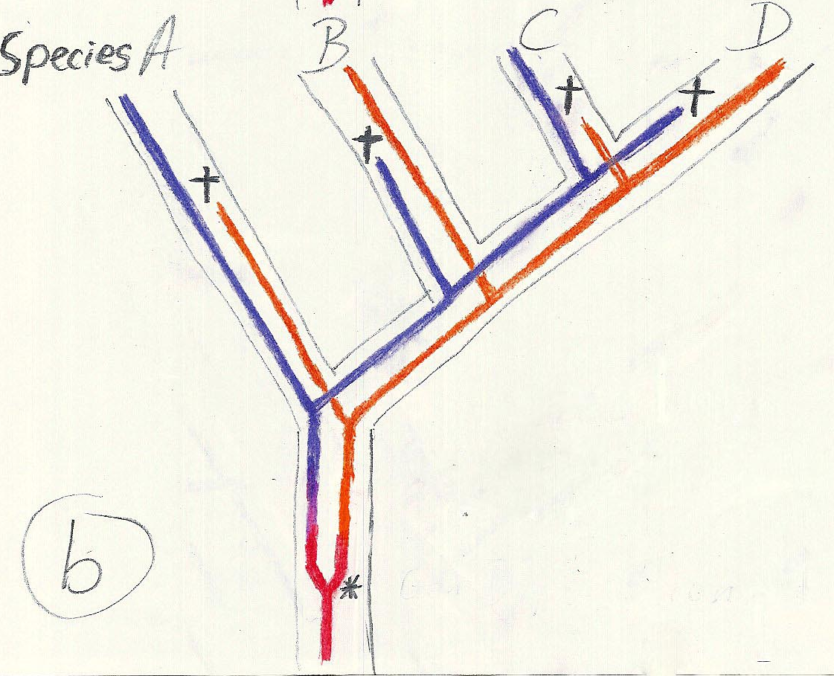
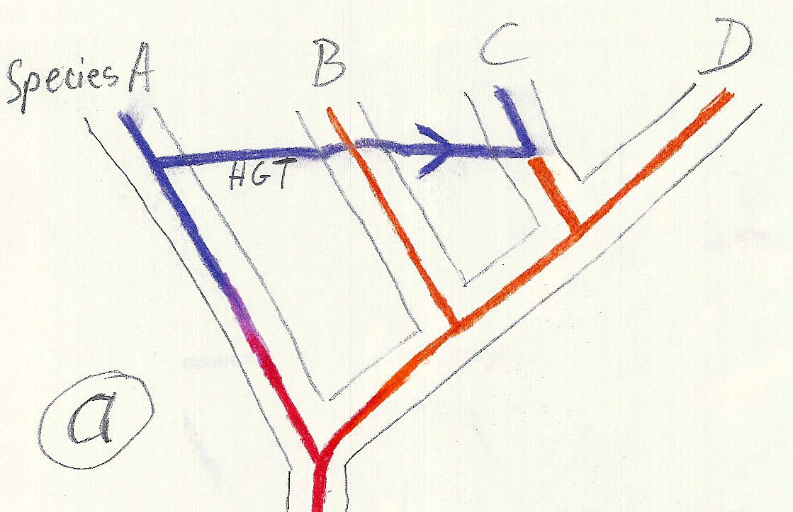
Gene duplication and gene transfer are equivalent explanations.
The more relatives of C are found that do not have the blue type of gene, the less likely is the duplication loss scenario
Ancient duplication followed by gene loss
Horizontal or lateral Gene
Note that scenario B involves many more individual events than A
1 HGT with
orthologous replacement
1 gene duplication followed by 4 independent gene loss events

Slide 37
What is it good for?
Gene duplication events can provide an outgroup that allows rooting a molecular phylogeny.
Most famously this principle was applied in case of the tree of life – the only outgroup available in this case are ancient paralogs (see http://gogarten.uconn.edu/cvs/Publ_Pres.htm for more info).
However, the same principle also is applicable to any group of organisms, where a duplication preceded the radiation (example).
Lineage specific duplications also provide insights into which traits were important during evolution of a lineage.

Slide 38
Function, ortho- and paralogy
molecular tree:
seq. from A
seq.’ from B
seq.’ from C
seq.’ from D
gene duplication
seq. from B
seq. from C
seq. from D
The presence of the duplication is a taxonomic character (shared derived character in species B C D).
The phylogeny suggests that seq’ and seq have similar function, and that this function was important in the evolution of the clade BCD.
seq’ in B and seq’in C and D are orthologs and probably have the same function, whereas seq and seq’ in BCD probably have different function (the difference might be in subfunctionalization of functions that seq had in A. – e.g. organ specific expression)

Slide 39
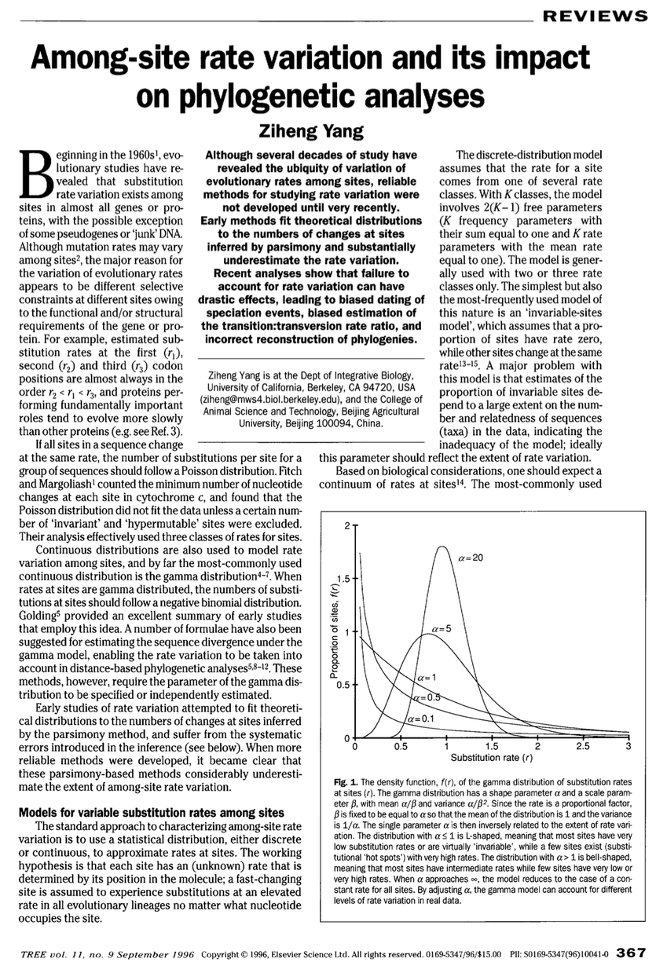

Slide 40
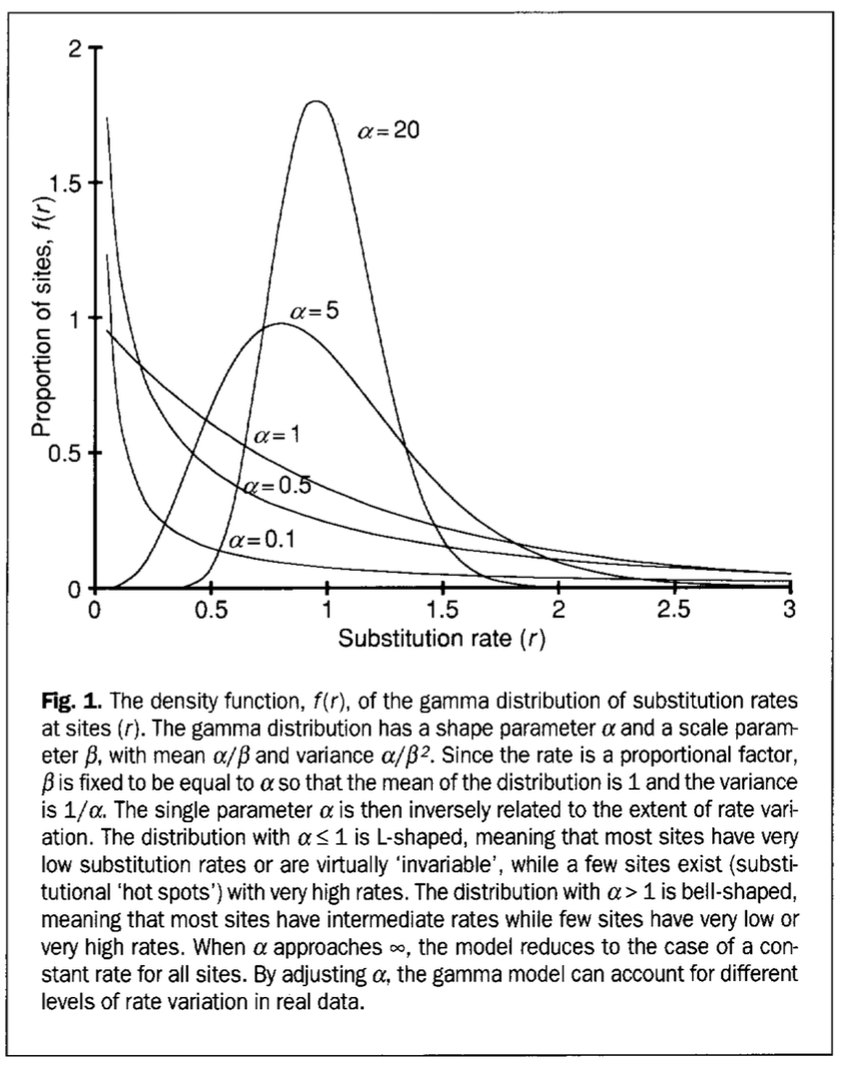

Slide 41
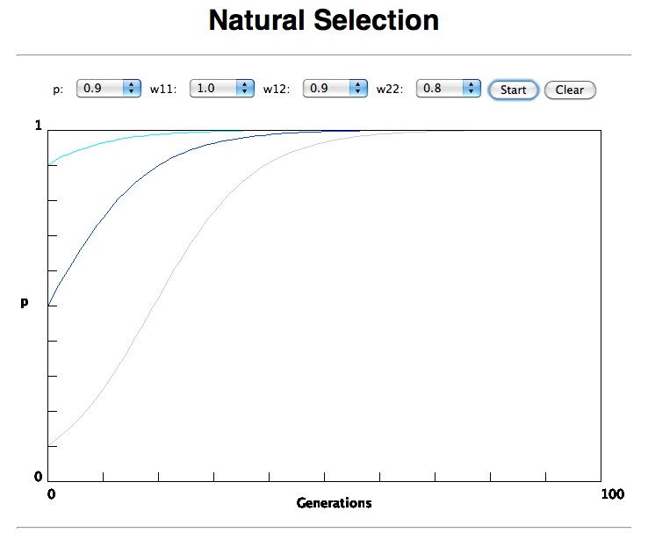

Slide 42
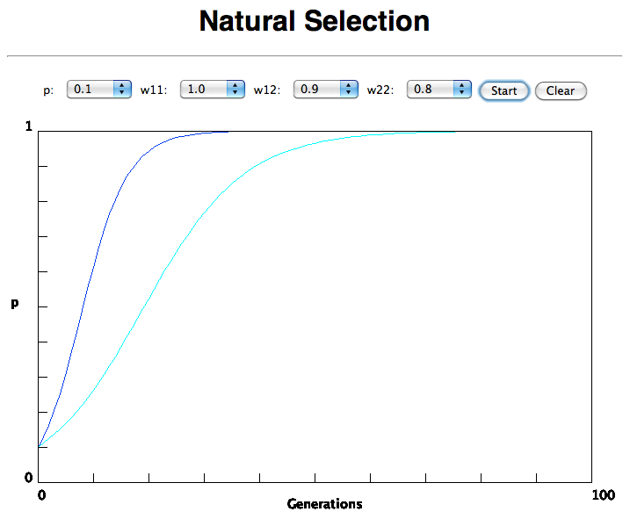
In the deterministic model, the time till fixation depends on the selective advantage, but fixation is guaranteed.

Slide 43
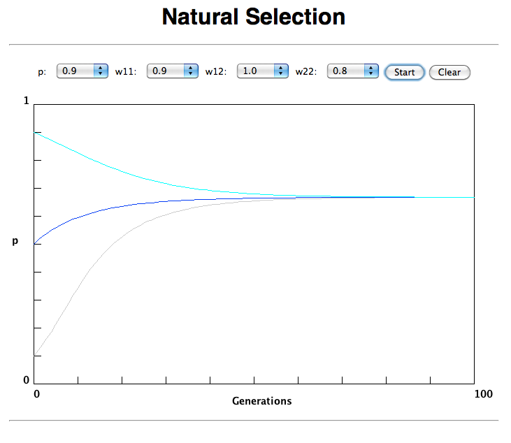
Only in case the heterozygote has an advantage (=balancing
selection) do both alleles coexist in a population.

Slide 44
Neutral theory:
The vast majority of observed sequence differences between members of a population are neutral (or according to the nearly neutral theory “close to neutral”). These differences can be fixed in the population through random genetic drift. Some mutations are strongly counter selected (this is why there are patterns of conserved residues). Only very seldom is a mutation under positive selection.
The neutral theory does not say that all evolution is neutral and everything is only due to to genetic drift.

Slide 45
Nearly Neutral theory:
Even synonymous mutations do not lead to random composition but to codon bias. Small negative selection might be sufficient to produce the observed codon usage bias.

Slide 46
the gradualist point of view
Evolution occurs within populations where the fittest organisms have a selective advantage. Over time the advantages genes become fixed in a population and the population gradually changes.
Note: this is not in contradiction to the the theory of neutral evolution. (which says what ?)
Processes that MIGHT go beyond inheritance with variation and selection?
  Horizontal gene transfer and recombination
  Polyploidization (botany, vertebrate evolution) see here or here
  Fusion and cooperation of organisms (Kefir, lichen, also the eukaryotic cell)
  Targeted mutations (?), genetic memory (?) (see Foster's and Hall's reviews on directed/adaptive mutations; see here for a counterpoint)
  Random genetic drift
  Gratuitous complexity
  Selfish genes (who/what is the subject of evolution??)
  Parasitism, altruism, Morons
  Evolutionary capacitors
  Hopeless monsters (in analogy to Goldschmidt’s hopeful monsters)

Slide 47
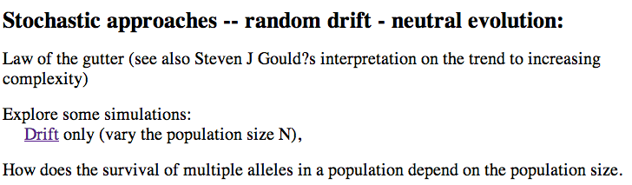
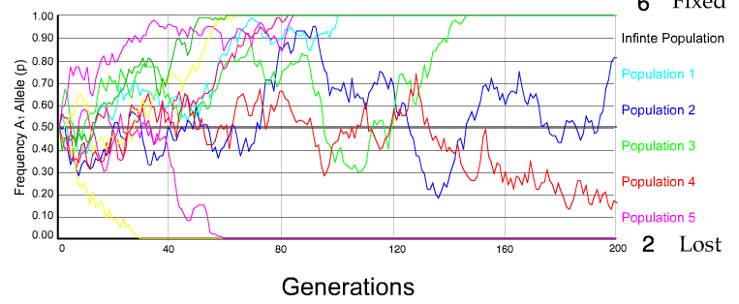
N=50 s=0
10 replicates

Slide 48
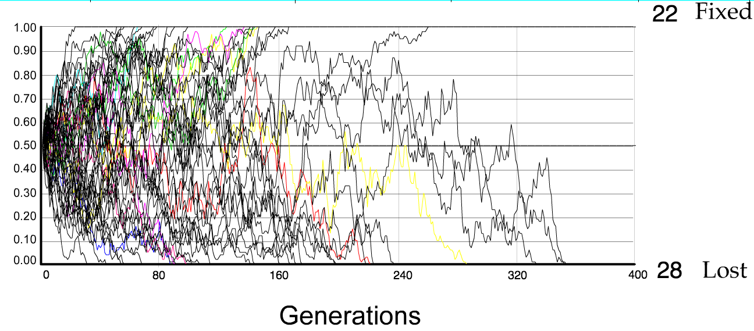
N=50 s=0
50 replicates

Slide 49
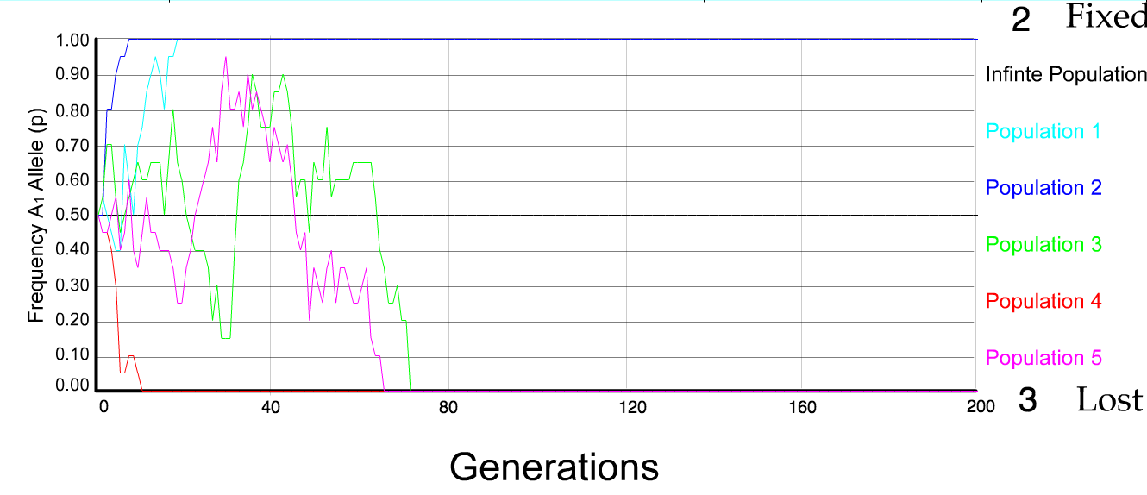
N=10 s=0
5 replicates

Slide 50
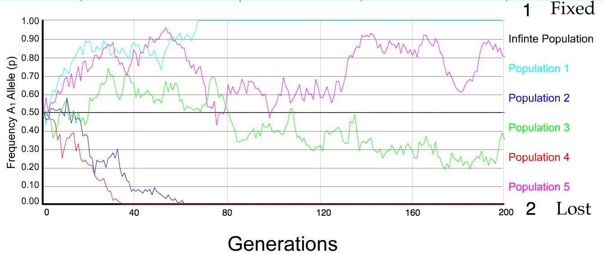
N=50 s=0
5 replicates

Slide 51
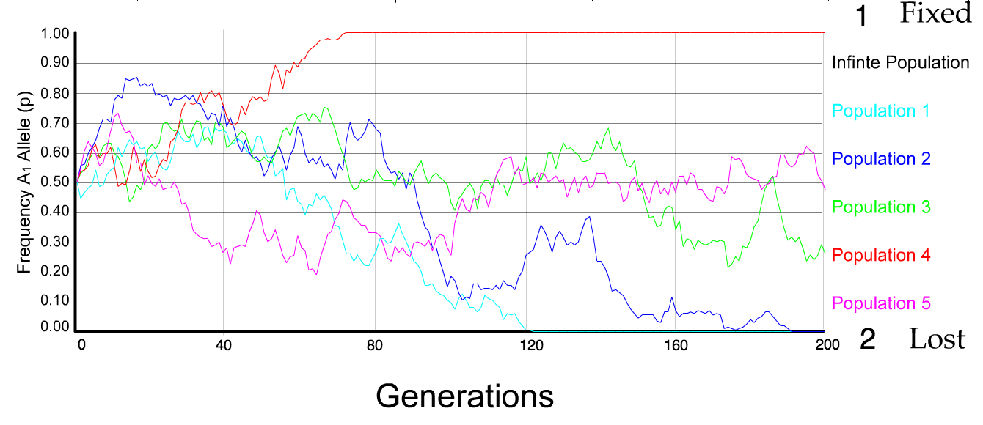
N=100 s=0
5 replicates

Slide 52
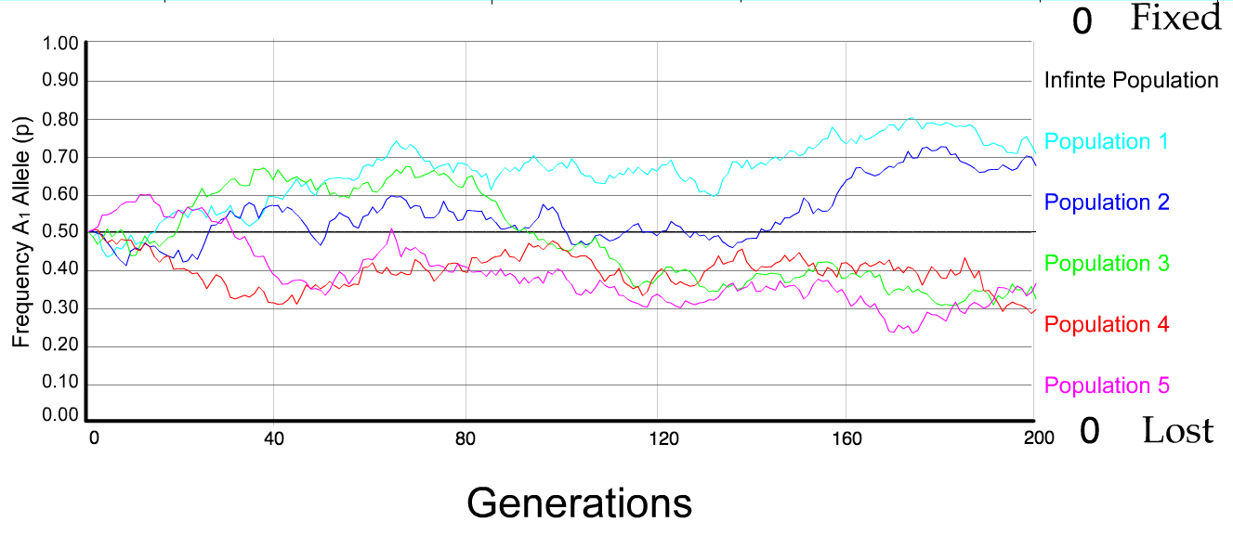
N=500 s=0
5 replicates

Slide 53
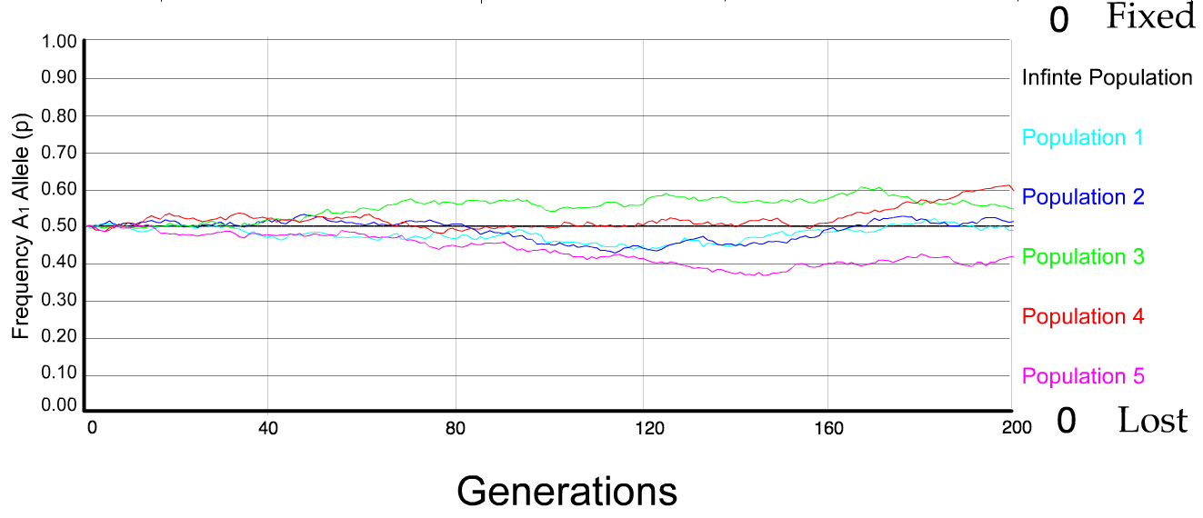
N=5000 s=0
5 replicates

Slide 54
s=0
Probability of fixation, P, is equal to frequency of allele in population. Mutation rate (per gene/per unit of time) = u ;
freq. with which allele is generated in diploid population size N =u*2N
Probability of fixation for each allele = 1/(2N)
Substitution rate =
frequency with which new alleles are generated * Probability of fixation= u*2N *1/(2N) = u = Mutation rate
Therefore:
If f s=0, the substitution rate is independent of population size, and equal to the mutation rate !!!! (NOTE: Mutation unequal Substitution! )
This is the reason that there is hope that the molecular clock might sometimes work.
Fixation time due to drift alone:
t_{av}=4*N_{e} generations
(N_{e}=effective population size; For n discrete generations
N_{e}= n/(1/N₁+1/N₂+…..1/N_{n})

Slide 55
s>0
Time till fixation on average:
t_{av}= (2/s) ln (2N) generations
(also true for mutations with negative “s” ! discuss among yourselves)
E.g.: N=10⁶,
s=0: average time to fixation: 4*10⁶ generations
s=0.01: average time to fixation: 2900 generations
N=10⁴,
s=0: average time to fixation: 40.000 generations
s=0.01: average time to fixation: 1.900 generations
N=10¹¹ (100 billion – size of the Prochlorococcus population),
s=0: average time to fixation: 4*10¹¹ generations (about 1 billion years) s=0.01: average time to fixation: 5200 generations (about 14 years)
Test question: What is the probability of fixation?
=> substitution rate of mutation under positive selection is larger than the rate with which neutral mutations are fixed.

Slide 56
Positive selection (s>0)
A new allele (mutant) confers some increase in the fitness of the organism
Selection acts to favour this allele
Also called adaptive selection or Darwinian selection.
NOTE: Fitness = ability to survive and reproduce
Modified from from www.tcd.ie/Genetics/staff/Aoife/GE3026/GE3026_1+2.ppt

Slide 57
Random Genetic Drift
Selection
100
advantageous
Allele frequency
disadvantageous
0
Modified from from www.tcd.ie/Genetics/staff/Aoife/GE3026/GE3026_1+2.ppt

Slide 58
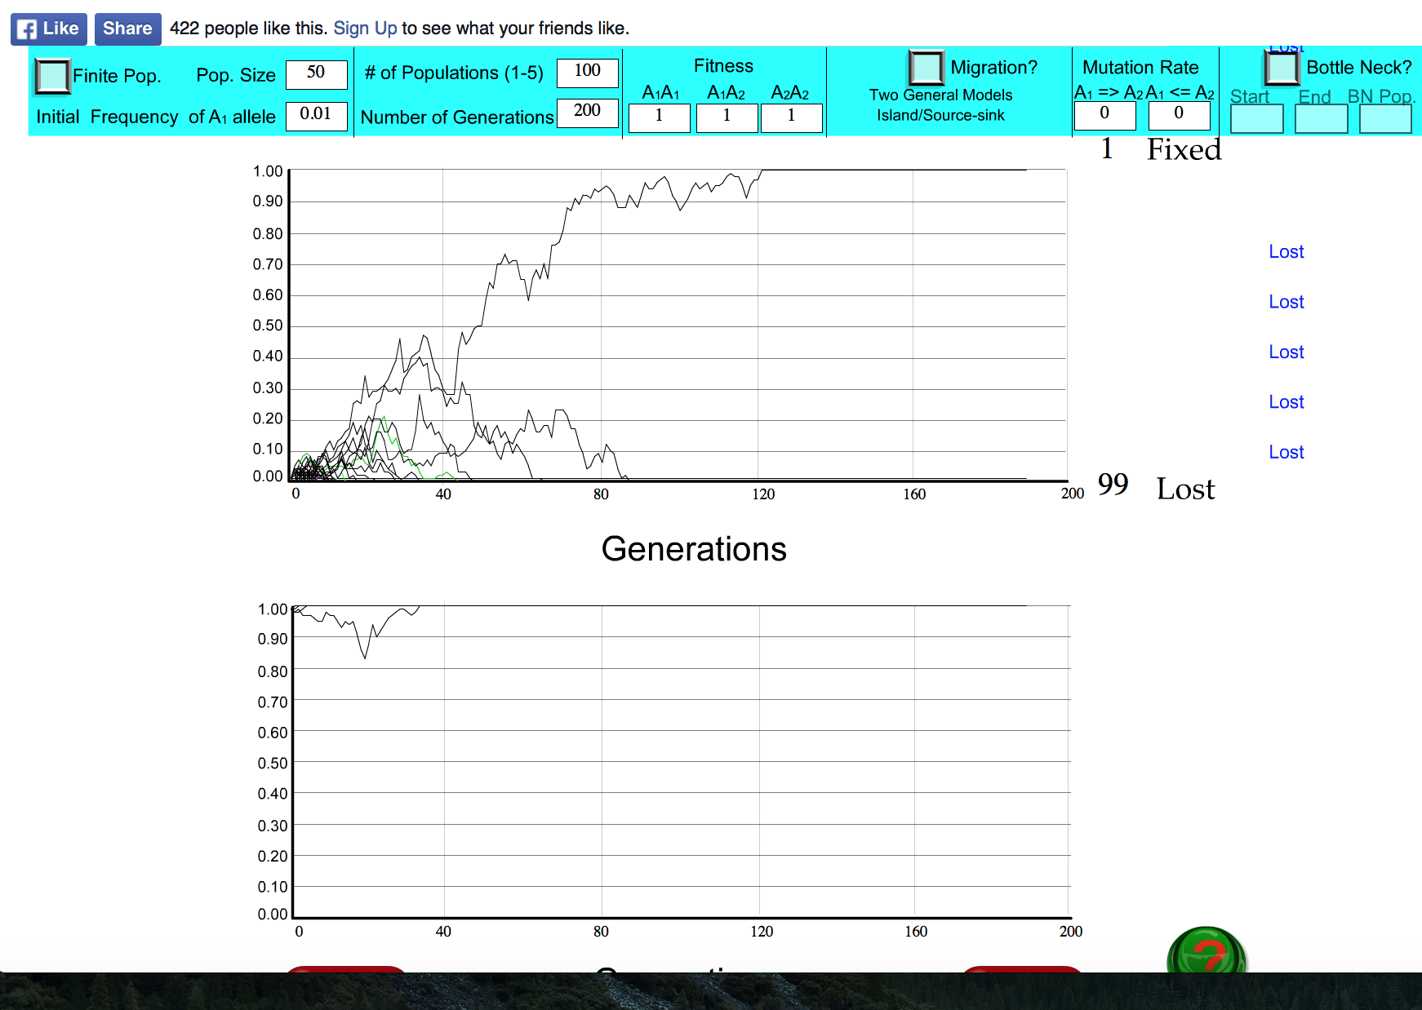
s=0

Slide 59
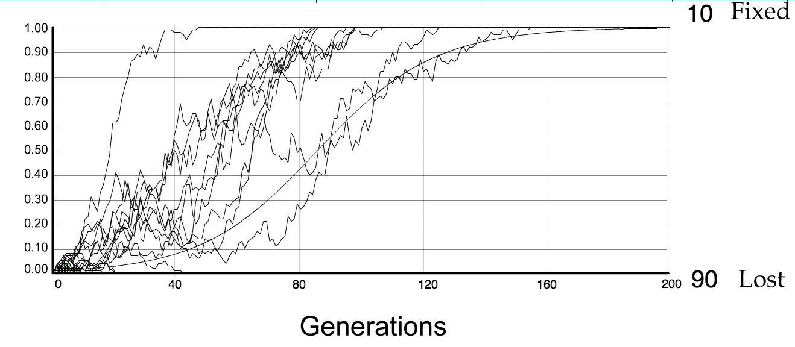
For advantageous mutations:
Probability of fixation, P, is approximately equal to 2s;
e.g., if selective advantage s = 5% then P = 10%
tav=2/s*log2N generations = 40*log100= 80

Slide 60
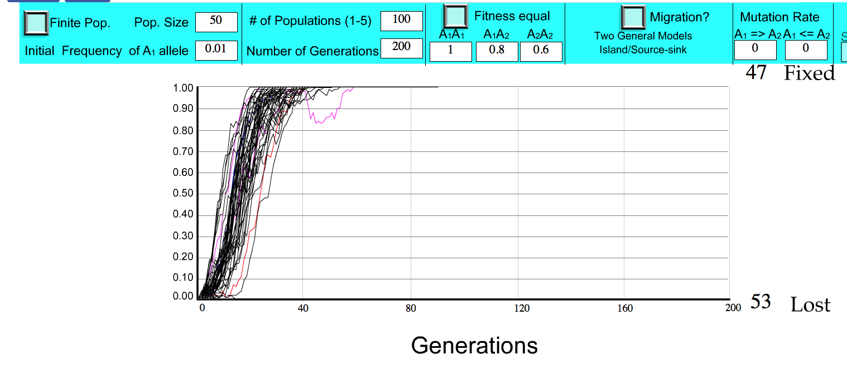
S=.2 => shorter fixation time.

Slide 61
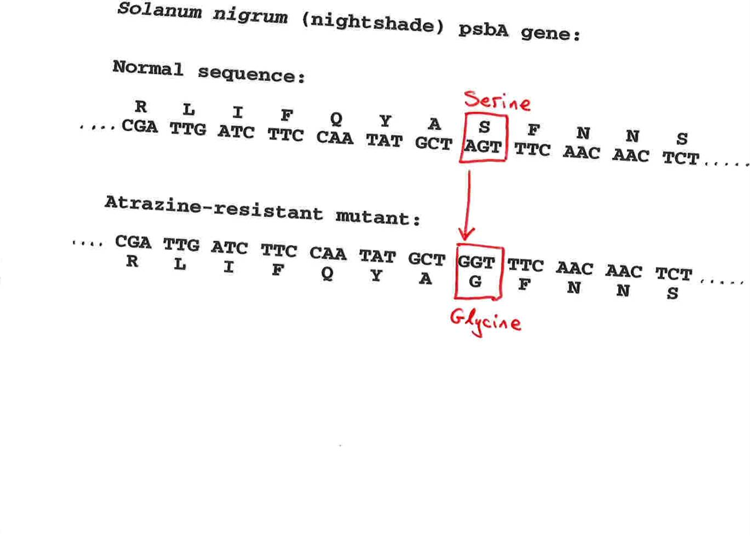
Advantageous allele
Herbicide resistance gene in nightshade plant
Modified from from www.tcd.ie/Genetics/staff/Aoife/GE3026/GE3026_1+2.ppt

Slide 62
selection versus drift
The larger the population the longer it takes for an allele to become fixed.
Note: Even though an allele conveys a strong selective advantage of 10%, the allele has a rather large chance to go extinct.
Note#2: Fixation is faster under selection than under drift.
Question: Can you think of genes that have a higher fixation probability? (Hint: HGT)

Slide 63
Negative selection (s<0)
A new allele (mutant) confers some decrease in the fitness of the organism
Selection acts to remove this allele
Also called purifying selection
Modified from from www.tcd.ie/Genetics/staff/Aoife/GE3026/GE3026_1+2.ppt

Slide 64
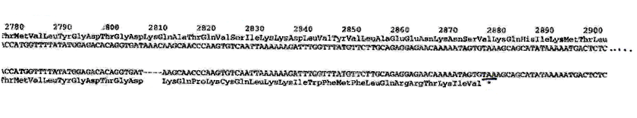
Deleterious allele
Human breast cancer gene, BRCA2
5% of breast cancer cases are familial
Mutations in BRCA2 account for 20% of familial cases
Normal (wild type) allele
Mutant allele
(Montreal 440
Family)
Stop codon
4 base pair deletion
Causes frameshift
Modified from from www.tcd.ie/Genetics/staff/Aoife/GE3026/GE3026_1+2.ppt

Slide 65
Neutral mutations
Neither advantageous nor disadvantageous
Invisible to selection (no selection)
Frequency subject to ‘drift’ in the population
Random drift – random changes in small populations

Slide 66
This is how far we got in Monday’s class

Slide 67
Types of Mutation-Substitution
Replacement of one nucleotide by another
Synonymous (Doesn’t change amino acid)
  Rate sometimes indicated by Ks
  Rate sometimes indicated by d_{s}
Non-Synonymous (Changes Amino Acid)
  Rate sometimes indicated by Ka
  Rate sometimes indicated by d_{n}
(this and the following 4 slides are from
mentor.lscf.ucsb.edu/course/ spring/eemb102/lecture/Lecture7.ppt)

Slide 68
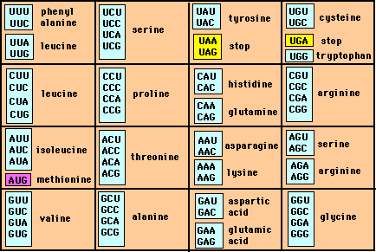
Genetic Code – Note degeneracy of 1st vs 2nd vs 3rd position sites

Slide 69
Genetic Code
Four-fold degenerate site – Any substitution is synonymous
From: mentor.lscf.ucsb.edu/course/spring/eemb102/lecture/Lecture7.ppt

Slide 70
Genetic Code
Two-fold degenerate site – Some substitutions synonymous, some
non-synonymous
From: mentor.lscf.ucsb.edu/course/spring/eemb102/lecture/Lecture7.ppt

Slide 71
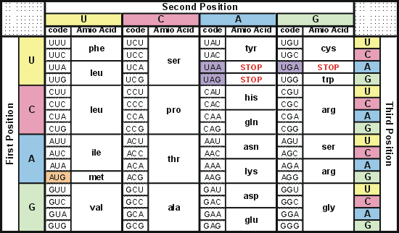
Degeneracy of 1st vs 2nd vs 3rd position sites results in 25.5% synonymous changes and 74.5% non synonymous changes (Yang&Nielsen,1998).
Genetic Code
Notes:
An inspection of the genetic code table suggests most changes at the first position are nonsynonymous, all changes at the second codon position are nonsynonymous and only some changes at the third position are synonymous. As a result we do not expect to see equal proportions of synonymous and nonsynonymous mutations even if there is no selection at protein level. Indeed, if mutations from any one nucleotide to any other occur at the same rate , we expect 25.5% of mutations to be synonymous and 74.5% mutations to be nonsynonymous.

Slide 72
Measuring Selection on Genes
Null hypothesis = neutral evolution
Under neutral evolution, synonymous changes should accumulate at a rate equal to mutation rate
Under neutral evolution, amino acid substitutions should also accumulate at a rate equal to the mutation rate
From: mentor.lscf.ucsb.edu/course/spring/eemb102/lecture/Lecture7.ppt

Slide 73
Counting #s/#a
Ser Ser Ser Ser Ser
Species1 TGA TGC TGT TGT TGT
Ser Ser Ser Ser Ala
Species2 TGT TGT TGT TGT GGT
#s = 2 sites
#a = 1 site
#a/#s=0.5
To assess selection pressures one needs to calculate the rates (Ka, Ks), i.e. the occurring substitutions as a fraction of the possible syn. and nonsyn. substitutions.
Things get more complicated, if one wants to take transition transversion ratios and codon bias into account. See chapter 4 in Nei and Kumar, Molecular Evolution and Phylogenetics.
Modified from: mentor.lscf.ucsb.edu/course/spring/eemb102/lecture/Lecture7.ppt

Slide 74
Testing for selection using dN/dS ratio
dN/dS ratio (aka Ka/Ks or ω (omega) ratio) where
dN = number of non-synonymous substitutions / number of all possible non-synonymous substitutions
dS =number of synonymous substitutions / number of all possible non-synonymous substitutions
dN/dS >1 positive, Darwinian selection
dN/dS =1 neutral evolution
dN/dS <1 negative, purifying selection
Notes:
The synonymous and non-synonymous rates dN and dS are defined as the numbers of synonymous and nonsynonymous substitutions per site. The ratio of the two rates omega=dN/dS then measures selective pressure at the protein level. If selection level has no effect on fitness, nonsynonymous mutations will be fixed at the same rate as synonymous mutations so that dN=dS and omega=1. If nonsynonymous mutations are deleterious purifying selection will reduce their fixation rate so that dN<dS and omega<1. If nonsynonymous mutations are favored by Darwinian selection, they will be fixed at a higher rate than synonymous mutations resulting in dN>dS and omega>1.

Slide 75
dambe
Two programs worked well for me to align nucleotide sequences based on the amino acid alignment,
One is DAMBE (only for windows). This is a handy program for a lot of things, including reading a lot of different formats, calculating phylogenies, it even runs codeml (from PAML) for you.
The procedure is not straight forward, but is well described on the help pages. After installing DAMBE go to HELP -> general HELP -> sequences -> align nucleotide sequences based on …->
If you follow the instructions to the letter, it works fine.
DAMBE also calculates Ka and Ks distances from codon based aligned sequences.

Slide 76
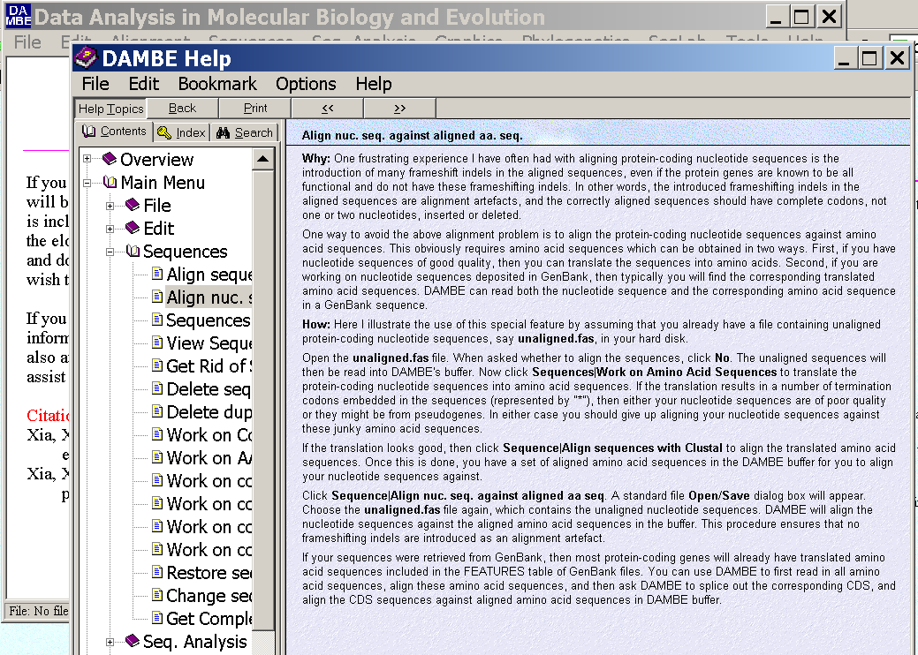
dambe (cont)

Slide 77
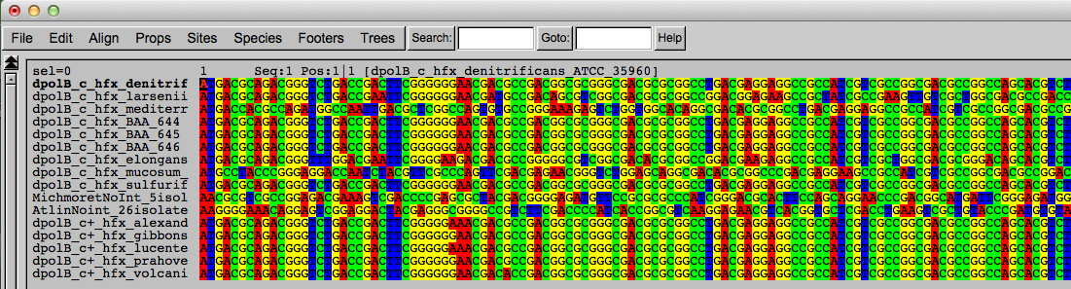
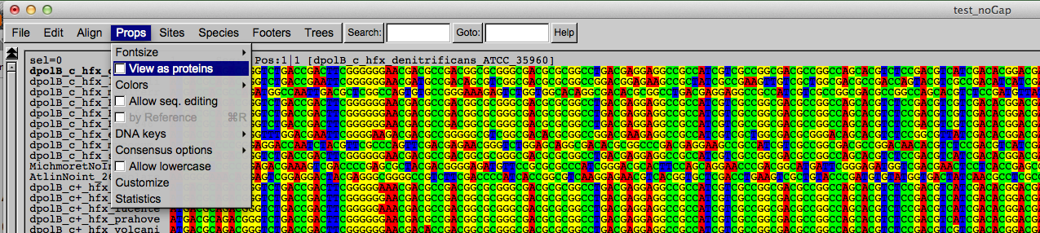
Codon based alignments in Seaview
Load nucleotide sequences (no gaps in sequences, sequence starts with nucleotide corresponding to 1st codon position)
Select view as proteins

Slide 78
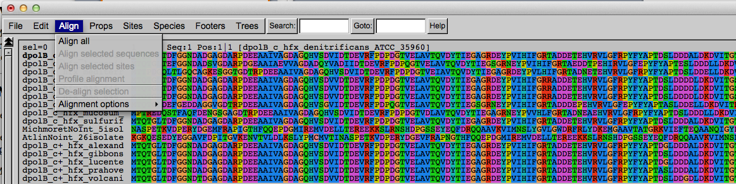
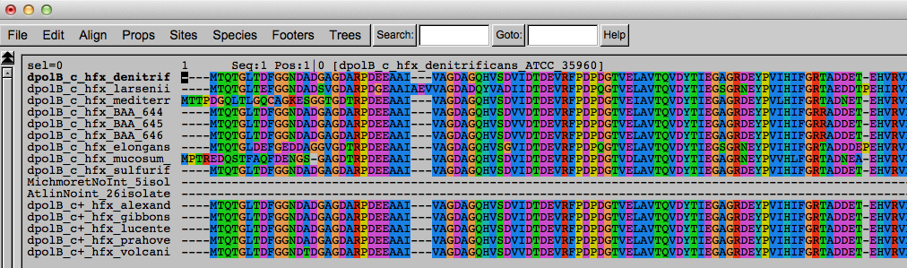
Codon based alignments in Seaview
With the protein sequences displayed, align sequences
Select view as nucleotides

Slide 79
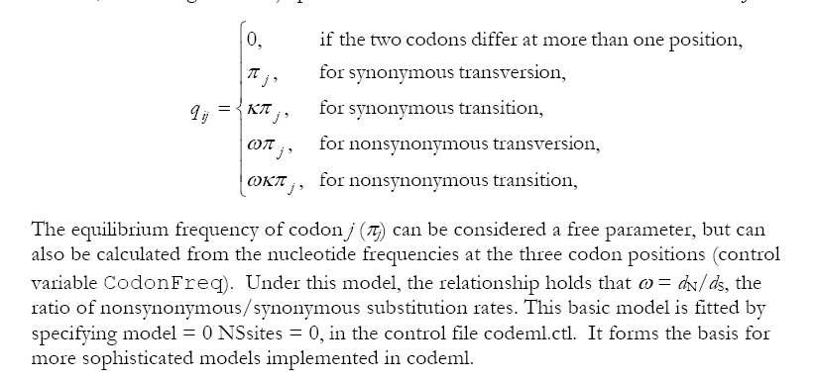
PAML (codeml) the basic model

Slide 80

sites versus branches
You can determine omega for the whole dataset; however, usually not all sites in a sequence are under selection all the time.
PAML (and other programs) allow to either determine omega for each site over the whole tree, ,
or determine omega for each branch for the whole sequence,
.
It would be great to do both, i.e., conclude codon 176 in the vacuolar ATPases was under positive selection during the evolution of modern humans – alas, a single site often does not provide much statistics. PAML does provide a branch site model.

Slide 81
Sites model(s)
have been shown to work great in few instances.
The most celebrated case is the influenza virus HA gene.
A talk by Walter Fitch (slides and sound) on the evolution of
this molecule is here .
This article by Yang et al, 2000 gives more background on ml aproaches to measure omega. The dataset used by Yang et al is here: flu_data.paup .

Slide 82
sites model in MrBayes
The MrBayes block in a nexus file might look something like this:
begin mrbayes;
set autoclose=yes;
lset nst=2 rates=gamma nucmodel=codon omegavar=Ny98;
mcmcp samplefreq=500 printfreq=500;
mcmc ngen=500000;
sump burnin=50;
sumt burnin=50;
end;

Slide 83
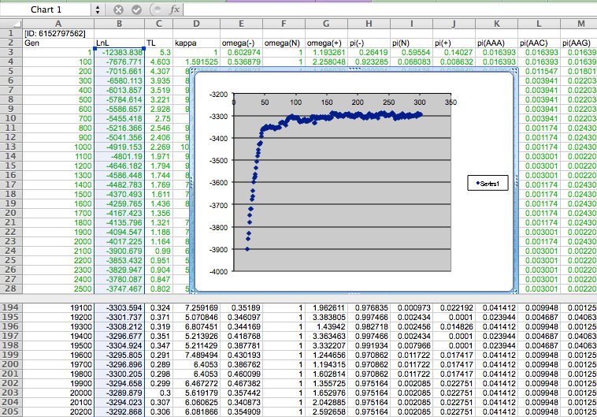

Slide 84
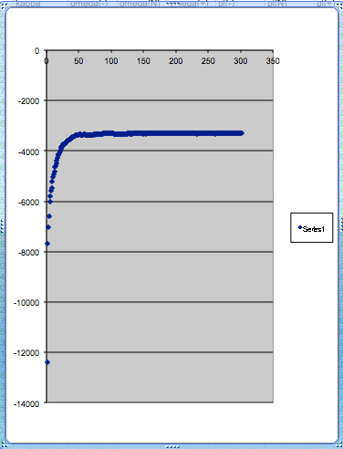
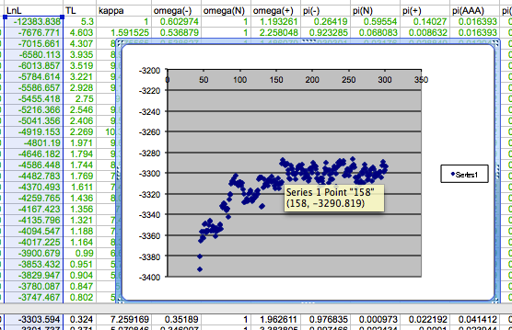
plot LogL to determine which samples to ignore
the same after rescaling the y-axis

Slide 85
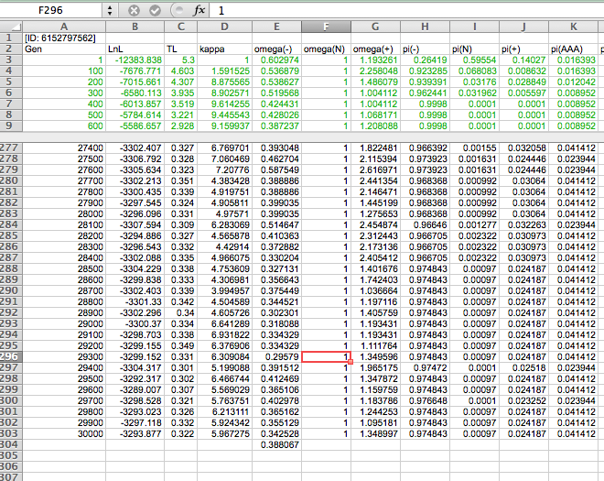

Slide 86
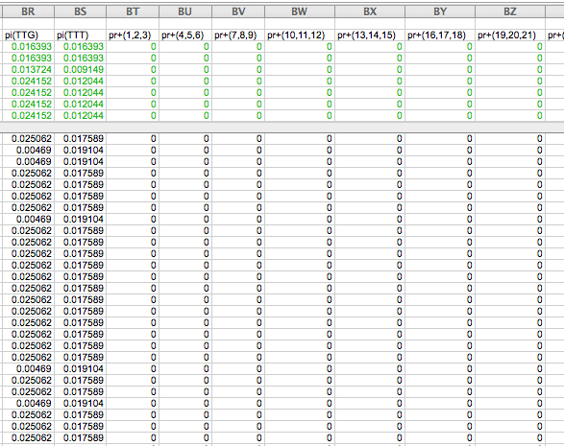

Slide 87
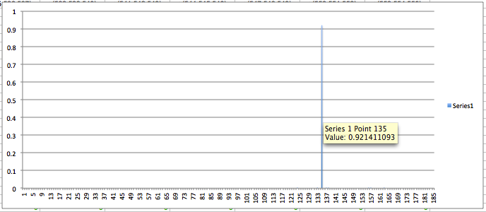
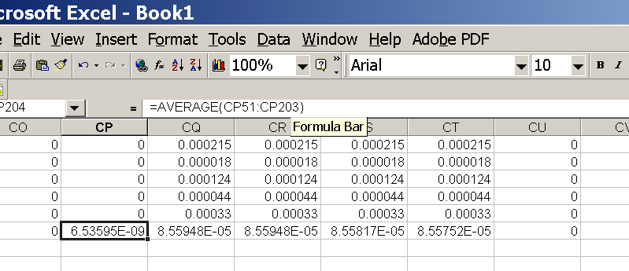
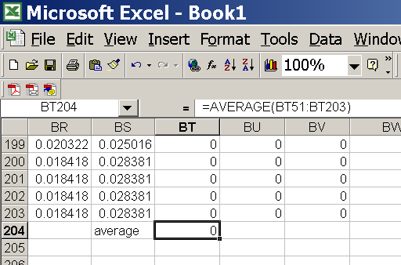
for each codon calculate the the average probability
copy paste formula
plot row
enter formula

Slide 88
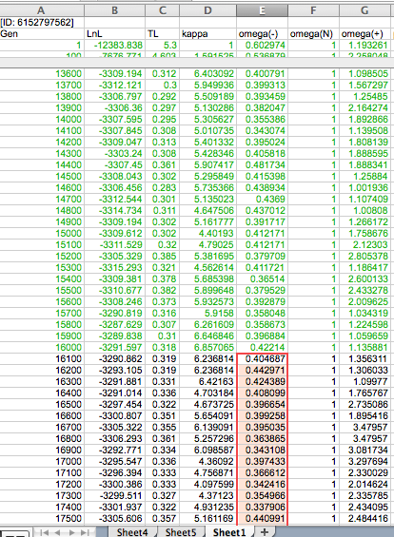
To determine credibility interval for a parameter (here omega<1):
Select values for the parameter, sampled after the burning.
Copy paste to a new spreadsheet,

Slide 89
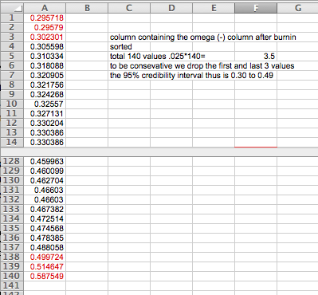
Sort values according to size,
Discard top and bottom 2.5%
Remainder gives 95% credibility interval.

Slide 90
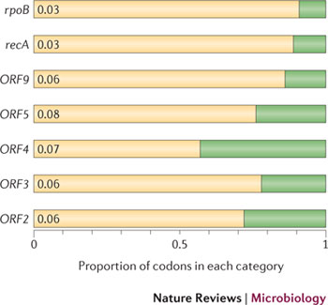
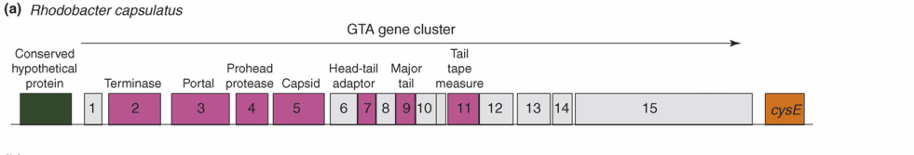
Purifying selection in GTA genes
dN/dS <1 for GTA genes has been used to infer selection for function
GTA genes
Lang AS, Zhaxybayeva O, Beatty JT. Nat Rev Microbiol. 2012 Jun 11;10(7):472-82
Lang, A.S. & Beatty, J.T. Trends in Microbiology , Vol.15, No.2 , 2006
Notes:
The ratio of non-synonymous-to-synonymous (dN/dS, or ω) codon substitution rates can be used as an indication of the selective pressure acting on a protein-coding gene. If a gene (or gene segment) is under purifying selection, non-synonymous mutations (that is, mutations resulting in a change of the encoded amino acid) will be selected against, resulting in ω < 1. In neutrally evolving proteins, synonymous and non-synonymous mutations will be fixed at approximately the same rate, resulting in ω = 1. Because different regions of a protein-coding gene may be under different selective constraints, codons can be divided into two categories: those with ω < 1 (yellow; the estimated ω is indicated on the bar) and those with ω fixed to 1 (green); the estimated proportion of codons in each category is given on the horizontal axis.

Slide 91
Purifying selection in E.coli ORFans
dN-dS < 0 for some ORFan E. coli clusters seems to suggest they are functional genes.
Gene groups | Number | dN-dS>0 | dN-dS<0 | dN-dS=0
E. coli ORFan clusters | 3773 | 944 (25%) | 1953 (52%) | 876 (23%)
Clusters of E.coli sequences found in Salmonella sp., Citrobacter sp. | 610 | 104 (17%) | 423(69%) | 83 (14%)
Clusters of E.coli sequences found in some Enterobacteriaceae only | 373 | 8 (2%) | 365 (98%) | 0 (0%)
Adapted after Yu, G. and Stoltzfus, A. Genome Biol Evol (2012) Vol. 4 1176-1187

Slide 92
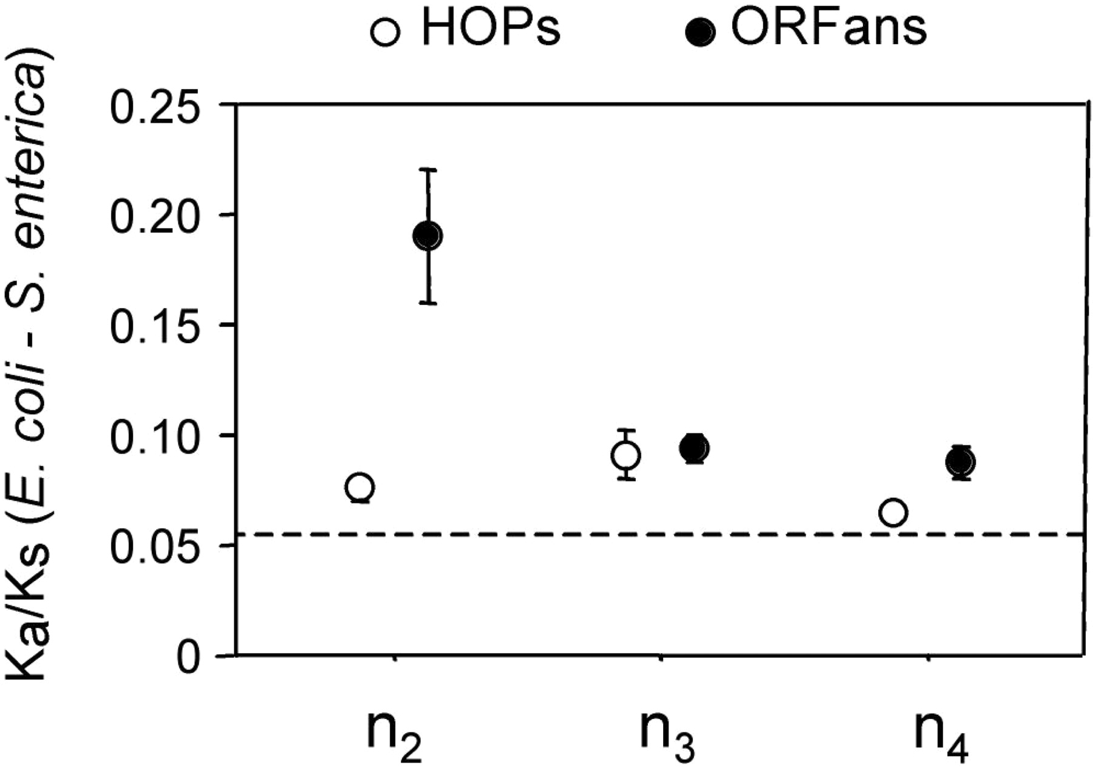
Vincent Daubin and Howard Ochman: Bacterial Genomes as New Gene Homes: The Genealogy of ORFans in E. coli. Genome Research 14:1036-1042, 2004
The ratio of non-synonymous to synonymous substitutions for genes found only in the E.coli - Salmonella clade is lower than 1, but larger than for more widely distributed genes.
Increasing phylogenetic depth
Fig. 3 from Vincent Daubin and Howard Ochman, Genome Research 14:1036-1042, 2004

Slide 93

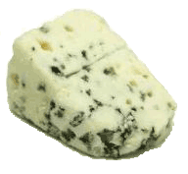

Trunk-of-my-car analogy: Hardly anything in there is the is the result of providing a selective advantage. Some items are removed quickly (purifying selection), some are useful under some conditions, but most things do not alter the fitness. See here for a published version.
Could some of the inferred purifying selection be due to the acquisition of novel detrimental characteristics (e.g., protein toxicity, HOPELESS MONSTERS)?

Slide 94

Vertically Inherited Genes Not Expressed for Function

Slide 95


Counting Algorithm
Calculate number of different nucleotides/amino acids per MSA column (X)
Calculate number of nucleotides/amino acids substitutions (X-1)
Calculate number of synonymous changes
S=(N-1)nc-N
assuming N=(N-1)aa
X=2 1 nucleotide substitution
1 non-synonymous change
X=2 1 amino acid substitution

Slide 96
Simulation Algorithm
Calculate MSA nucleotide frequencies (%A,%T,%G,%C)
Introduce a given number of random substitutions ( at any position) based on inferred base frequencies
Compare translated mutated codon with the initial translated codon and count synonymous and non-synonymous substitutions

Slide 97




Evolution of Coding DNA Sequences Under a Neutral Model
E. coli Prophage Genes
Count distribution from simulations
Probability distribution
n=90
Non-synonymous
n= 90
k= 24
p=0.763
P(≤24)=3.63E-23
Observed=24
P(≤24) < 10⁻⁶
n=90
Synonymous
n= 90
k= 66
p=0.2365
P(≥66)=3.22E-23
Observed=66
P(≥66) < 10⁻⁶

Slide 98




Evolution of Coding DNA Sequences Under a Neutral Model
E. coli Prophage Genes
Count distribution
Probability distribution
n=375
Synonymous
n= 375
k= 243
p=0.237
P(≥243)=7.92E-64
Observed=243
P(≥243) < 10⁻⁶
n=723
Synonymous
n= 723
k= 498
p=0.232
P(≥498)=6.41E-149
Observed=498
P(≥498) < 10⁻⁶

Slide 99
Evolution of Coding DNA Sequences Under a Neutral Model
E. coli Prophage Genes
 |  | OBSERVED |  | SIMULATED |  | Dnapars | Simulated | Codeml
Gene | Alignment Length (bp) | Substitutions | Synonymous changes* | Substitutions | p-value synonymous (given *) | Minimum number of substitutions | dN/dS | dN/dS
Major capsid | 1023 | 90 | 66 | 90 | 3.23E-23 | 94 | 0.113 | 0.13142
Minor capsid C | 1329 | 81 | 59 | 81 | 1.98E-19 | 84 | 0.124 | 0.17704
Large terminase subunit | 1923 | 75 | 67 | 75 | 7.10E-35 | 82 | 0.035 | 0.03773
Small terminase subunit | 543 | 100 | 66 | 100 | 1.07E-19 | 101 | 0.156 | 0.25147
Portal | 1599 | 55 | 46 | 55 | 1.36E-21 | *64 | 0.057 | 0.08081
Protease | 1329 | 55 | 37 | 55 | 4.64E-11 | 55 | 0.162 | 0.24421
Minor tail H | 2565 | 260 | 168 | 260 | 1.81E-44 | 260 | 0.17 | 0.30928
Minor tail L | 696 | 30 | 26 | 30 | 1.30E-13 | 30 | 0.044 | 0.05004
Host specificity J | 3480 | 723 | 498 | 723 | 6.42E-149 | *773 | 0.137 | 0.17103
Tail fiber K | 741 | 41 | 28 | 41 | 1.06E-09 | 44 | 0.14 | 0.18354
Tail assembly I | 669 | 39 | 33 | 39 | 3.82E-15 | 40 | 0.064 | 0.07987
Tail tape measure protein | 2577 | 375 | 243 | 375 | 7.92E-64 | 378 | 0.169 | 0.27957
Values well under the p=0.01 threshold, suggesting rejection of the null hypothesis of neutral evolution of prophage sequences.

Slide 100
Evolution of Coding DNA Sequences Under a Neutral Model
B. pseudomallei Cryptic Malleilactone Operon Genes and
E. coli transposase sequences
 |  | OBSERVED |  | SIMULATED
Gene | Alignment Length (bp) | Substitutions | Synonymous changes* | Substitutions | p-value synonymous (given *)
Aldehyde dehydrogenase | 1544 | 13 | 3 | 13 | 4.67E-04
AMP- binding protein | 1865 | 9 | 6 | 9 | 1.68E-02
Adenosylmethionine-8-amino-7-oxononanoate aminotransferase | 1421 | 20 | 12 | 20 | 6.78E-04
Fatty-acid CoA ligase | 1859 | 13 | 2 | 13 | 8.71E-01
Diaminopimelate decarboxylase | 1388 | 7 | 3 | 7 | 6.63E-01
Malonyl CoA-acyl transacylase | 899 | 2 | 1 | 2 | 4.36E-01
FkbH domain protein | 1481 | 17 | 9 | 17 | 2.05E-02
Hypothethical protein | 431 | 3 | 2 | 3 | 1.47E-01
Ketol-acid reductoisomerase | 1091 | 2 | 0 | 2 | 1.00E+00
Peptide synthase regulatory protein | 1079 | 10 | 5 | 10 | 8.91E-02
Polyketide-peptide synthase | 12479 | 135 | 66 | 135 | 4.35E-27
 |  | OBSERVED |  | SIMULATED
Gene | Alignment Length (bp) | Substitutions | Synonymous changes* | Substitutions | p-value synonymous (given *)
Putative transposase | 903 | 175 | 107 | 175 | 1.15E-29

Slide 101
Other ways to detect positive selection
Selective sweeps -> fewer alleles present in population
(see contributions from archaic Humans for example)
Repeated episodes of positive selection -> high dN
(works well for repeated positive – aka diversifying – selection; e.g. virus interaction with the immunesystem)

Slide 102
Other ways to detect positive selection
Selective sweeps -> fewer alleles present in population
(allele shows little within allele divergence - see contributions from archaic Humans for example),
SNP or neighboring SNPs are at higher frequency within a population.
Repeated episodes of positive selection -> high dN

Slide 103

Fig. 1 Current world-wide frequency distribution of CCR5-Δ32 allele frequencies. Only the frequencies of Native populations have been evidenced in Americas, Asia, Africa and Oceania. Map redrawn and modified principally from <ce:cross-ref refid="bib5"> B...
Eric Faure , Manuela Royer-Carenzi
Is the European spatial distribution of the HIV-1-resistant CCR5-Δ32 allele formed by a breakdown of the pathocenosis due to the historical Roman expansion?
Infection, Genetics and Evolution, Volume 8, Issue 6, 2008, 864 - 874
http://dx.doi.org/10.1016/j.meegid.2008.08.007

Slide 104

Geographic origin of the three populations studied.
196,524 SNPs
-> PCA
Hafid Laayouni et al. PNAS 2014;111:2668-2673
©2014 by National Academy of Sciences
Notes:
Geographic origin of the three populations studied. (A) European/Romanians and Rroma/Gipsy share the same location, even if the origin of the latter is in North India. (B) Plot of the populations under analysis according to the coordinates to the two main eigenvectors of smartpca (Eigensoft) analysis, in which each dot represents an individual. Individuals within the circles and the same color have been considered for the study; those of different colors represent false population allocation and those intermediate represent admixed individuals. ROM, nongypsy Romanians; INDI, individuals from North India; GYP, Rroma/Gypsies living in Romania.

Slide 105

Manhattan plot of results of selection tests in Rroma, Romanians, and Indians using TreeSelect statistic (A) and XP-CLR statistic (B).
SNP frequencies within and between populations
selective sweeps detected through linkage disequilibrium
Laayouni H et al. PNAS 2014;111:2668-2673
Convergent evolution in European and Rroma populations reveals pressure exerted by plague on Toll-like receptors.
©2014 by National Academy of Sciences
Notes:
Manhattan plot of results of selection tests in Rroma, Romanians, and Indians using TreeSelect statistic (A) and XP-CLR statistic (B). Chromosomes ordered from chromosome 1 to chromosome 22.

Slide 106

Variant arose about
5800 years ago

Slide 107

The age of haplogroup D was found to be ~37,000 years

Slide 108



Slide 109


Fig. 6 Four possible scenarios of genetic mixture involving Neandertals.
R E Green et al. Science 2010;328:710-722
Published by AAAS
Notes:
Four possible scenarios of genetic mixture involving Neandertals. Scenario 1 represents gene flow into Neandertal from other archaic hominins, here collectively referred to as Homo erectus. This would manifest itself as segments of the Neandertal genome with unexpectedly high divergence from present-day humans. Scenario 2 represents gene flow between late Neandertals and early modern humans in Europe and/or western Asia. We see no evidence of this because Neandertals are equally distantly related to all non-Africans. However, such gene flow may have taken place without leaving traces in the present-day gene pool. Scenario 3 represents gene flow between Neandertals and the ancestors of all non-Africans. This is the most parsimonious explanation of our observation. Although we detect gene flow only from Neandertals into modern humans, gene flow in the reverse direction may also have occurred. Scenario 4 represents old substructure in Africa that persisted from the origin of Neandertals until the ancestors of non-Africans left Africa. This scenario is also compatible with the current data.

Slide 110



Slide 111

Figure 1 Denisovan Genetic Material as a Fraction of that in New Guineans Populations are only shown as having Denisova ancestry if the estimates are more than two standard errors from zero (we combine estimates for populations in this study wit...
David Reich , Nick Patterson , Martin Kircher , Frederick Delfin , Madhusudan?R. Nandineni , Irina Pugach , Albert...
Denisova Admixture and the First Modern Human Dispersals into Southeast Asia and Oceania
The American Journal of Human Genetics Volume 89, Issue 4 2011 516 - 528
http://dx.doi.org/10.1016/j.ajhg.2011.09.005

Slide 112

Did the Denisovans Cross Wallace's Line?
Science 18 October 2013:
vol. 342 no. 6156 321-323
Ancient migrations.
The proportions of Denisovan DNA in modern human populations are shown as red in pie charts, relative to New Guinea and Australian Aborigines (3). Wallace's Line (8) is formed by the powerful Indonesian flow-through current (blue arrows) and marks the limit of the Sunda shelf and Eurasian placental mammals.

Slide 113

Figure 3 A Model of Population Separation and Admixture that Fits the Data The admixture graph suggests Denisova-related gene flow into a common ancestral population of Mamanwa, New Guineans, and Australians, followed by admixture of New Guinean...
David Reich , Nick Patterson , Martin Kircher , Frederick Delfin , Madhusudan R. Nandineni , Irina Pugach , Albert...
Denisova Admixture and the First Modern Human Dispersals into Southeast Asia and Oceania
The American Journal of Human Genetics Volume 89, Issue 4 2011 516 - 528
http://dx.doi.org/10.1016/j.ajhg.2011.09.005

Slide 114

Archaic human admixture with modern Homo sapiens
From: http://en.wikipedia.org/wiki/Archaic_human_admixture_with_modern_Homo_sapiens

Slide 115
“Genotyping of a DNA sample that was submitted to a commercial genetic-testing facility demonstrated that the Y chromosome of this African American individual carried the ancestral state of all known Y chromosome SNPs.”
Mendez , et al. 2013
An African American Paternal Lineage Adds an Extremely Ancient Root to the Human Y Chromosome Phylogenetic Tree
The American Journal of Human Genetics Volume 92, Issue 3 2013 454 - 459
http://dx.doi.org/10.1016/j.ajhg.2013.02.002

Slide 116

Figure 1 Genealogy of A00, A0, and the Reference Sequence Lineages on which mutations were identified and lineages that were used for placing those mutations on the genealogy are indicated with thick and thin lines, respectively. The numbers of ...
Mendez , et al. 2013
An African American Paternal Lineage Adds an Extremely Ancient Root to the Human Y Chromosome Phylogenetic Tree
The American Journal of Human Genetics Volume 92, Issue 3 2013 454 - 459
http://dx.doi.org/10.1016/j.ajhg.2013.02.002

Slide 117

Figure 2 Map Showing Cameroon and the Approximate Location where Mbo Speakers Live
Fernando L. Mendez , Thomas Krahn , Bonnie Schrack , Astrid-Maria Krahn , Krishna R. Veeramah , August E. Woerner ...
An African American Paternal Lineage Adds an Extremely Ancient Root to the Human Y Chromosome Phylogenetic Tree
The American Journal of Human Genetics Volume 92, Issue 3 2013 454 - 459
http://dx.doi.org/10.1016/j.ajhg.2013.02.002

Slide 118
For more discussion on archaic and early humans see:
http://en.wikipedia.org/wiki/Denisova_hominin
http://www.nytimes.com/2012/01/31/science/gains-in-dna-are-speeding-research-into-human-origins.html
http://www.nytimes.com/2014/10/23/science/research-humans-interbred-with-neanderthals.html?
http://www.sciencedirect.com/science/article/pii/S0002929711003958
http://www.abc.net.au/science/articles/2012/08/31/3580500.htm
http://www.sciencemag.org/content/334/6052/94.full
http://www.sciencemag.org/content/334/6052/94/F2.expansion.html
http://haplogroup-a.com/Ancient-Root-AJHG2013.pdf

Slide 119



How do you define evolution?
Richard Goldschmidt 1940
hopeful monsters
Mutationism HGT/WGD!
Punctuated Equilibrium
Few genes / large effect
Vilified by Mayr, celebrated 1977 Gould & Evo-devo
Ernst Mayr 1942
NeoDarwinian Synthesis
Natural Selection
Gradualism
Many genes/small effect
Dario – “Fisher right”
Motoo Kimura 1968
Neutral Theory
Genetic Drift is main force for changing allele frequencies
Slide from Chris Pires
Notes:
Goldschmitdt,R. (1940). The Material Basis of Evolution
Mayr, Ernst (1942). Systematics and the origin of species, from the viewpoint of a zoologist

Slide 120

Duplications and Evolution
Ohno postulated that gene duplication plays a major role in evolution
Small scale duplications (SSD)
Whole genome duplications (WGD)
Polyploid: nucleus contains three or more copies of each chromosome
Autopolyploid: formed within a single species
Diploids AA and A’A’ Polyploid AAA’A’
Allopolyploid: formed from more than one species
Diploids AA and BB Polyploid AABB
Susumu Ohno 1970
Evolution by gene duplication
1R and 2R hypothesis
“Junk DNA” 1972
Slide from Chris Pires

Slide 121


e.g. gene duplications in yeast
from Benner et al., 2002
Figure 1. The number of duplicated gene pairs (vertical axis) in the genome of the yeast Saccharomyces cerevisiae versus f₂, a metric that models divergence of silent positions in twofold redundant codon systems via an approach-to-equilibrium kinetic process and therefore acts as a logarithmic scale of the time since the duplications occurred. Recent duplications are represented by bars at the right. Duplications that diverged so long ago that equilibrium at the silent sites has been reached are represented by bars where f₂ 0.55. Noticeable are episodes of gene duplication between the two extremes, including a duplication at f₂ 0.84. This represents the duplication, at ~80 Ma, whereby yeast gained its ability to ferment sugars found in fruits created by angiosperms. Also noticeable are recent duplications of genes that enable yeast to speed DNA synthesis, protein synthesis, and malt degradation, presumably representing yeast's recent interaction with humans.
The chemical pathway that converts glucose to alcohol in yeast arose ~80 Ma, near the time that fermentable fruits became dominant. Gene families that suffered duplication near this time, captured in the episode of gene duplication represented in the histogram in Fig. 1 by bars at f₂ 0.84, are named in red. According to the hypothesis, this pathway became useful to yeast when angiosperms (flowering, fruiting plants) began to provide abundant sources of fermentable sugar in their fruits.

Slide 122

Gene Transfer, Sex, and Recombination:
Inventions do not need to be made sequentially
Gene transfer, followed by homologous or non-homologous recombination, allows inventions to be shared across the tree of life

Slide 123
Aside: Gene and genome duplication versus
Horizontal Gene Transfer
Autochtonous gene/genome
duplication are rare
in prokaryotes
Gene family expansion through horizontal gene transfer –
the most common process in prokaryotes

Slide 124

Horizontal Gene Transfer (HGT) and the
Acquisition of New Capabilities
Most important process to adapt microorganisms to new environments.
E.g.: Antibiotic and heavy metal resistance,
pathways that allow acquisition and breakdown of new substrates.
Creation of new metabolic pathways.
HGT not autochthonous gene duplication is the main
process of gene family expansion in prokaryotes.
Also important in the recent evolution of multicellular eukaryotes
(HGT between fish species and between grasses).
Selection acts on the Holobiont (= Host + Symbionts)
To adapt to new conditions, new symbionts can be acquired, or existing symbionts can acquire new genes through HGT.

Slide 125





Gene Transfer in Eukaryotes
Bacterial parasites on red algae
HGT
Human gut symbiont

Slide 126

Gene Transfer in Eukaryotes – Example 2
Highlights
Key genes for C₄ photosynthesis were transmitted between distantly related grasses
These genes contributed to the adaptation of the primary metabolism
Their transmission was independent from most of the genome
Curr Biol. 2012 Mar 6;22(5):445-9. Epub 2012 Feb 16.
Adaptive Evolution of C(4) Photosynthesis
through Recurrent Lateral Gene Transfer.
Christin PA, Edwards EJ, Besnard G, Boxall SF, Gregory R, Kellogg EA, Hartwell J, Osborne CP.
Eric H. Roalson Current Biology Vol 22 No 5 R162

Slide 127

Gene Transfer in Eukaryotes – Example 2
From: Christin PA, Edwards EJ, Besnard G, Boxall SF, Gregory R, Kellogg EA, Hartwell J, Osborne CP.
Adaptive Evolution of C(4) Photosynthesis
through Recurrent Lateral Gene Transfer. Curr Biol. 2012 Mar 6;22(5):445-9. Epub 2012 Feb 16.

Slide 128


Gene Transfer in Eukaryotes – Example 3

Slide 129
HGT as a force creating new pathways

Slide 130

HGT as a force creating new pathways – Example I
Acetoclastic Methanogenesis
Unique to subset of Archaea
Energy production via reduction of multiple carbon substrates to CH₄
900 Million metric tons of biogenic methane produced annually.
Over 66% of biogenic methane is produced from acetate, mostly by Methanosarcina genera.
From: Galagan et al., 2002
Fournier and Gogarten (2008) Evolution of Acetoclastic Methanogenesis in Methanosarcina via Horizontal Gene Transfer from Cellulolytic Clostridia. J. Bacteriol. 190(3):1124-7

Slide 131


Clostridia acetigenic pathway
Methanosarcina
acetoclastic pathway
AckA
HGT
PtaA
PtaA
AckA
Figures drawn with Metacyc (www.metacyc.org)

Slide 132

HGT as a force creating new pathways – Example 2
Oxygen producing photosynthesis

